Slide 1

BASIC MEDICAL SCIENCE
FSC MEDICAL TECHNOLOGIES I
DR DANISH

Slide 2
Prostate Gland
Introduction to the Prostate:
The prostate is a walnut-sized fibromuscular gland located below the bladder and in front of the rectum in males.
It is a key component of the male reproductive system.
Its major role is the production and secretion of seminal (prostatic) fluid, which nourishes and assists in the transport of sperm during ejaculation.

Slide 3
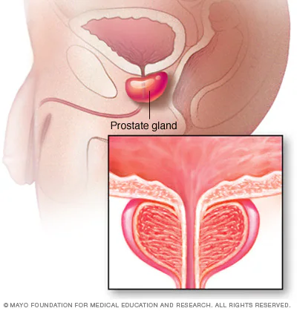

Slide 4
Anatomy of the Prostate Gland
• Peripheral Zone
  Located at the back (posterior) of the gland.
  Most common site for prostate cancer.
• Central Zone
  Surrounds the ejaculatory ducts.
  Plays an important role in sperm transport.

Slide 5
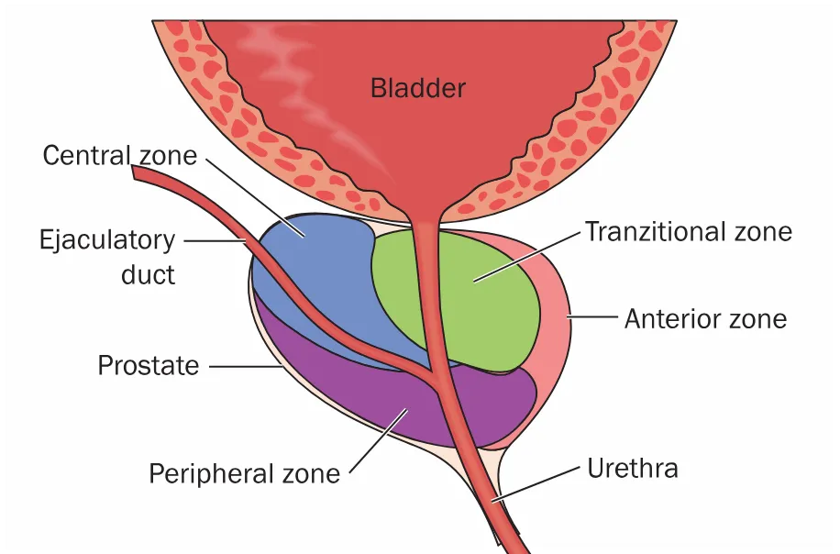

Slide 6
Continued
• Transitional Zone
  Surrounds the urethra.
  Primary site of Benign Prostatic Hyperplasia (BPH), a non-cancerous enlargement.
• Anterior Fibromuscular Stroma
  Contains mostly muscle and fibrous tissue.
  Provides structural support and surrounds the urethra.

Slide 8
Histology
The prostate is composed of:
• Glandular Tissue
  Contains numerous branched glands that produce and secrete prostatic fluid.
• Smooth Muscle Fibers & Fibrous Tissue
  Help propel prostatic secretions into the urethra during ejaculation.

Slide 9
Continued
Prostatic Fluid
Milky, alkaline secretion.
Contains enzymes, citric acid, lipids, and proteins.
Functions to:
  Enhance sperm motility and viability.
  Neutralize the acidic environment of the female reproductive tract.

Slide 10
Blood Supply
Arterial Supply
  Provided mainly by branches of the internal iliac arteries, especially:
    Inferior vesical artery
    Middle rectal artery
Venous Drainage
  Drains into the prostatic venous plexus.
  Eventually reaches the internal iliac veins, then systemic circulation.

Slide 11
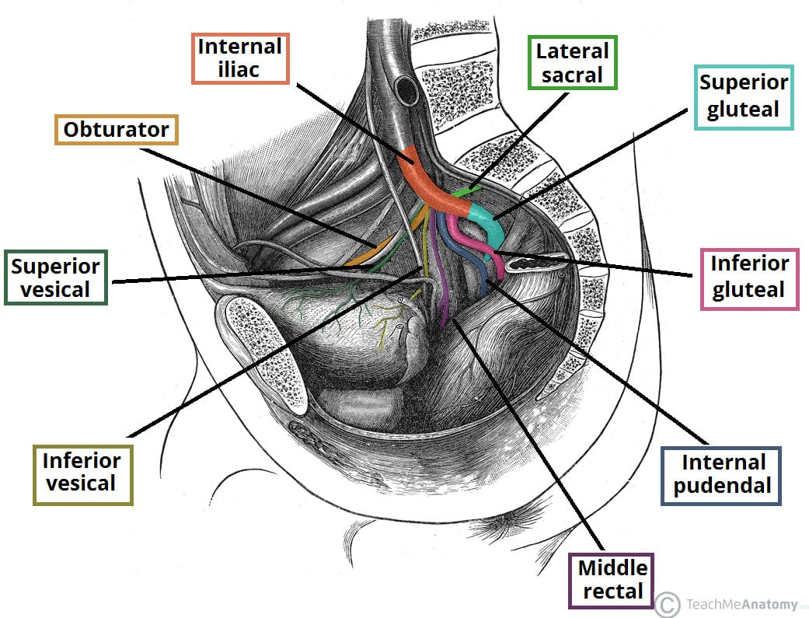

Slide 12
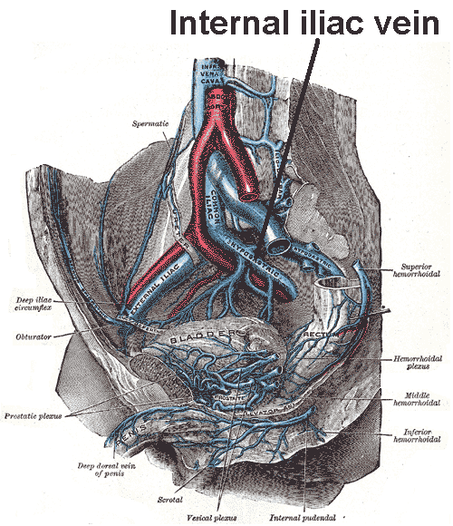

Slide 13
Innervation
The prostate receives autonomic nerve supply, including:
• Sympathetic Nerves
  Regulate smooth muscle tone within the prostate.
  Control contraction during ejaculation, essential for pushing prostatic fluid into the urethra.
• Parasympathetic Nerves
  Stimulate secretion of prostatic fluid, particularly during sexual arousal.

Slide 14
Functions of the Prostate
A. Production and Secretion of Prostatic Fluid
Main function is the creation of prostatic fluid, which forms a significant portion of the seminal fluid (ejaculate).

Slide 15
Continued
B. Support of Sperm Transport
Prostatic fluid:
  Nourishes sperm.
  Enhances mobility and viability.
  Helps ensure sperm survival in the female reproductive tract.

Slide 16
Continued
C. Contribution to Ejaculation Mechanism
The prostate aids in closing the bladder neck during ejaculation.
Prevents retrograde ejaculation (semen flowing backward into the bladder).

Slide 17


