Slide 1

GENERAL ANATOMY
BS RIT,MLT,OTT
1ST SEMESTER
DR DANISH

Slide 2
Anatomical Classification of Blood Vessels
Overview of Blood Vessels:
The circulatory system contains arteries, arterioles, capillaries, venules, and veins.
These vessels work together to:
  Transport blood.
  Deliver nutrients & oxygen.
  Remove waste products.
  Maintain blood pressure & tissue perfusion.

Slide 3
Arteries
Arteries are efferent vessels: they carry blood away from the heart.
They branch in a tree-like pattern, decreasing in diameter as they move away from the heart.
Two main types:
  Elastic arteries
  Muscular arteries

Slide 4
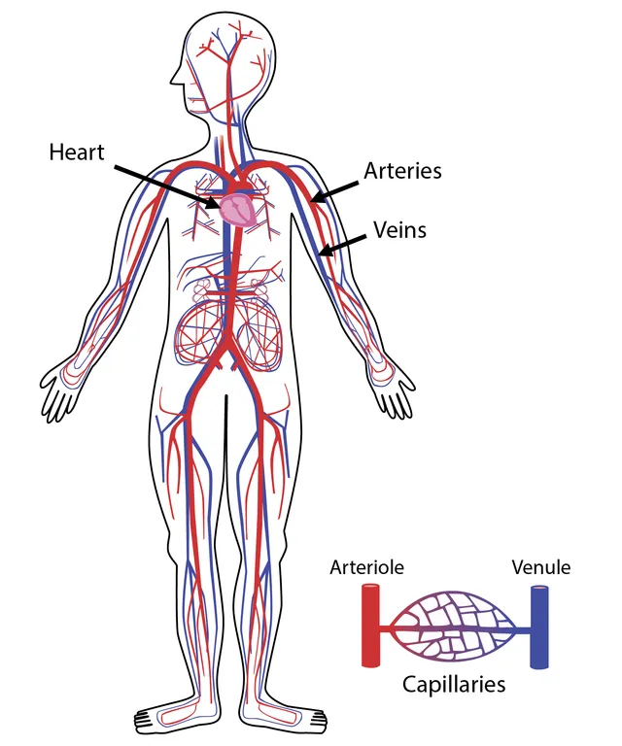

Slide 5
Elastic Arteries
Characterized by a tunica media rich in elastic connective tissue fibers.
Smooth muscle content is low compared to muscular arteries.
Large diameters: approx. 2.5 cm → 1 cm.
Also called large arteries.

Slide 6
Continued
Major elastic arteries:
  Aorta & pulmonary trunk.
  Main branches like brachiocephalic, common carotid, subclavian, common iliac.
  Right and left pulmonary arteries.
Function:
  Allow arteries to stretch and recoil, maintaining continuous blood flow during the cardiac cycle.

Slide 7
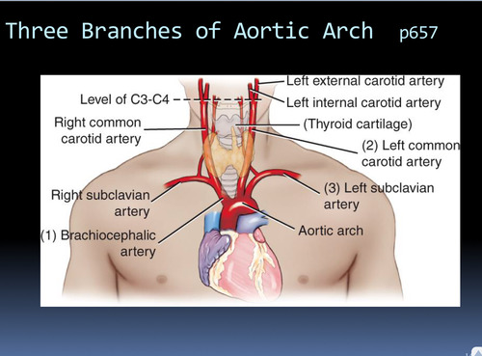

Slide 8
Muscular Arteries
Have a tunica media rich in smooth muscle cells.
Branches of large arteries.
Known as medium-sized arteries.
Diameter range: 10 mm to 0.1 mm.
Examples:
  Axillary, brachial, radial, ulnar arteries (upper limb)
  Femoral, popliteal, anterior & posterior tibial arteries (lower limb)
Function:
  Regulate blood flow by vasoconstriction & vasodilation.

Slide 9
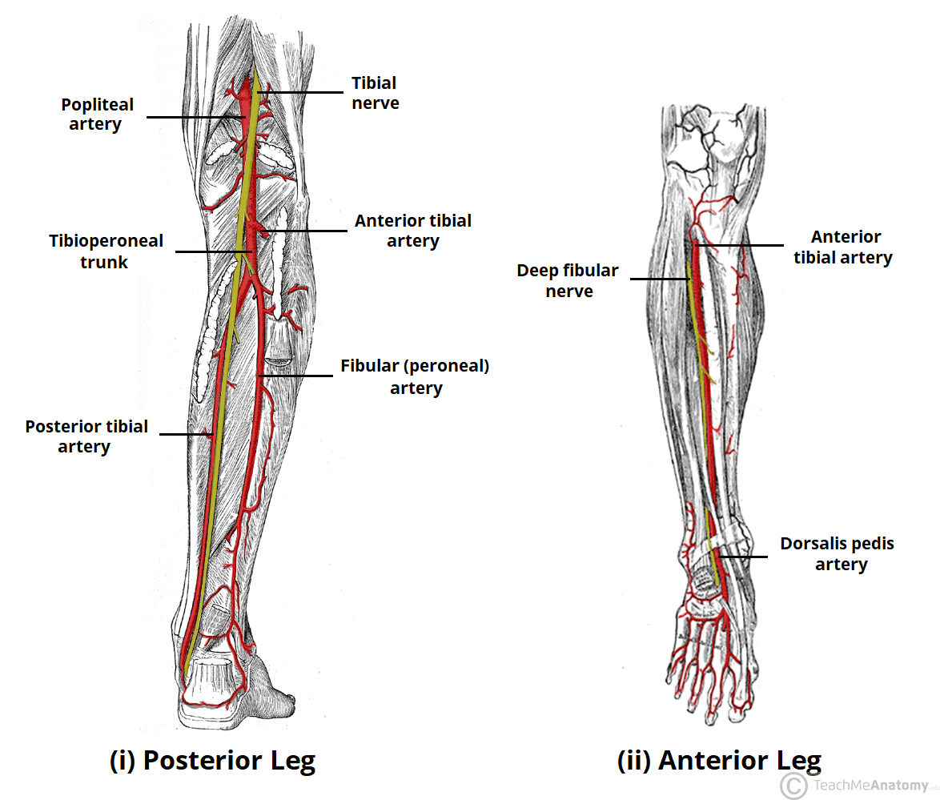

Slide 10
Arterioles
Smallest branches of muscular arteries.
Diameter: 100 μm to 10 μm.
Mark the beginning of microvasculature.
Structural features:
  Tunica intima: endothelium + thin connective layer.
  Larger arterioles: two layers of smooth muscle.
  Terminal arterioles: one layer of smooth muscle.
Terminal arterioles open into capillaries.

Slide 11
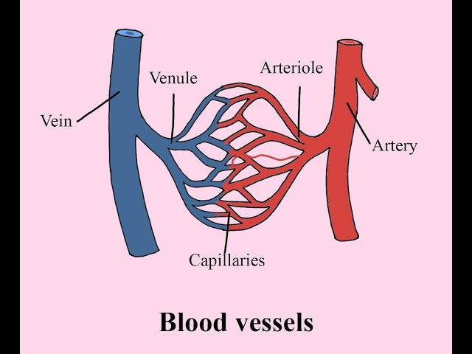

Slide 12
Functions of Arterioles
Narrow lumen + thick muscular wall enables strong control of blood flow.
Major functions:
  Provide 80% of total resistance to blood flow.
  Regulate tissue perfusion.
  Control blood flow into capillary beds>(a network of tiny blood vessels that connects arterioles to venules)
  Maintain body temperature by regulating blood flow to skin.
  Influence arterial blood pressure.

Slide 14
Capillaries
Smallest blood vessels forming interconnected networks (capillary beds).
Found in nearly every tissue of the body.
Diameter: 7–9 μm.

Slide 16
Continued
Structure:
  Endothelial tube.
  Basement membrane.
  Surrounded by pericytes (contractile cells).
Function:
  Exchange of gases, nutrients & wastes between blood and tissue.
  High surface area due to network arrangement

Slide 17
Types of Capillaries
1. Continuous Capillaries
Diameter: 7–9 μm.
No pores or gaps.
Found in muscles, lungs, and brain.

Slide 18
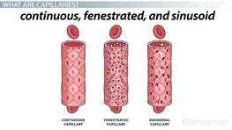

Slide 19
Continued
2. Fenestrated Capillaries
Possess pores (fenestrae) 60–80 nm in diameter.
Found in organs requiring rapid exchange (kidney, intestine, endocrine glands).

Slide 21
Continued
3. Sinusoidal Capillaries (Sinusoids)
Large lumen (30–40 μm).
Irregular, tortuous walls.
Large gaps between endothelial cells.
Found in liver, spleen, bone marrow, adrenal medulla.
Allow easy movement of cells & large molecules.

Slide 23
Metarteriole, Thoroughfare Channel & Precapillary Sphincters
Terminal arterioles branch into metarterioles.
Metarterioles have discontinuous smooth muscle.
They lead into thoroughfare channels, which drain into venules.
Precapillary sphincters:
  Circular smooth muscle at capillary entrances.
  Control blood entry into capillary beds.
  Important in thermoregulation and blood flow distribution.

Slide 24
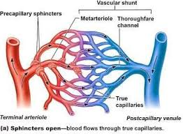

Slide 25
Venules
Receive blood from capillaries.
Two or more capillaries join to form a postcapillary venule.
Diameter: 10–30 μm.
Walls:
  Endothelium + thin adventitia.
  Allow passage of leukocytes during inflammation.

Slide 26
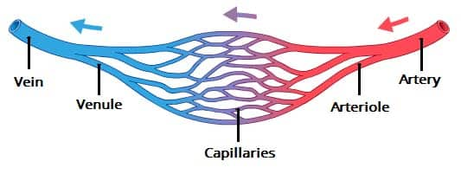

Slide 27
Veins
Venules join to form veins, which return blood to the heart.
Have large lumens, thin walls.
More collagen, fewer elastic & muscle fibers.

Slide 29
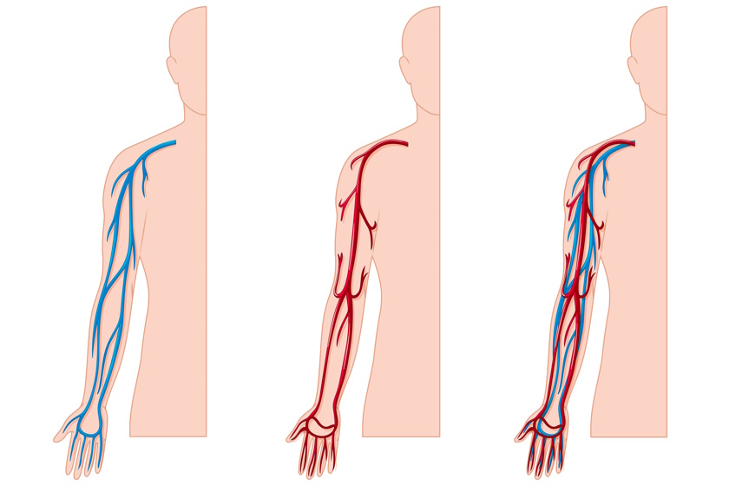

Slide 30
Continued
Classified into:
  Small veins
  Medium veins
  Large veins (e.g., vena cava, portal vein)
Many contain valves:
  Prevent backflow of blood.
  Especially numerous in limbs.
  Formed by folds of endothelium.

Slide 31
Venae Comitantes
Paired veins accompanying an artery.
Most common in limbs.
Connected by cross-connections.
Help arterial pulsations assist venous return.

Slide 32
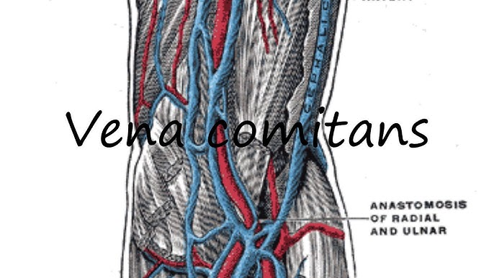

Slide 33
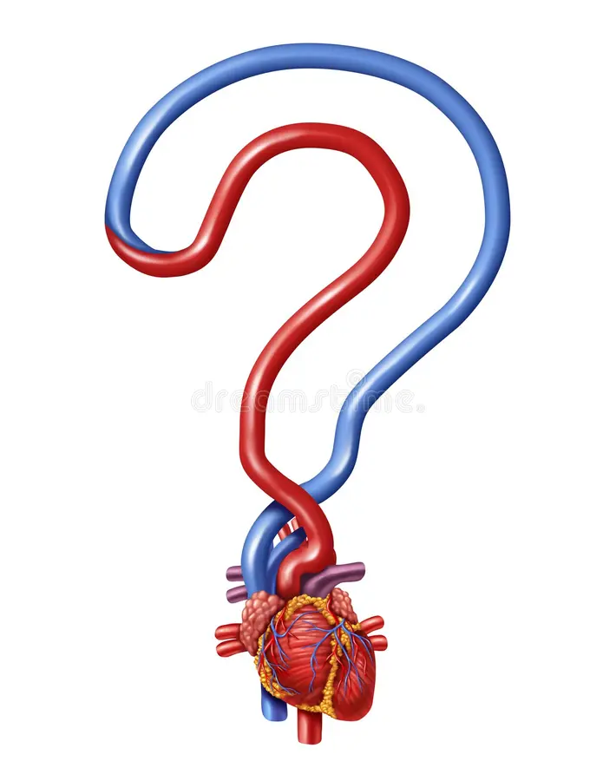

Slide 34
