Slide 1
Branches of Science
ADNAN RAMZAN
BS(PSY)

Slide 2
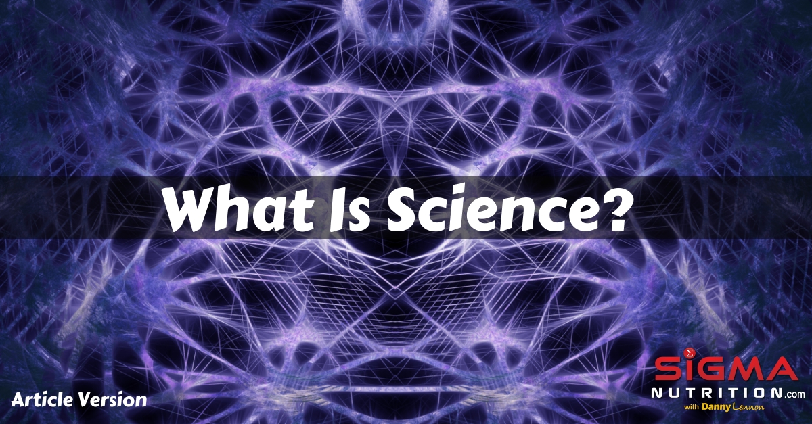

Slide 3
Science
Science is the systematic study of the natural world through observation, experiments, investigations, and reasoning.
Goals of Science
To gain knowledge and understand natural phenomena
To improve technology and solve problems
To make life easier and better
Notes:
Science = Knowledge of everything around us
→ Living + Non-living + Natural events
systematic study is an organized, planned, and methodical approach to learning or research,

Slide 4
Scientific method
observation
Questioning
Hypothesis
Analysis
Result

Slide 5
Major Branches of Science
Physics
Physics is the fundamental science studying matter, energy, force, and motion
Example: Electricity, motors, cars moving
Chemistry
Study of materials, their particles (atoms & molecules), and how they change.
Example: Rusting, cooking food, fuel burning
Biology
Study of living organisms and life processes.
Example: Plants, animals, human body systems
Notes:
Matter is anything that takes up space and can be weighed

Slide 6
Other Supporting Branches
Branch | What it studies | Example
Astronomy | Universe, stars, planets | Solar system
Geology | Earth's structure, rocks | Earthquakes
Zoology | Animals | Birds, fish
Botany | Plants | Photosynthesis
Microbiology | Microorganisms | Bacteria
Environmental Science | Ecosystems, pollution | Conservation
Notes:
Photosynthesis is the process plants, algae, and some bacteria use to turn light energy into chemical energy, creating food for themselves

Slide 7
What is Physics?
Physics is the branch of science that deals with matter, energy, and their interactions.
It explains:
Why objects move or stop
How light travels
How electricity works
How sound reaches our ears

Slide 8
Major Themes in Physics
Topic | What it means | Example
Mechanics | Motion & forces | Running, driving
Light (Optics) | Reflection, refraction | Mirrors, lenses
Sound & Waves | Sound production | Speakers, instruments
Heat (Thermodynamics) | Heat transfer | Cooking
Electricity | Electric current & circuits | Bulbs, TV
Magnetism | Magnetic forces | Compass
Energy | Ability to do work | Solar/wind energy

Slide 9
Branches of Physics
Classical Physics (motion, forces)
Modern Physics (atoms, space science)
Nuclear Physics (radioactivity)
Electronics (phones, computers)

Slide 10
Applications of Physics in Daily Life
Area | Use
Transport | Cars, trains, aircraft
Communication | Mobile phones, Internet
Medicine | X-ray, MRI, ECG
Home | Refrigerator, washing machine
Space | Satellites, rockets

Slide 11
Physics Experiments
Experiment 1 → Motion & Speed
Aim: Calculate speed of a toy car
Speed = Distance ÷ Time
Experiment 2 → Light Reflection
Shine torch on mirror → light changes direction
Experiment 3 → Magnet Attraction
Magnet attracts iron objects only
Conclusion: Magnetic force exists

Slide 12


