Slide 1

ANATOMY
BS OTT,MLT,RIT
1ST SEMESTER
DR DANISH

Slide 2
HEART
General Description
The heart is a cone-shaped, hollow, muscular organ located in the thoracic cavity.
Its primary function is to pump blood to different parts of the body.
It is a four-chambered organ consisting of:
  Two atria (receiving chambers)
  Two ventricles (pumping chambers)

Slide 3
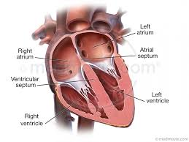

Slide 4
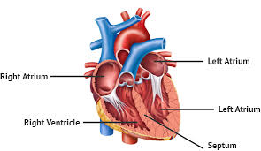

Slide 5
Right and Left Heart
Right Heart
Composed of:
  Right atrium
  Right ventricle
Right atrium
  Receives deoxygenated blood from:
    Superior vena cava
    Inferior vena cava
    Cardiac veins (draining the heart wall)

Slide 6
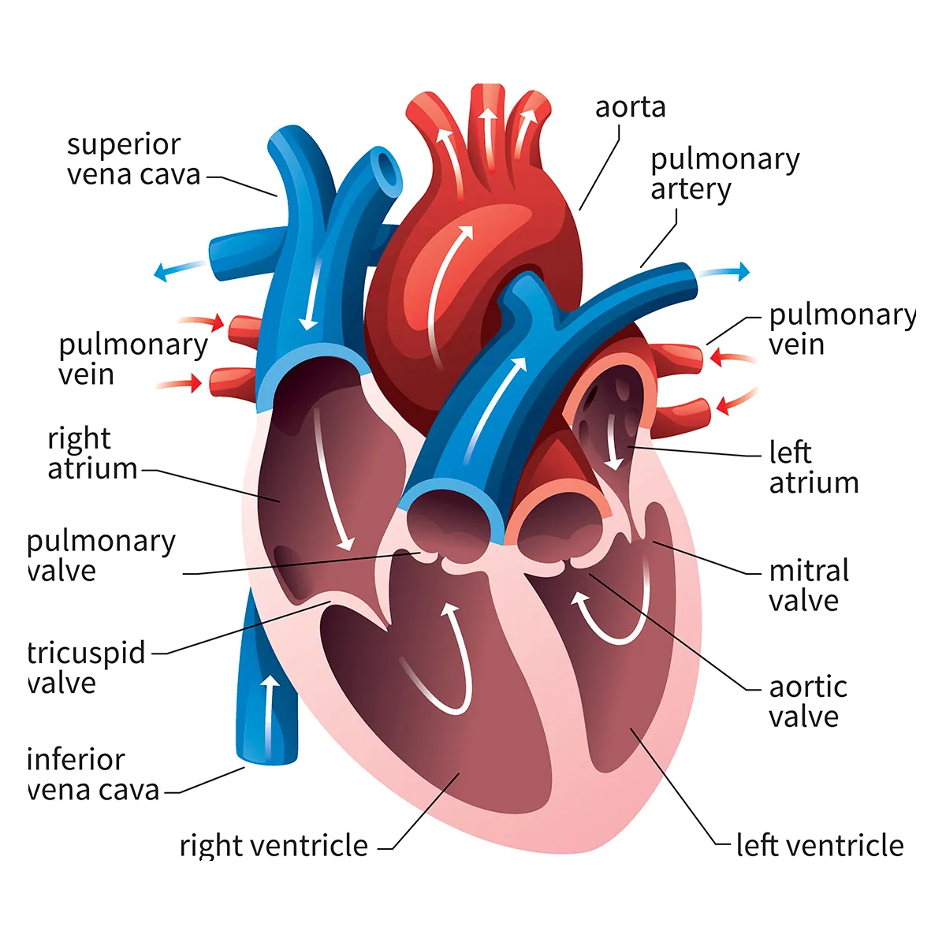

Slide 7
Continued
Blood then moves through the right atrioventricular orifice (guarded by the tricuspid valve) into the right ventricle.
Right ventricle
  Pumps blood into the pulmonary trunk, which divides into pulmonary arteries.
  Carries blood to the lungs for oxygenation.

Slide 9
Left Heart
Composed of:
  Left atrium
  Left ventricle
Left atrium
  Receives oxygenated blood from the lungs via four pulmonary veins.
Blood passes through the left atrioventricular orifice, guarded by the mitral (bicuspid) valve, into the left ventricle.
Left ventricle
  Pumps oxygenated blood into the aorta.
  Distributes blood to the entire body.

Slide 11
Structure of the Heart Wall
The heart wall consists of three layers:
Endocardium (Innermost Layer)
Myocardium (Middle Layer)
Epicardium (Outer Layer)

Slide 12
Endocardium (Innermost Layer)
Made of endothelium and subendothelial connective tissue.
Endothelium lines:
  Inner surface of the heart
  Blood vessels
  Lymph vessels

Slide 13
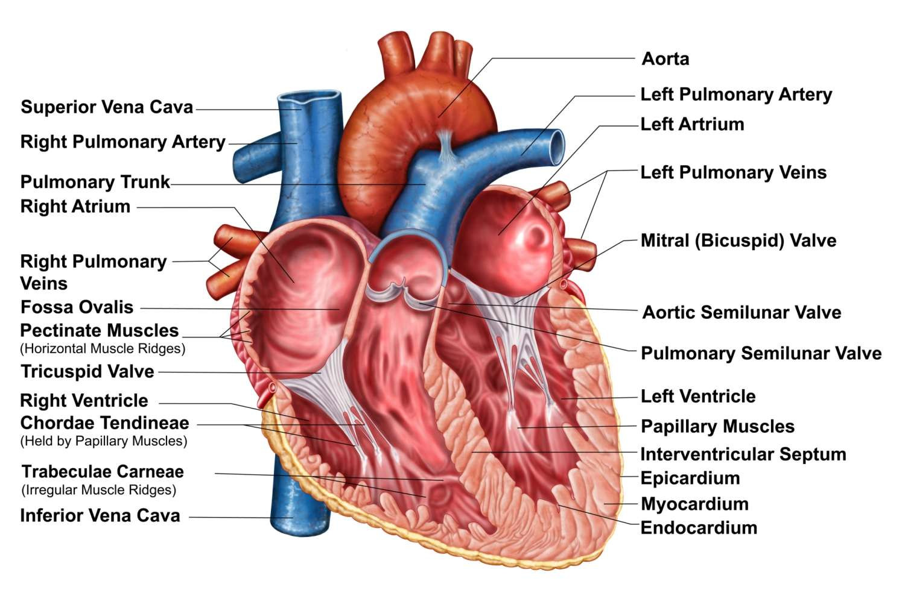

Slide 14
Myocardium (Middle Layer)
The thickest layer.
Composed of special striated cardiac muscle.
Responsible for:
  Rhythmic contraction and relaxation
  Pumping action of the heart

Slide 16
Epicardium (Outer Layer)
Outermost coat of the heart.
Made of:
  A layer of flat epithelial cells
  Thin connective tissue beneath

Slide 17
Blood Vessels
Blood vessels form a network of tubes that:
  Carry blood away from the heart
  Deliver it to tissues
  Return it back to the heart
Types include:
  Arteries
  Arterioles
  Capillaries
  Venules
  Veins

Slide 18
Structure of Blood Vessels
Most blood vessels contain three tunics (layers):
Tunica Intima
Tunica Media
Tunica Adventitia

Slide 19
Continued
Tunica Intima
Innermost layer
Made of:
  Endothelium
  Subendothelial connective tissue
Provides smooth lining for blood flow

Slide 20
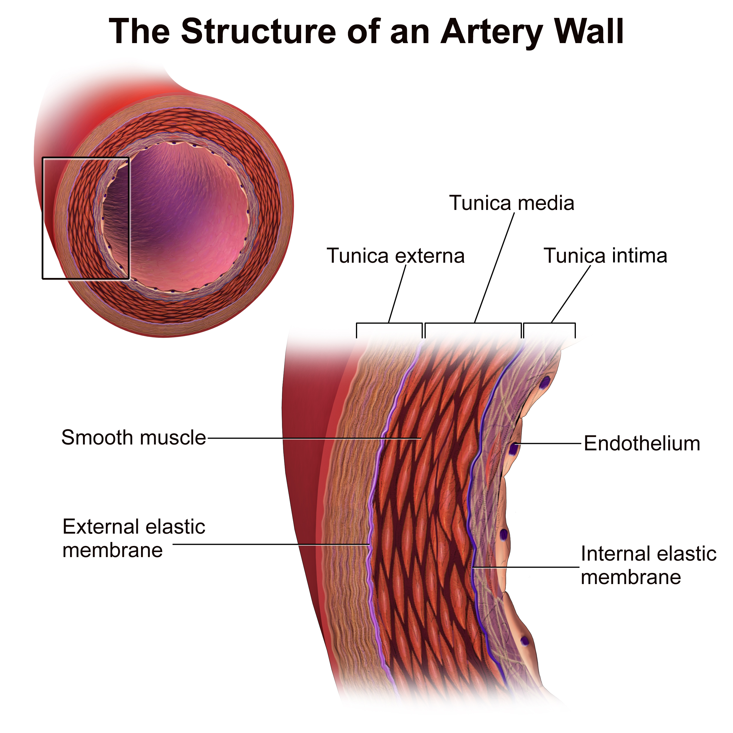

Slide 21
Continued
Tunica Media
Middle layer
Made of:
  Smooth muscle
  Elastic fibers
Regulates vessel diameter (vasoconstriction/vasodilation)

Slide 23
Continued
Tunica Adventitia
Outermost layer
Made of connective tissue
Provides structural support and protection to blood vessels

Slide 25
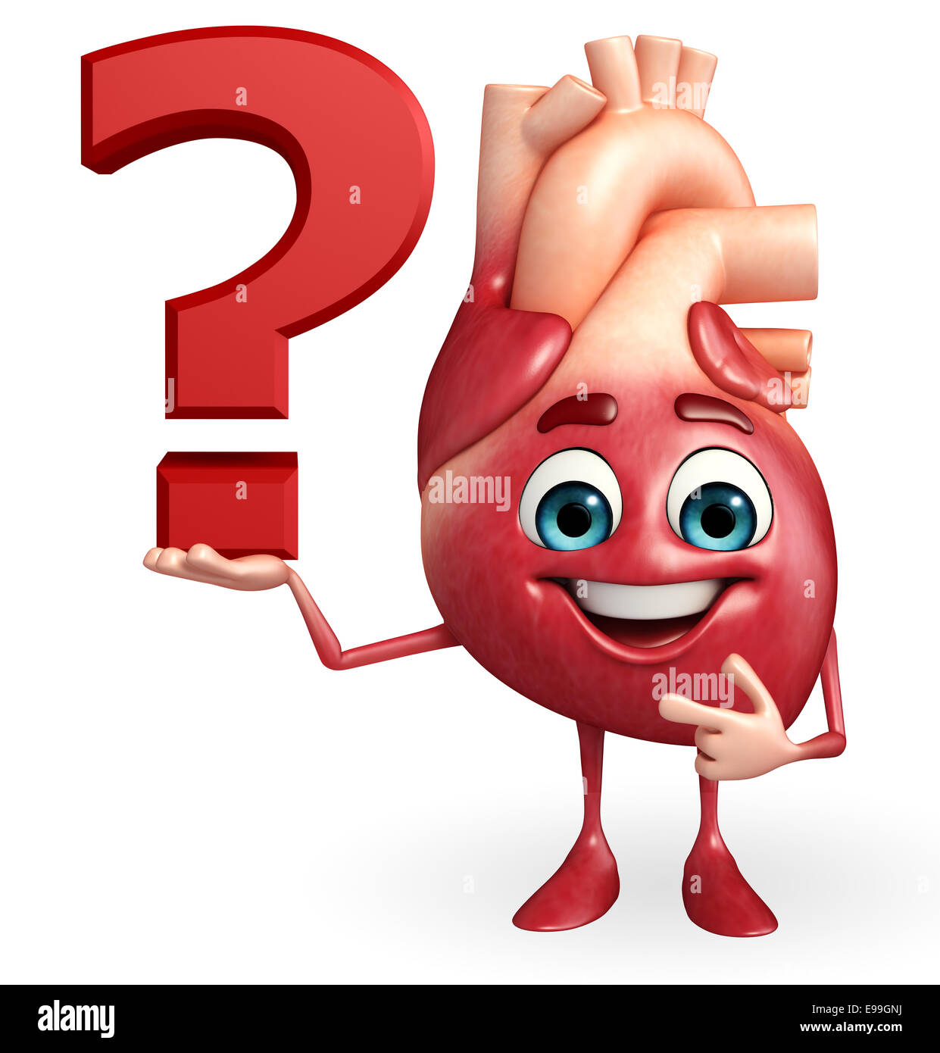

Slide 26
