Slide 1

PHYSIOTHERAPY TECHNIQUES I
FSC PT I
DR DANISH

Slide 2
Brachial Plexus Injury
Overview
The brachial plexus is a network of nerves from the spinal cord in the neck.
Controls muscles of the shoulder, elbow, wrist, and hand.
Also responsible for sensation in the arm.
Injuries can be:
  Minor → recover in weeks
  Severe → may cause permanent disability

Slide 3
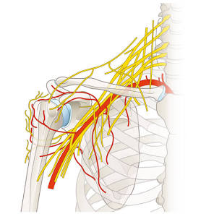

Slide 4
Causes
Stretching injuries:
  Occur when head and neck are forcefully separated from the shoulder (e.g., motorcycle or car accidents).
  Severe stretching can tear the nerves from the spinal cord.
Pressure injuries:
  Can result from crushing of the brachial plexus (e.g., during fracture/dislocation of collarbone or first rib).
  Swelling of nearby tissues may also compress nerves.
Cutting injuries:
  Occur due to trauma that directly severs nerve tissues.

Slide 5
Signs & Symptoms
Loss of muscle control in arm or hand.
Loss of sensation.
Signals between brain and arm disrupted.
Weakness, numbness, or paralysis depending on severity.

Slide 6
Types of Brachial Plexus Injuries
Erb’s Palsy
Damage to upper C5–C6 nerves.
Children may have partial or full paralysis of the arm.
Affected arm hangs by the side, cannot be fully raised.

Slide 7
CONTINUED
Klumpke’s Palsy
Damage to lower C8–T1 nerves.
Paralysis of forearm and hand muscles.
Often produces a “claw hand” appearance.

Slide 8
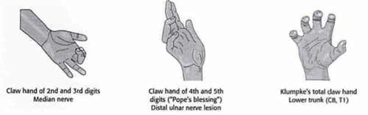

Slide 9
Diagnosing a Brachial Plexus Injury
Usually detected by a pediatrician or doctor when weakness is observed.
Diagnostic tests include:
  MRI
  EMG (electromyogram)
  NCS (nerve conduction study)
Determines the extent of nerve damage.

Slide 10
Treatment of Brachial Plexus Injuries
General Management
Many adult cases do not recover without treatment.
Early evaluation is important.
Joint stiffness must be prevented by movement.
If sensory nerves are affected, caution required to avoid burns or injuries.
Recovery depends on severity and location of injury.

Slide 11
Treatment Approaches
Surgery:
  Exploratory nerve surgery to improve function.
  Follow-up surgeries for persistent weakness.
Physical therapy:
  Daily exercises to keep limb flexible.
  Can begin soon after birth in infants.

Slide 12
Prognosis
Most injuries recover within 6 months.
About 10% result in permanent impairment.
May cause loss of sensation or full paralysis in severe cases.

Slide 13
Psychosocial Support
Children may need:
  Long-term therapy
  Emotional support
  Counseling for self-esteem issues

Slide 14
Radial Nerve Injury – Wrist Drop
Overview
Radial nerve runs along underside/back of arm.
Controls movement of the triceps, wrist, and fingers.
Damage causes radial neuropathy → “wrist drop”.

Slide 15
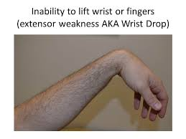

Slide 16
Causes
Humerus fracture.
Sleeping with upper arm in awkward position ("Saturday night palsy").
Leaning arm over a chair for long periods.
Alcohol-related nerve compression during sleep.
Using crutches.
Falls or blows to the arm.
Tight wrist accessories (bracelets, watches).

Slide 17
Symptoms
Sharp or burning pain.
Numbness or tingling.
Trouble straightening the arm.
Inability to extend wrist/fingers (“wrist drop” or “finger drop”).
Weak grip strength.

Slide 18
Treatment Options
Relieve symptoms while restoring movement.
Allow arm and hand use as much as possible.
Interventions include:
  Surgery to repair nerve or relieve compression.
  Braces or splints to support hand function.
  Physical therapy for muscle strength.
  Occupational/vocational therapy for workplace adjustments.

Slide 19
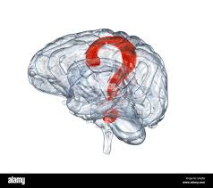

Slide 20


