Slide 1

BASIC MEDICAL SCIENCE
FSC MEDICAL TECHNOLOGIES I
DR DANISH

Slide 2
Parathyroid Gland
Parathyroid glands are small endocrine glands.
Located near or attached to the posterior surface of the thyroid gland.
Typically four in number, but the count may vary.
Classified based on position:
  Superior (upper) parathyroid glands
  Inferior (lower) parathyroid glands
Play a crucial role in calcium homeostasis by secreting parathyroid hormone (PTH).

Slide 3
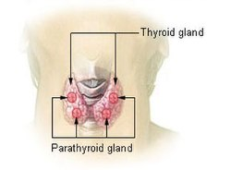
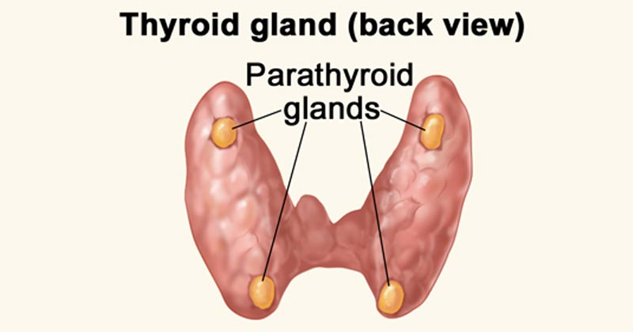

Slide 4
Anatomy of the Parathyroid Glands – Structure
Each gland is small, oval-shaped, reddish-brown.
Size is usually similar to a grain of rice.
May vary in number—some individuals have more or fewer than four.
Mostly located on the posterior surface of the thyroid, but ectopic locations can occur.

Slide 6
Blood Supply
Supplied by branches of the inferior thyroid arteries.
Arterial blood enters through multiple small vessels, ensuring oxygen and nutrient supply.
Venous drainage occurs through parathyroid veins, draining into internal jugular veins.

Slide 7
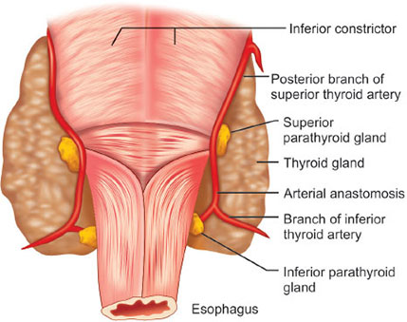

Slide 8
Histology
Composed of two main cell types:
Chief (principal) cells
Oxyphil cells
Chief cells:
Synthesize and secrete parathyroid hormone (PTH).
Play a key role in calcium regulation.

Slide 9
Continued
Oxyphil cells:
Larger, eosinophilic cells.
Function unclear—may act as reserve cells or have other unknown roles.

Slide 10
Innervation
Innervated by sympathetic nerve fibers from the autonomic nervous system.
Exact role of innervation is uncertain.
Sympathetic stimulation may modulate hormone secretion and glandular activity.

Slide 11
Functions
Regulate calcium in the body.
Acts on bones,kidneys and intestines to increase calcium level in blood when they are low.
Stimulates osteoclasts activity in bones ,enhancing bone resorption & release Ca+ into bloodstream.
Promote th eproduction of vitamin active vitamin D.

Slide 12


Slide 13


