Slide 1

BASIC MEDICAL SCIENCE
FSC MEDICAL TECHNOLOGIES I
DR DANISH

Slide 2
The Thyroid Gland
Introduction:
Definition:
  The thyroid gland is a butterfly-shaped endocrine gland located in the lower front part of the neck.
Main Function:
  Produces hormones that regulate metabolism, body temperature, and energy use.
Example:
  When your thyroid works faster (hyperthyroidism), you may feel hot, anxious, and lose weight quickly due to increased metabolism.

Slide 3
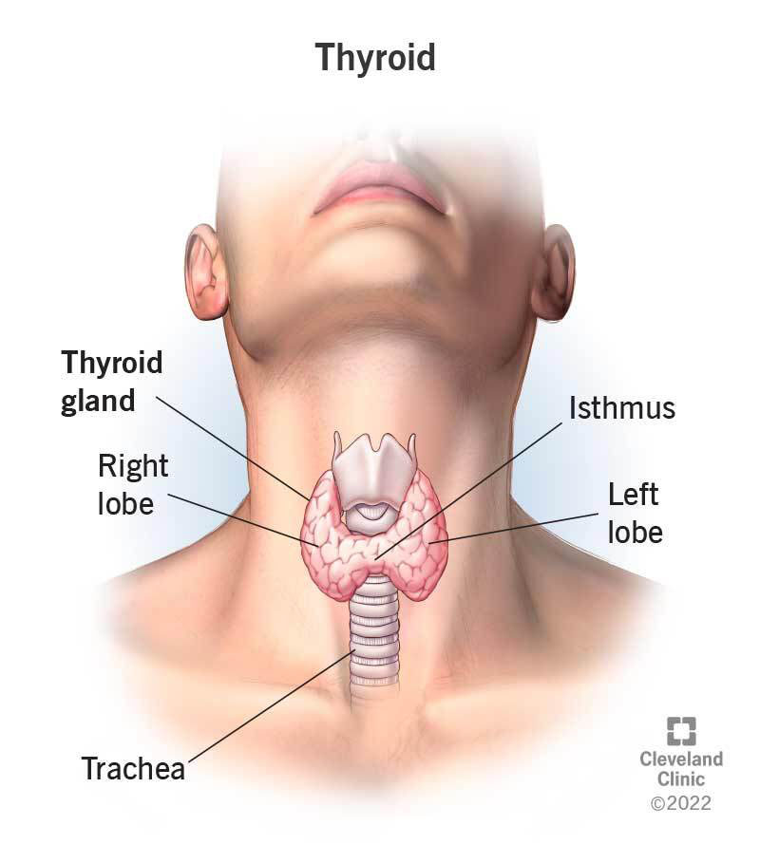

Slide 4
Anatomy of the Thyroid Gland
Location:
  Lies in front of the trachea, just below the voice box (larynx).
Structure:
  Two lobes (right & left) connected by a central part called the isthmus.
Blood Supply:
  Rich blood supply from superior and inferior thyroid arteries.
Example:
  Because of high blood flow, thyroid surgery requires careful techniques to prevent bleeding.

Slide 5
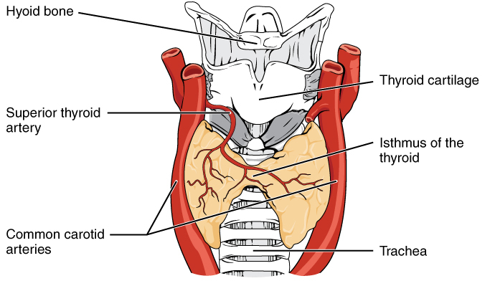

Slide 6
Thyroid Hormones
Major Hormones Produced:
  T3 (Triiodothyronine) – more active hormone
  T4 (Thyroxine) – more abundant but needs conversion to T3
  Calcitonin – helps regulate calcium levels
Example:
  Low T3/T4 levels slow down metabolism, causing fatigue, weight gain, and cold intolerance.

Slide 7
Blood & Nerve Supply of the Thyroid Gland
1. Superior Thyroid Artery
First branch of the external carotid artery.
Descends to upper pole of the thyroid gland.
Supplies: Upper part of both lobes and the isthmus.
Example:
  During thyroid surgery, ligating this artery too close to the gland may injure the external laryngeal nerve—affecting high-pitched voice.

Slide 9
Continued
2. Inferior Thyroid Artery
Branch of the thyrocervical trunk (from subclavian artery).
Reaches the posterior part of the thyroid.
Supplies: Majority of the gland’s lower portions.
Example:
  Close anatomical relation to recurrent laryngeal nerve makes careful dissection essential to avoid hoarseness after surgery.

Slide 10
Nerve Supply of the Thyroid Gland
A. Sympathetic Innervation
Derived from cervical sympathetic ganglia:
  Superior cervical ganglion
  Middle cervical ganglion
  Inferior (stellate) cervical ganglion
Function:
  Regulates blood flow—not hormone secretion.
Example:
  Increased sympathetic activity constricts thyroid blood vessels.

Slide 11
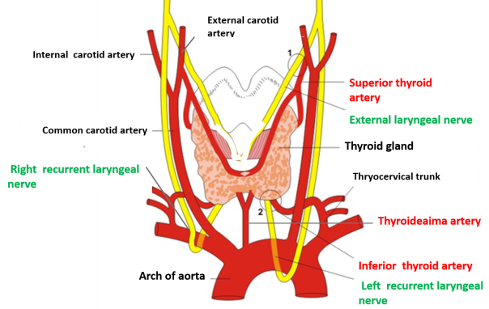

Slide 12
Continued
B. Parasympathetic Innervation
From the vagus nerve (CN X) via laryngeal branches.
Provides some vasomotor control.

Slide 13


Slide 14


