Slide 1
ANATOMY
BS RIT,OTT,MLT
1ST SEMESTER
DR DANISH

Slide 2

1. Naming of Muscles
a. Shape
Muscles are often named by the shape they resemble.
Examples:
  Deltoid → triangular like the Greek letter delta (Δ)
  Serratus → saw-toothed appearance
  Rhomboid → shaped like a rhombus

Slide 3
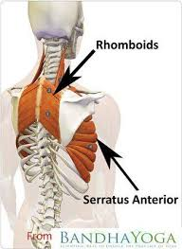
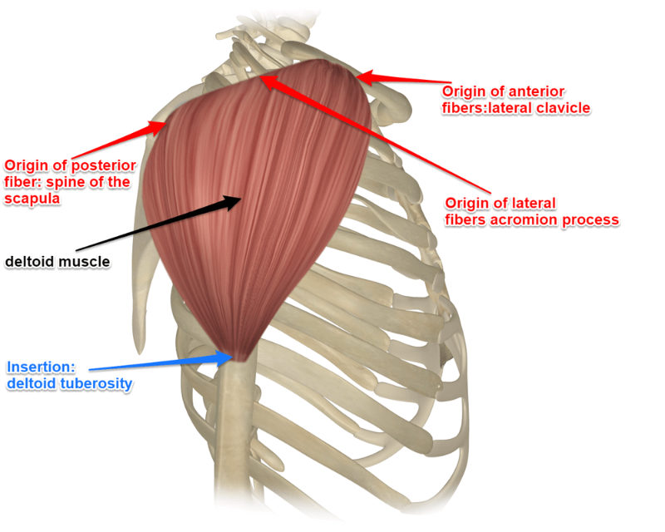

Slide 4
CONTINUED
b. Size
Names may indicate the muscle’s size.
Examples:
  Gluteus maximus → the largest gluteal muscle
  Gluteus minimus → the smallest
  Extensor digitorum longus → long muscle extending digits

Slide 5
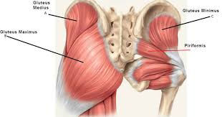

Slide 6
Continued
c. Location or Position
Indicates where the muscle is found.
Examples:
  Tibialis anterior → in front of the tibia
  Interosseous muscles → located between bones

Slide 7
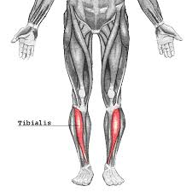

Slide 8
Continued
d. Attachments (Origin & Insertion)
Named after bones or structures they attach to.
Examples:
  Sternohyoid → from sternum to hyoid
  Sternocleidomastoid → attaches to sternum, clavicle, and mastoid process

Slide 9
Continued
e. Action
Named based on what they do.
Examples:
  Extensor digitorum → extends fingers
  Adductor pollicis → adducts the thumb

Slide 10
Continued
f. Number of Heads
Some muscles have multiple origins.
Examples:
  Biceps brachii → 2 heads
  Triceps brachii → 3 heads

Slide 11
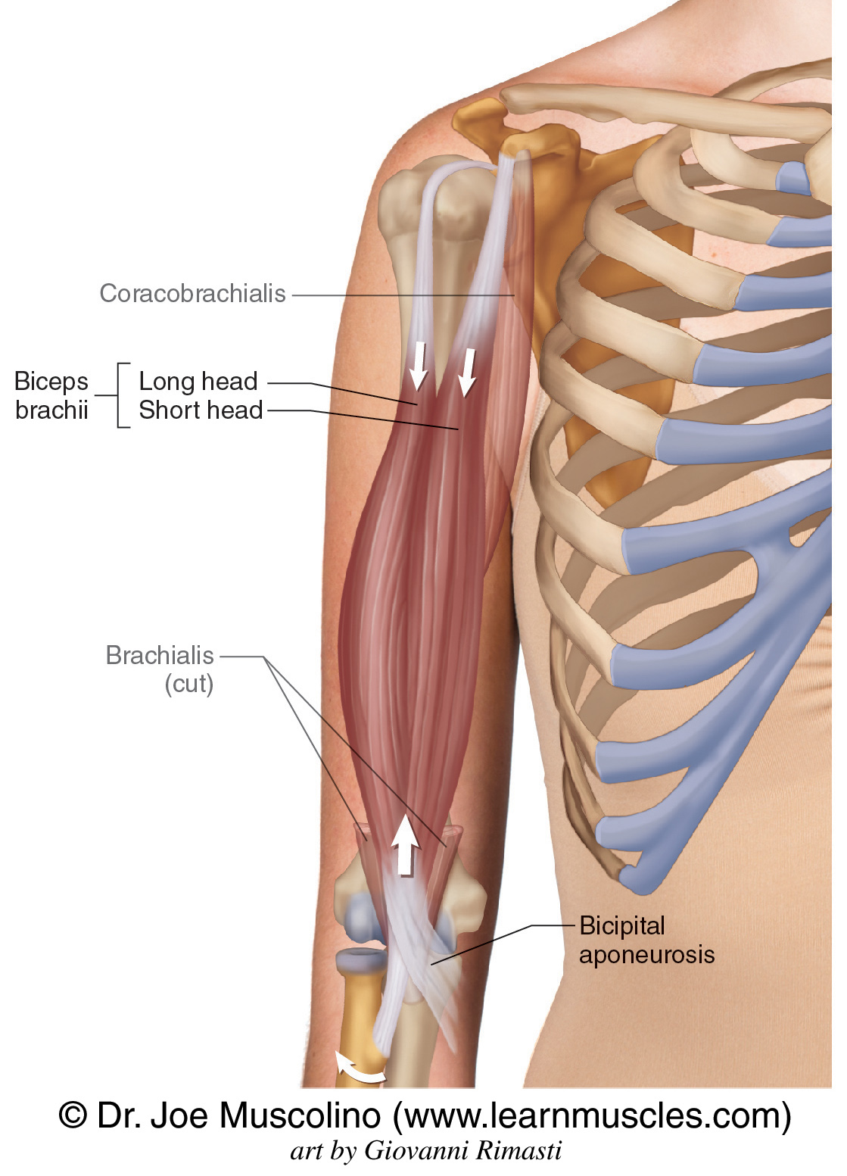
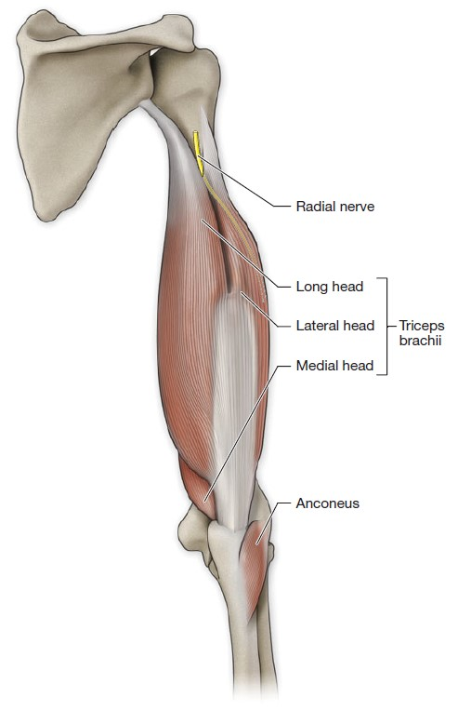

Slide 12
Continued
g. Direction of Fibers
Based on fiber orientation.
Examples:
  Transversus abdominis → fibers run horizontally
  Obliques → fibers run diagonally

Slide 13
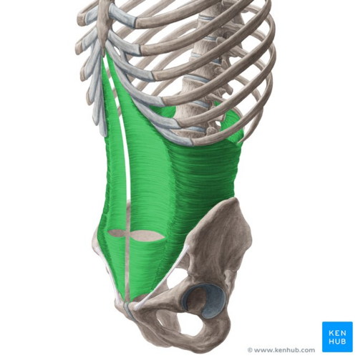

Slide 14
2. Blood Supply of Skeletal Muscle
Muscles receive blood from muscular branches of nearby arteries.
Each muscle usually has:
  One main artery entering through a neurovascular hilum
  This artery travels with a vein and nerve
Accessory arteries may also supply ends of muscles.
Inside the muscle:
  Arteries branch through connective tissue
  Smaller arterioles supply individual muscle fibers

Slide 15
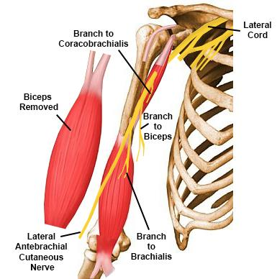
Continued
Example:
The biceps brachii is mainly supplied by the brachial artery, which sends smaller branches into the muscle belly.

Slide 16
3. Nerve Supply of Skeletal Muscle
Most skeletal muscles are controlled voluntarily by the brain.
Motor nerves bring:
  Motor fibers → cause contraction
  Sensory fibers → give information about stretch (proprioception)
Muscle spindles and Golgi tendon organs help regulate muscle tone and prevent injury.

Slide 17
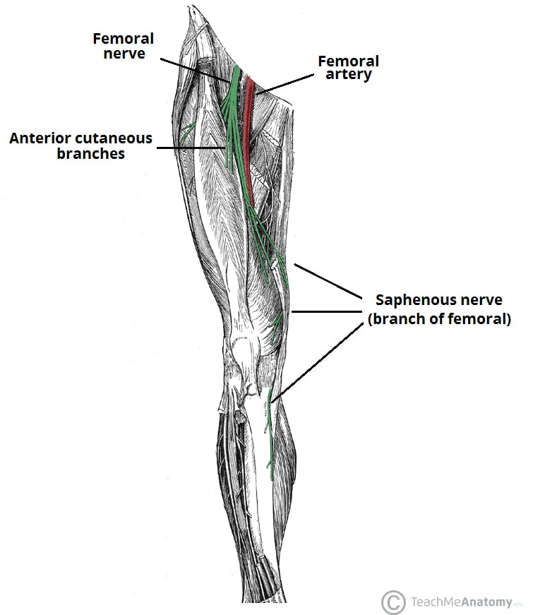
Continued
Example:
The quadriceps femoris receives motor supply from the femoral nerve.

Slide 18
4. Types of Muscle Contraction
a. Phasic Contractions
Used for active movements.
Isometric contraction
  Muscle length does not change; tension increases.
  Example: holding a heavy bag without moving your arm.

Slide 19
Continued
Isotonic contraction
  Muscle changes length.
  Concentric: muscle shortens
    Example: lifting a dumbbell (biceps curl upward).
  Eccentric: muscle lengthens
    Example: slowly lowering a dumbbell.

Slide 20
Continued
b. Reflexive Contraction
Automatic (not under conscious control).
Examples:
Contraction of diaphragm during breathing
Knee jerk reflex when patellar tendon is tapped

Slide 21
5. Clinical Notes
a. Muscle Paralysis
Paralysis → loss of muscle power
Types:
  Hemiplegia: paralysis of one side of body
  Paraplegia: paralysis of lower limbs
  Quadriplegia: paralysis of all four limbs
  Paresis: partial weakness
  Hemiparesis: weakness on one side of the body

Slide 22
Continued
b. Muscle Strain & Muscle Spasm
Muscle strain → overstretching causing fiber tear
  Example: sudden sprinting causes hamstring strain
Muscle spasm → involuntary, painful contraction
  Example: calf cramp during dehydration

Slide 23


Slide 24


