Slide 1

BASIC MEDICAL SCIENCE
FSC MEDICAL TECHNOLOGIES I
DR DANISH

Slide 2
Endocrine System
OVERVIEW:
The endocrine system is a network of glands in the body that produce and release hormones.
These hormones travel through the bloodstream and regulate various functions such as growth, metabolism, reproduction, mood, and homeostasis. It helps maintain the body's internal balance and coordinates long-term processes.

Slide 3
Major Endocrine Glands
Pituitary gland
Thyroid gland
Parathyroid gland
Adrenal gland
Hormones of testis
Prostate
Ovaries
Pancreas and thymus

Slide 4
PITUITARY GLAND
Overview
Also known as the hypophysis.
Small, pea-sized gland located at the base of the brain, just below the hypothalamus.
Situated in the sella turcica of the sphenoid bone.
Often called the “master gland” because it regulates several physiological processes.
Controls other endocrine glands and influences:
  Growth
  Metabolism
  Reproduction
  Stress response

Slide 5
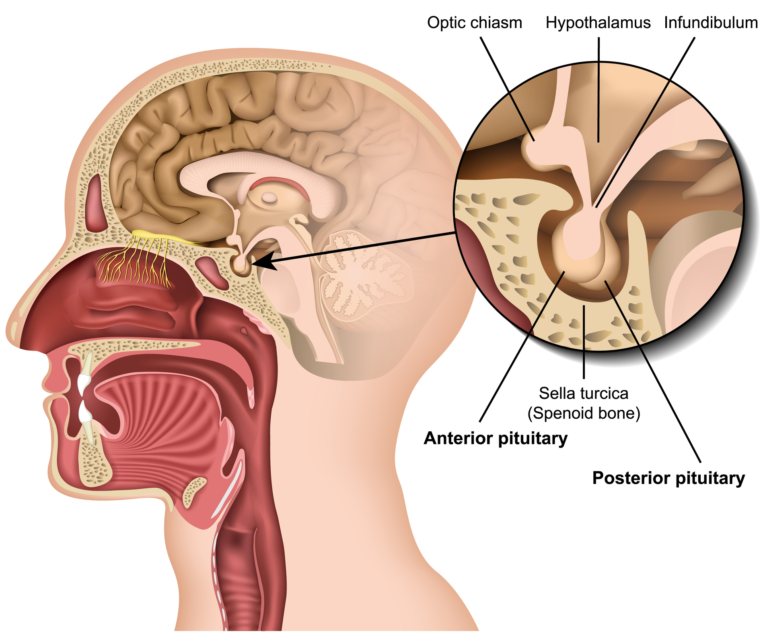

Slide 6
Anatomy of the Pituitary Gland
1. Structure
Consists of two distinct lobes:
  Anterior pituitary (Adenohypophysis)
  Posterior pituitary (Neurohypophysis)
Lobes differ in:
  Embryonic origin
  Structure
  Function

Slide 7
2. Anterior Pituitary (Adenohypophysis)
General Features
Larger portion, ~80% of total gland weight.
Composed of glandular tissue.
Contains different cell types that secrete specific hormones.

Slide 8
CONTINUED
Subdivisions
Pars distalis (largest and most important region)
Pars intermedia
Pars tuberalis

Slide 9
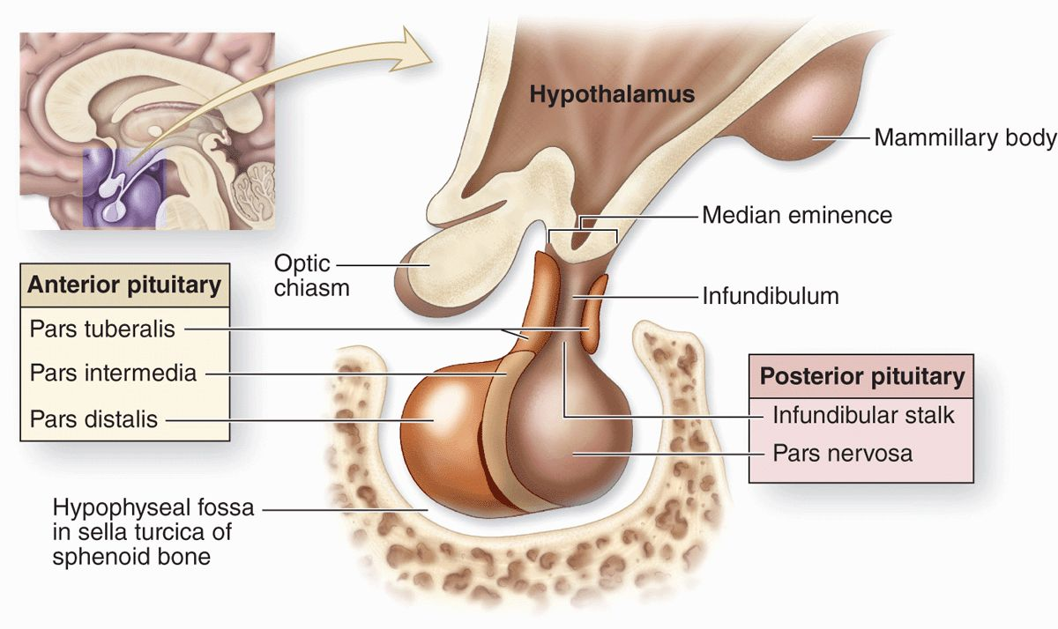

Slide 10
Hormones Secreted
Growth hormone (GH)
Thyroid-stimulating hormone (TSH)
Adrenocorticotropic hormone (ACTH)
Follicle-stimulating hormone (FSH)
Luteinizing hormone (LH)
Prolactin (PRL)

Slide 11
Posterior Pituitary (Neurohypophysis)
Small, compact structure made mainly of nerve fibers & neuroglial cells.
Does not synthesize hormones; it stores & releases two peptide hormones made by the hypothalamus: oxytocin & vasopressin (ADH).
Oxytocin: triggers uterine contractions during childbirth & milk ejection during breastfeeding.

Slide 12
CONTINUED
Vasopressin (ADH): regulates water reabsorption in kidneys, maintaining water balance & blood pressure.

Slide 13
Pituitary Stalk & Infundibulum
The pituitary gland connects to the hypothalamus via a stalk‑like structure called the pituitary stalk or infundibulum.
The stalk contains blood vessels & nerve fibers that link the hypothalamus to the posterior pituitary, allowing transport of neurohormones produced by the hypothalamus.
It acts as a conduit for releasing & inhibiting hormones synthesized in the hypothalamus to reach the anterior pituitary, regulating its hormone secretion.

Slide 15
Blood Supply
The pituitary receives blood from two main arteries: superior hypophyseal artery & inferior hypophyseal artery.
Superior hypophyseal artery: branches from the internal carotid artery; supplies the median eminence & upper pituitary stalk.
Inferior hypophyseal artery: branches from the cavernous segment of the internal carotid artery; supplies the posterior pituitary & lower pituitary stalk.

Slide 16
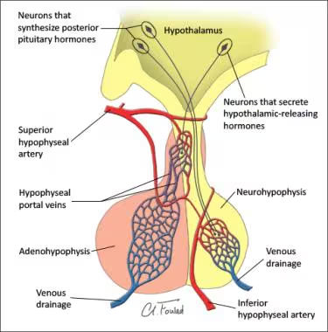

Slide 17


Slide 18


