Slide 1

GENERAL ANATOMY
DPT
1ST SEMESTER
DR DANISH

Slide 2
Classification of Skeletal Muscles
1. Classification Based on Shape
2. Classification Based on Group Action

Slide 3
A. Fusiform Muscles
Description: Thick in the middle, tapered at both ends.
Features: Fibers run parallel to the length of the muscle → good for rapid movement.
Examples:
  Biceps brachii
  Sartorius

Slide 4
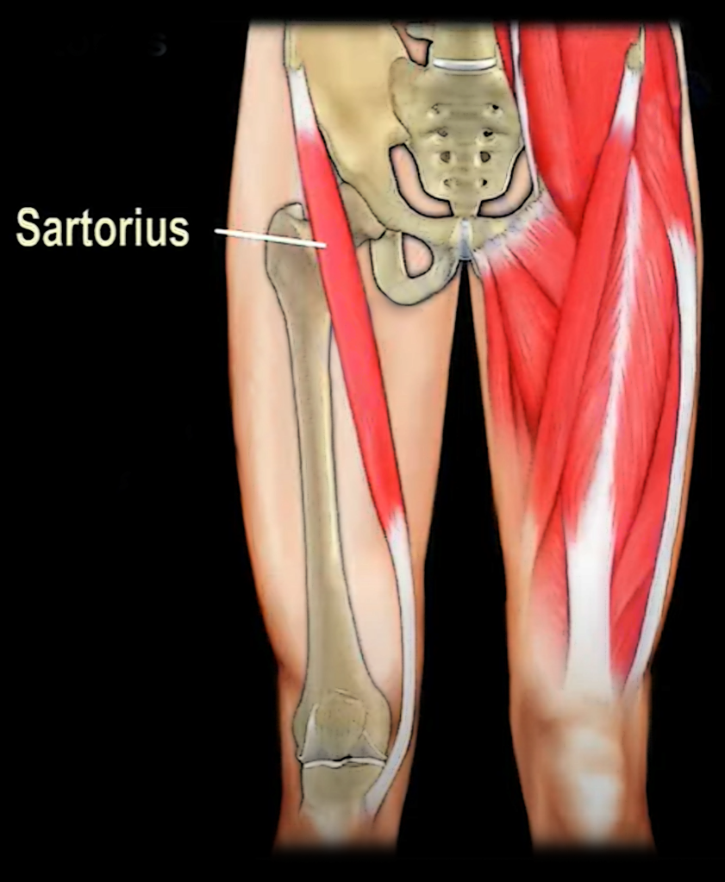
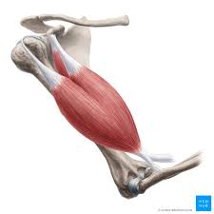

Slide 5
B. Pennate Muscles
Description: Muscle fibers attach obliquely to a central tendon (like a feather).
Types:
  Unipennate: Fibers on one side of tendon – e.g., extensor digitorum longus
  Bipennate: Fibers on both sides – e.g., rectus femoris
  Multipennate: Multiple tendon branches – e.g., deltoid
Function: High power output due to more fibers packed in smaller area.

Slide 6
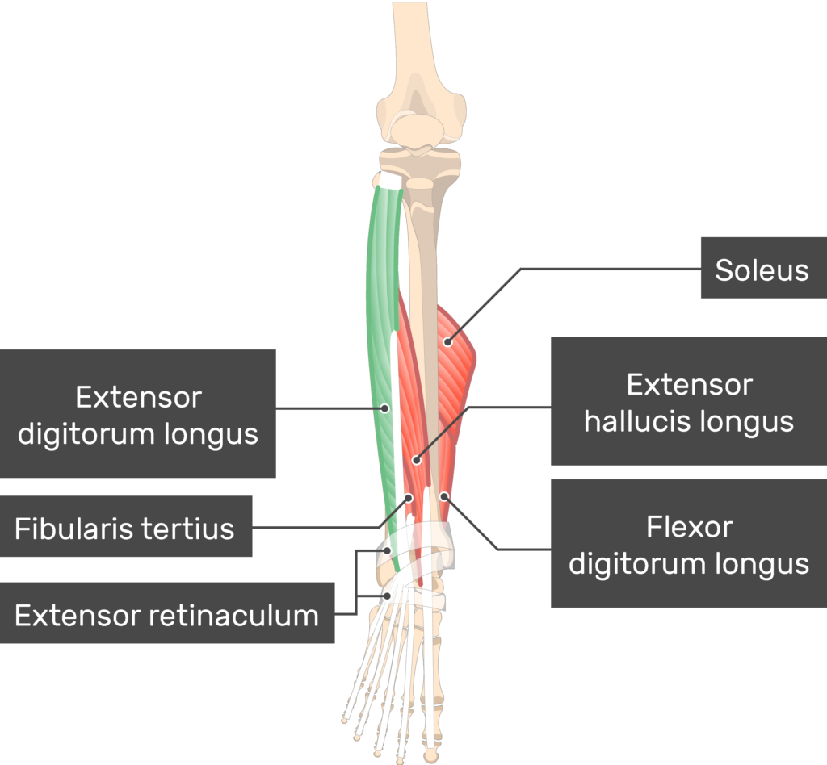
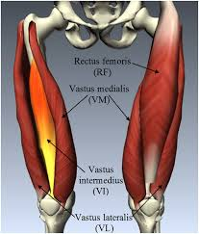
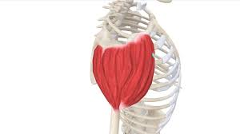

Slide 7
C. Parallel Muscles
Description: Fibers run parallel to long axis; uniform thickness.
Features: Produce greater range of motion.
Examples:
  Sternocleidomastoid
  Rectus abdominis

Slide 8
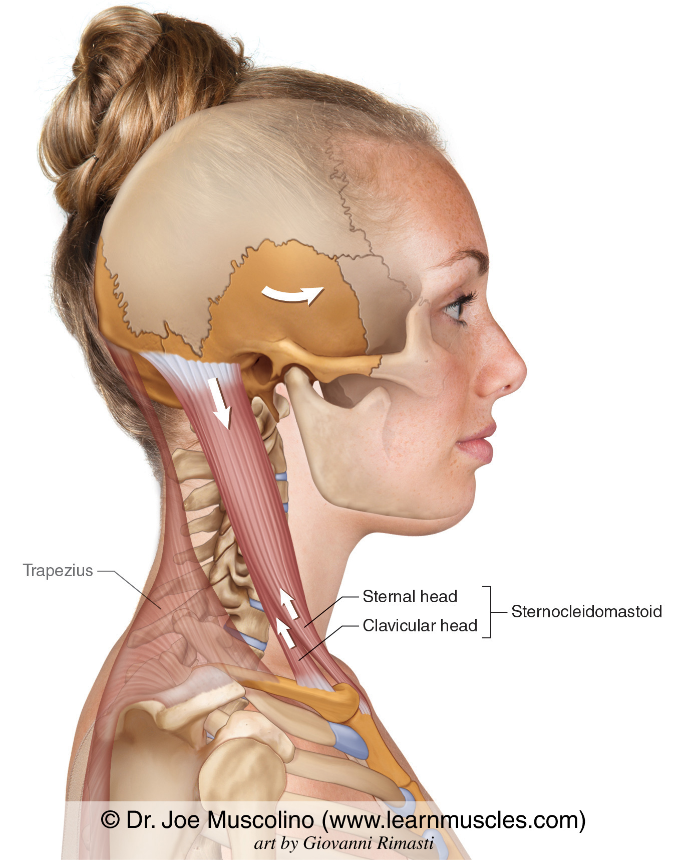

Slide 9
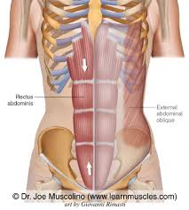

Slide 10
D. Triangular (Convergent) Muscles
Description: Broad origin narrowing to a single tendon.
Features: Can generate powerful pulls in varied directions.
Example:
  Pectoralis major

Slide 11
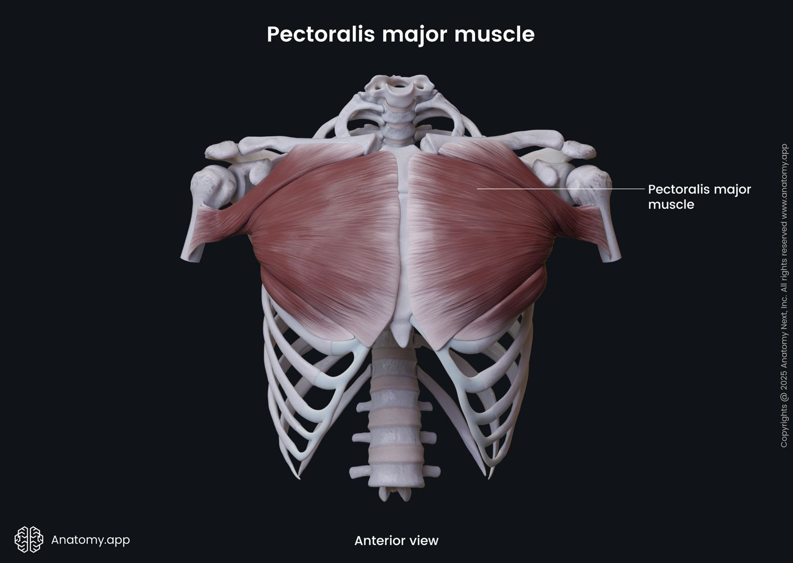

Slide 12
E. Circular (Sphincter) Muscles
Description: Fibers arranged concentrically around openings.
Function: Close or open body orifices.
Examples:
  Orbicularis oculi
  Orbicularis oris

Slide 13
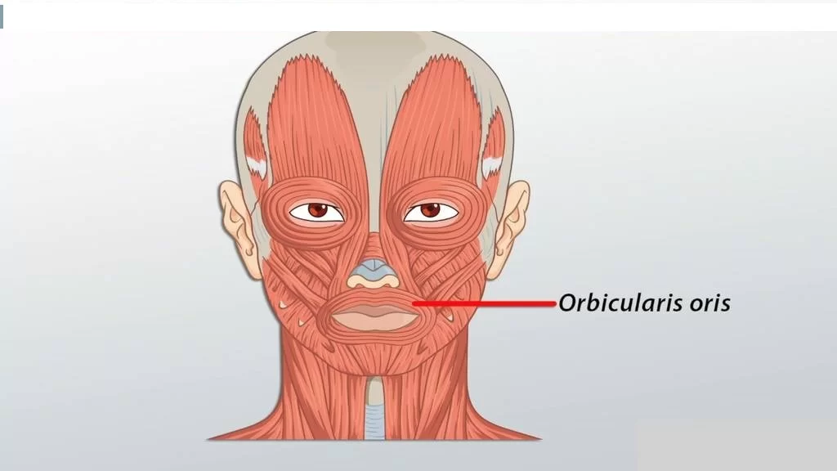

Slide 14
F. Spiral Muscles
Description: Fibers twist between origin and insertion.
Example:
  Supinator muscle

Slide 15
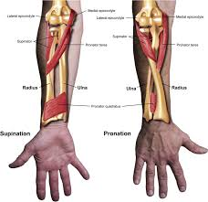

Slide 16
G. Quadrate (Square-shaped) Muscles
Description: Four-sided, flat muscles.
Example:
  Quadratus lumborum
  Pronator quadratus

Slide 17
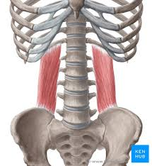

Slide 18
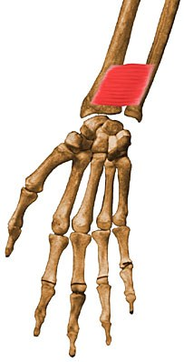

Slide 19
2. Classification Based on Group Action
A. Agonist (Prime Mover)
Role: Main muscle responsible for producing a specific movement.
Example:
  Biceps brachii → prime mover for elbow flexion.

Slide 20
B. Antagonist
Role: Produces the opposite action of agonist; relaxes when agonist contracts.
Example:
  Triceps brachii → antagonist during elbow flexion.

Slide 21
C. Synergist
Role: Assists the prime mover by stabilizing nearby joints or adding force.
Example:
  Brachialis and brachioradialis assist biceps in elbow flexion.

Slide 22
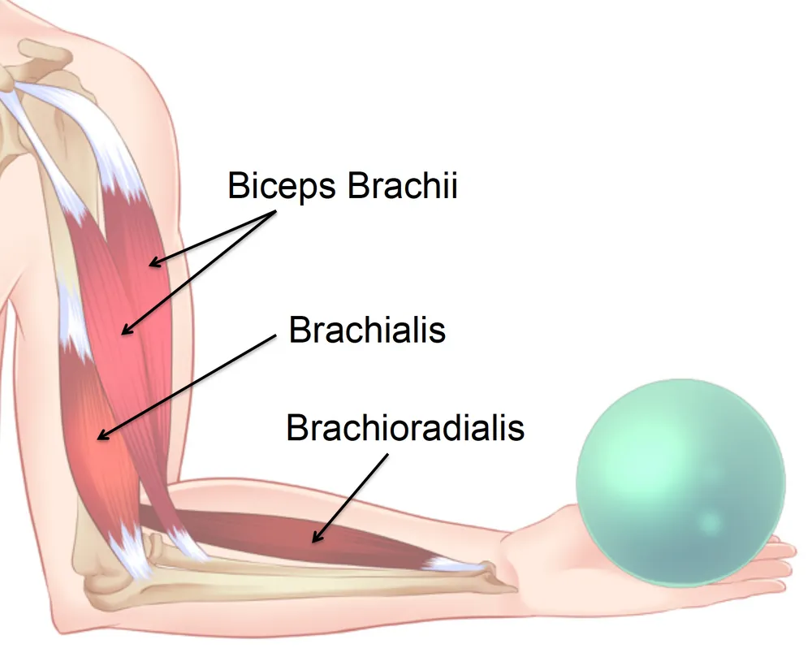

Slide 23
D. Fixator (Stabilizer)
Role: Stabilizes the origin of the prime mover, allowing efficient movement.
Example:
  Muscles of scapular region (rhomboids, trapezius) stabilize scapula during arm movements.

Slide 24
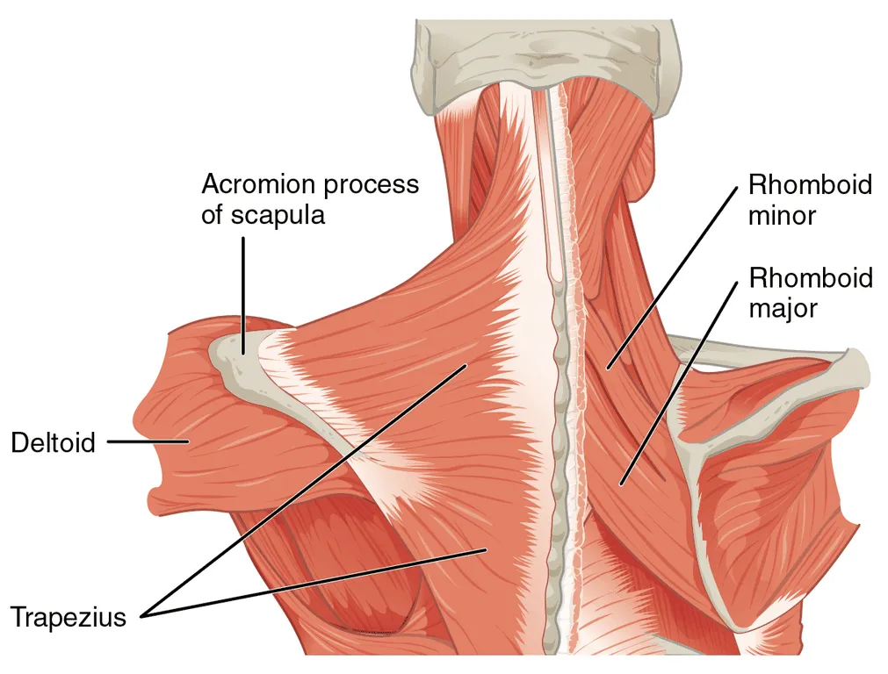

Slide 25
E. Neutralizer
Role: Cancels out unwanted movements produced by another muscle.
Example:
  During elbow flexion without supination, pronator teres neutralizes the supinating effect of biceps.

Slide 26
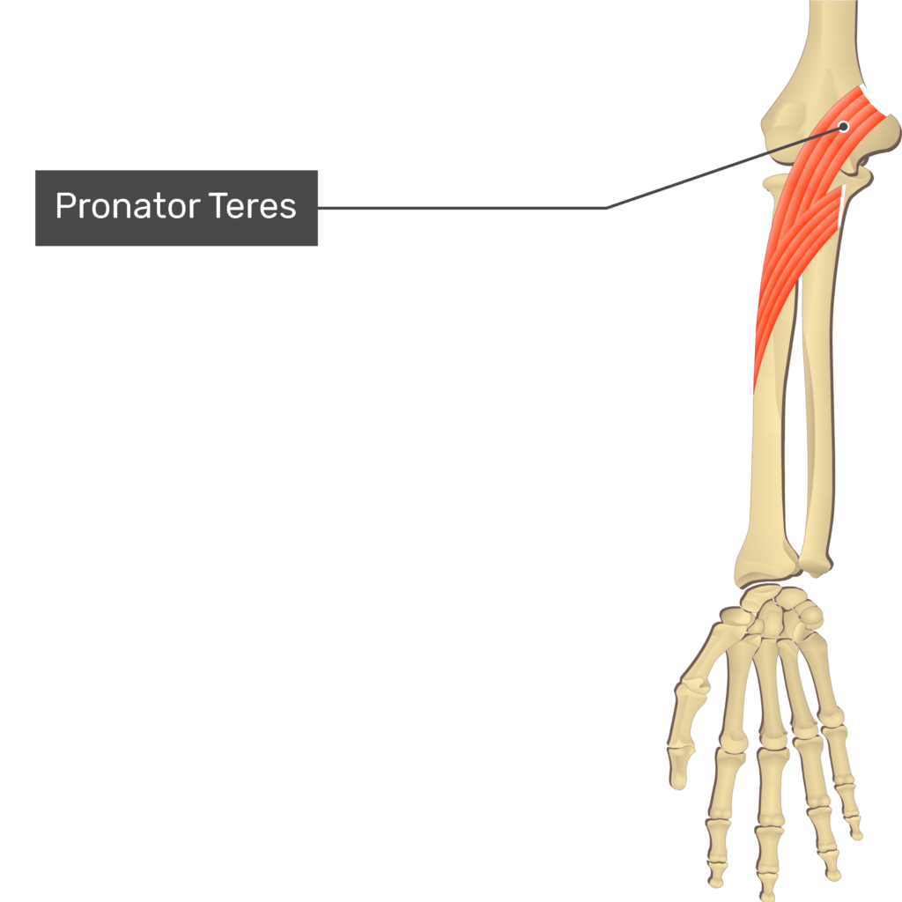

Slide 27


Slide 28


