Slide 1

BASIC MEDICAL SCIENCE
FSC MEDICAL TECHNOLOGIES I
DR DANISH

Slide 2
Skin
Largest organ of the human body.
Acts as a protective barrier between internal organs & external environment.
Composed of multiple layers with unique functions.

Slide 3
Layers of the Skin
Epidermis – outermost layer.
Made of epithelial cells.
Subdivided into sublayers: stratum corneum, stratum granulosum, stratum spinosum, stratum basale.
Stratum corneum = outermost dead‑cell layer that sheds continuously.
Stratum basale = deepest layer where new cells are formed by cell division.

Slide 4
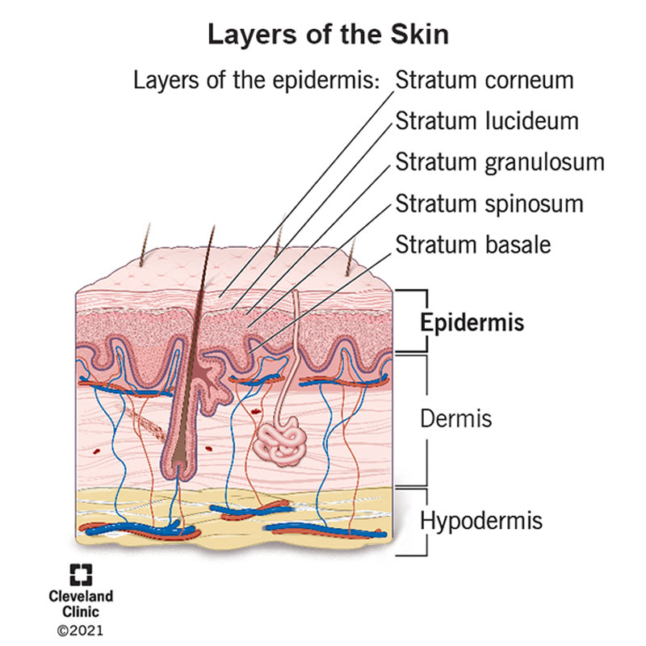

Slide 5
CONTINUED
Dermis – middle layer of connective tissue.
Contains blood vessels, nerves, hair follicles, sebaceous & sweat glands.
Provides structural support; has collagen & elastin fibers for strength & elasticity

Slide 6
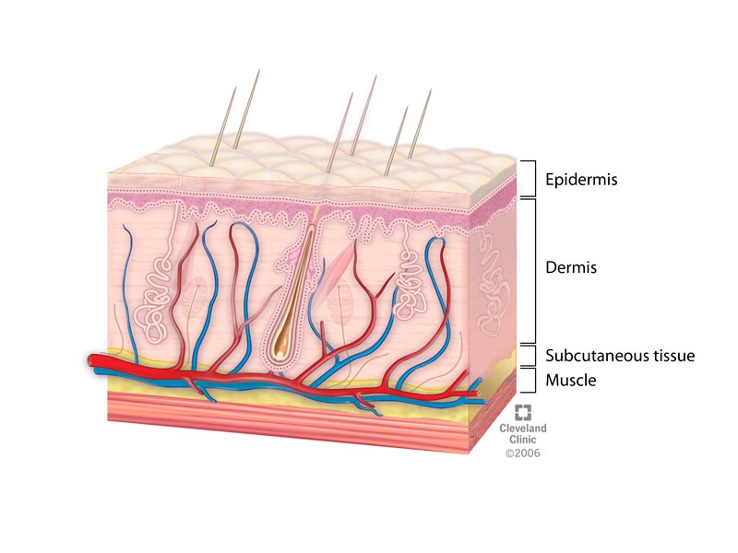

Slide 7
Hypodermis (Subcutaneous Tissue) – deepest layer
Mainly fat cells (adipocytes) & connective tissue.
Functions: energy storage, insulation, padding.

Slide 8
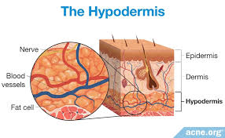

Slide 9
Structures within the Skin
Hair Follicles:
Located in dermis, extend into hypodermis.
Produce hair → protective skin covering.
Sebaceous Glands:
Connected to hair follicles
Secrete sebum → lubricates & waterproofs skin.

Slide 10
CONTINUED
Sweat Glands:
Distributed in dermis.
Produce sweat → regulates body temperature by evaporative cooling.
Blood Vessels:
supply nutrients and oxygen to skin cells and help regulate body temperature.

Slide 11
CONTINUED
Nerves: transmit sensory information (touch, temperature, pain) to the brain.

Slide 12
Functions of the Skin
Protection: barrier against pathogens, UV radiation, chemicals, and physical injury.
Temperature Regulation: sweat glands manage temperature via evaporation; blood vessels dilate or constrict to release/retain heat.
Sensation: nerves detect touch, pressure, temperature, and pain.
Synthesis of Vitamin D: UV radiation stimulates vitamin D production in the skin.

Slide 13
CONTINUED
Excretion: sweat glands remove waste and help maintain electrolyte balance.

Slide 14
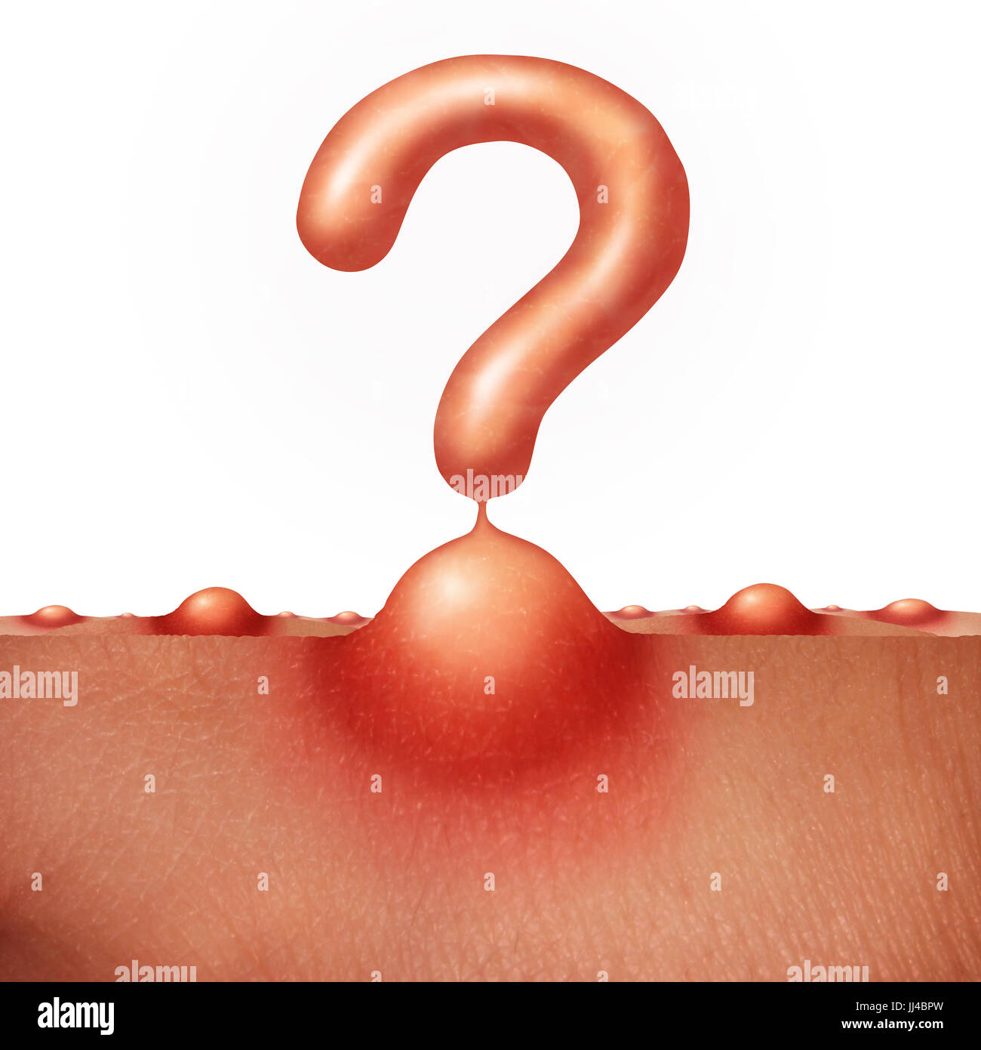

Slide 15


