Slide 1

GENERAL ANATOMY
DPT
1ST SEMESTER
DR DANISH

Slide 2
Parts of a Muscle
Origin
  Fixed, less movable end of the muscle.
Insertion
  Movable end where muscle action is produced.
Belly (Gaster)
  Thick, fleshy, contractile middle portion.

Slide 3
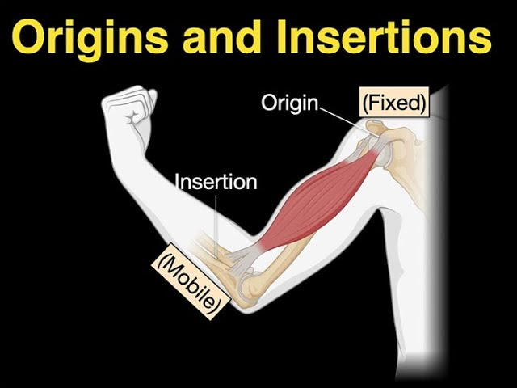

Slide 4
CONTINUED
Tendon
  Strong, fibrous cord attaching muscle to bone.
Aponeurosis
  Flattened sheet-like tendon for broad attachments.
Raphe
  Fibrous seam formed by interlacing tendons of two muscles.

Slide 5
Muscle Attachments
Fleshy Attachments
  Muscle fibers directly join bone (via short, firm connective tissue).
Tendinous Attachments
  Rope-like or cord-like tendons connect muscle to bone.
Aponeurotic Attachments
  Wide, flat tendons used by broad, flat muscles.
Fibrous & Fibrocartilaginous Attachments
  Seen at regions of friction or pressure.
Skin Attachments
  In muscles of facial expression.

Slide 6
Structures From Which a Muscle May Originate
Bones
  Most common site; includes shafts, tubercles, ridges.
Cartilage
  e.g., laryngeal muscles.
Ligaments
Fascia
  e.g., muscles originating from deep fascia.
Aponeuroses
Skin
  For facial muscles.

Slide 7
Structures Into Which Skeletal Muscles May Insert
Bones
  Primary insertion site.
Cartilage
  e.g., some pharyngeal or laryngeal muscles.
Ligaments
Fascia / Aponeuroses
  e.g., abdominal wall.
Skin
  Especially facial muscles.
Tendons of Other Muscles
  For coordinated group action.

Slide 8
Lubricating Mechanisms of Muscles
Synovial Tendon Sheaths
  Double-layered tubular sacs wrapped around tendons.
  Reduce friction where tendons pass through confined spaces.

Slide 9
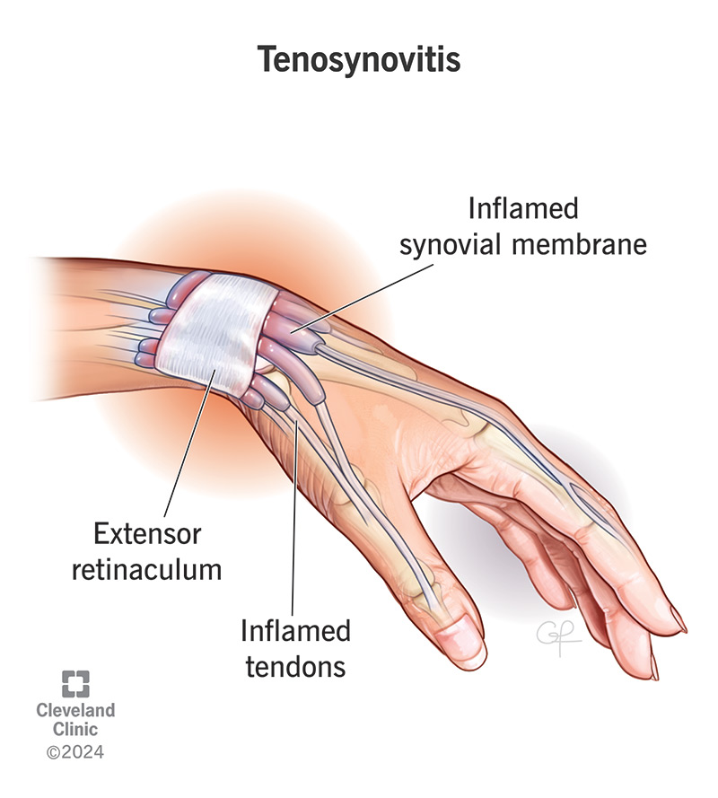

Slide 10
CONTINUED
Bursae
Fluid-filled sacs between tendon and bone/skin.
Prevent wear due to rubbing during movement.

Slide 11
CONTINUED
Retinacula + Synovial Fluid
Retinacula hold tendons in place; synovial fluid reduces friction.
Areolar Connective Tissue
Allows smooth gliding between muscle layers.

Slide 12


Slide 13


