Slide 1
Applied science
Awais Hamza

Slide 2
Continuous Motion in the Universe
Everything in the universe is in continuous motion.
Atoms vibrate internally; planets rotate and revolve; stars move through space.
Earth rotates on its axis and revolves around the Sun.
These motions affect us, but we do not always feel them because they are uniform.
Understanding motion is important as every physical process involves some form of movement.

Slide 3
Displacement
When a body moves from one position to another, the change in its position is called displacement.
It is represented as a vector quantity because it has both magnitude and direction.
Displacement shows how far and in what direction a body has moved from its original position.
If a body moves along a curved path from point A to point B, displacement is the straight-line vector from A to B.

Slide 4
Vector Representation
Let r₁ = position vector at point A (initial position).
Let r₂ = position vector at point B (final position).
Displacement D = r₂ – r₁
Illustrated by placing the tail of r₁ at origin and showing r₂ as final point; the arrow from r₁ to r₂ represents D.
Displacement is independent of the actual path travelled.

Slide 5
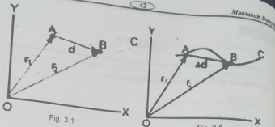
Vector Representation

Slide 6
Instantaneous Velocity
Average velocity does not describe motion in detail, especially if motion is curved or speed changes continuously.
To find velocity at a particular instant, we use instantaneous velocity.
Consider velocity vectors v₁ and v₂ at slightly different times.
As the time interval Δt becomes very small, the ratio Δd/Δt approaches a limiting value.
This limit gives the instantaneous velocity, which is always tangent to the path of the moving body.

Slide 7
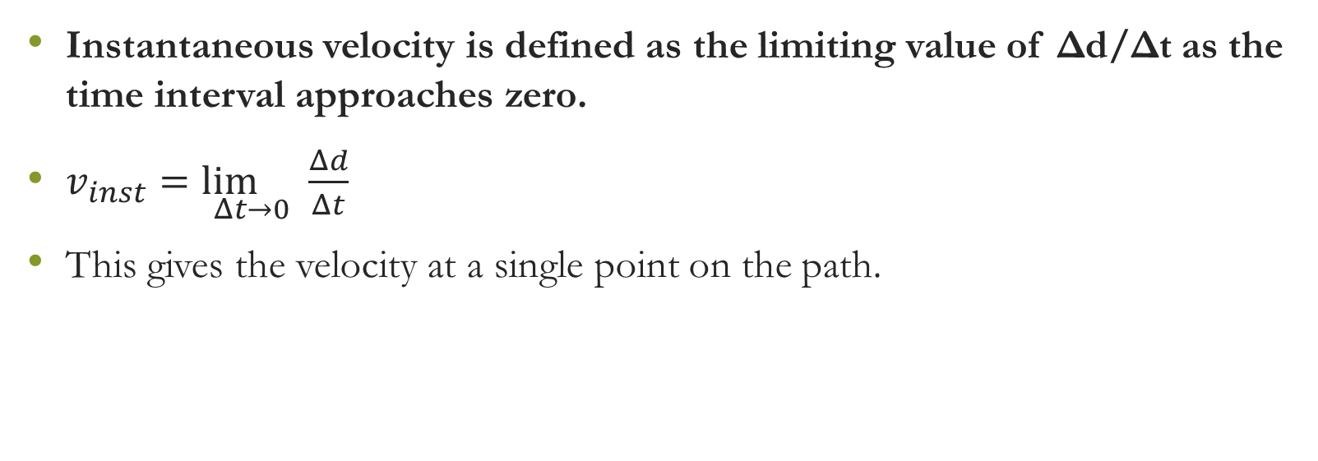
Instantaneous Velocity (Formula & Definition)
Instantaneous velocity is defined as the limiting value of Δd/Δt as the time interval approaches zero.
$v_{inst}=\underset{Δt→0}{\lim{}}\frac{Δd}{Δt}$
This gives the velocity at a single point on the path.

Slide 8
Acceleration
When the velocity of a body changes, the body is said to be moving with acceleration.
Acceleration occurs when:
  Speed changes,
  Direction changes, or
  Both speed and direction change.
Acceleration is also a vector quantity.

Slide 9
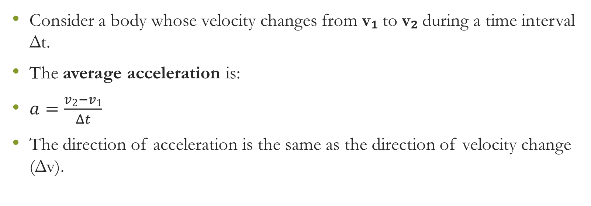
Average Acceleration
Consider a body whose velocity changes from v₁ to v₂ during a time interval Δt.
The average acceleration is:
$a=\frac{v_{2}−v_{1}}{Δt}$
The direction of acceleration is the same as the direction of velocity change (Δv).

Slide 10
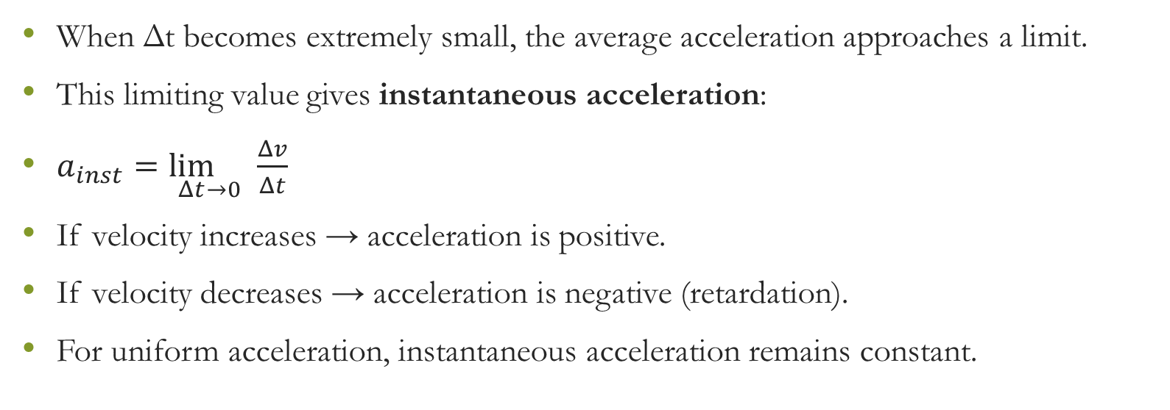
Instantaneous Acceleration
When Δt becomes extremely small, the average acceleration approaches a limit.
This limiting value gives instantaneous acceleration:
$a_{inst}=\underset{Δt→0}{\lim{}}\frac{Δv}{Δt}$
If velocity increases → acceleration is positive.
If velocity decreases → acceleration is negative (retardation).
For uniform acceleration, instantaneous acceleration remains constant.

Slide 11
Velocity-Time Graphs
Velocity-time graphs help us study how velocity changes with time.
Time is taken along the horizontal axis (x-axis).
Velocity is taken along the vertical axis (y-axis).
These graphs provide clear information about acceleration and distance travelled.

Slide 12
v-t Graph for Constant Velocity
If a body moves with constant velocity, the graph is a horizontal straight line.
This means velocity does not change with time.
No acceleration (a = 0)

Slide 13
v-t Graph for Constant Acceleration
When a body accelerates uniformly, the v-t graph is a straight line sloping upward.
Equal increases in velocity occur during equal intervals of time.
The slope of this line gives the acceleration.

Slide 14
v-t Graph for Increasing Acceleration
When acceleration is not constant, the graph becomes a curve.
The slope of the tangent at any point on the curve gives the instantaneous acceleration.
A steeper slope = greater acceleration.

Slide 15

Distance from v-t Graph
Distance travelled is equal to the area under the velocity-time graph.
For constant velocity:
$\text{Distance}=v×t$
Represented by the area of a rectangle under the line.

Slide 16
Distance from v-t Graph (Variable Velocity)
Even when acceleration is not constant, distance can still be found by calculating the area under the curve.
For increasing velocity, the graph area forms shapes such as triangles, rectangles, or irregular regions.
The total shaded area = total distance travelled.

Slide 17
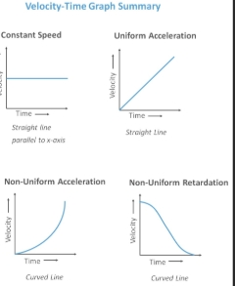

Slide 18
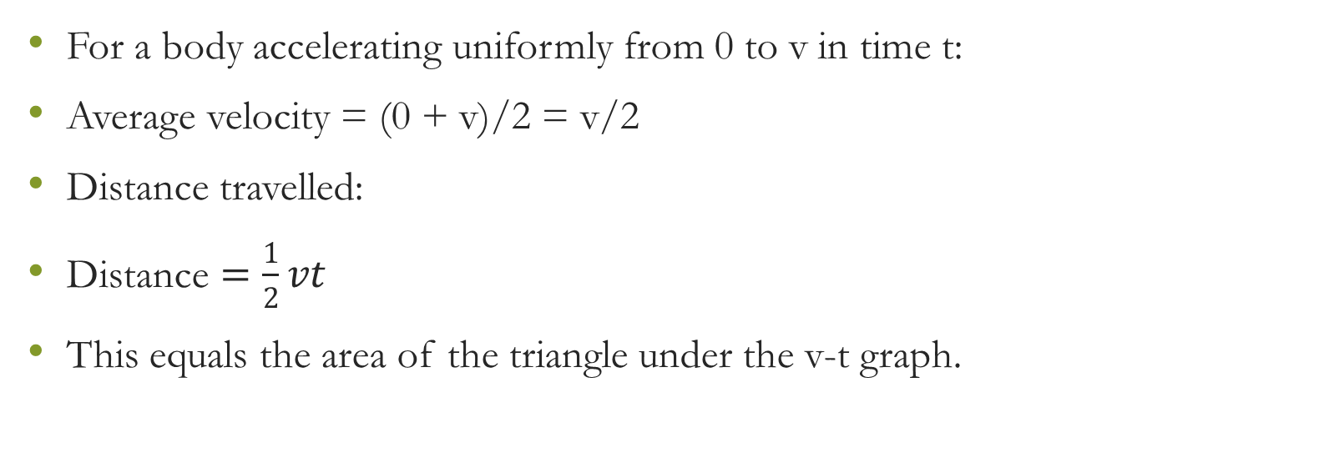
Example (Uniform Acceleration)
For a body accelerating uniformly from 0 to v in time t:
Average velocity = (0 + v)/2 = v/2
Distance travelled:
$\text{Distance}=\frac{1}{2}vt$
This equals the area of the triangle under the v-t graph.

Slide 19
Centre of Gravity
Centre of gravity (CG) is a theoretical point where the entire weight of a body acts.
Knowledge of CG is important in:
  Engineering designs
  Stability of structures
  Construction of bridges and buildings
  Understanding natural motions of bodies

Slide 20
Behaviour of Centre of Gravity
The CG of Earth is not at its exact centre due to uneven distribution of mass.
For symmetric objects made of uniform material, CG lies at their geometric centre.
For irregular shaped objects, CG may lie at unusual or even external points.

Slide 21
Determining Centre of Gravity
Method 1: Balancing Method
Suspend the body from a point using a string.
The body will balance when the CG is vertically below the suspension point.
Method 2: Plumb Line Method
Suspend object from point A → trace vertical line.
Suspend again from point B → trace second line.
The intersection of the two lines gives the centre of gravity.

Slide 22
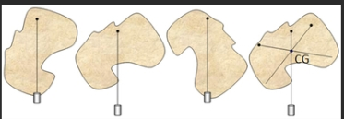
Plumb line method

