Slide 1

Radiologic Technology and Imaging Profession
BS(RIT + OTT)
ADNAN RAMZAN

Slide 2
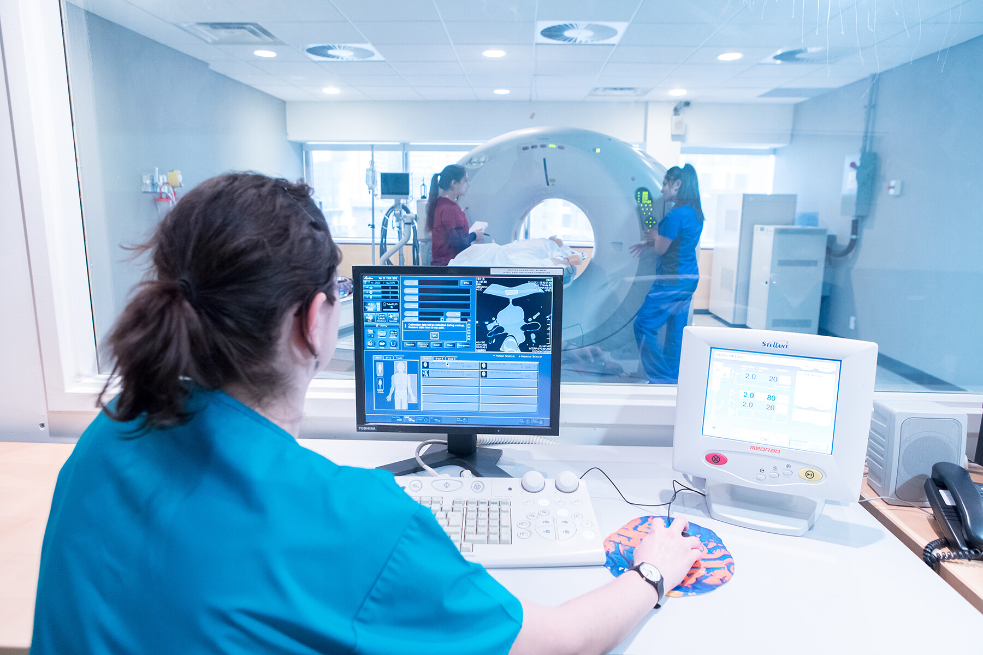

Slide 3
What is Radiologic Technology?
A healthcare field that uses imaging equipment to visualize the inside of the body.
Helps doctors diagnose illnesses, injuries, and diseases.
Includes X-ray, CT, MRI, ultrasound, and more.

Slide 4
History of Radiologic Technology
1895: Wilhelm Conrad Roentgen discovered X-rays.
Early imaging used glass plates and long exposures.
Modern technology now includes digital imaging, 3D scans, and computer-aided diagnostics.

Slide 5
Role of a Radiologic Technologist
Operate imaging equipment safely.
Position patients correctly.
Ensure clear, accurate images.
Protect patients from unnecessary radiation.
Assist doctors during procedures.

Slide 6
Medical Imaging Modalities
X-ray – basic imaging of bones, lungs.
CT – cross-sectional 3D images.
MRI – soft tissue detail.
Ultrasound – uses sound waves.
Nuclear Medicine – functional imaging.
Fluoroscopy – real-time X-rays.
Interventional Radiology – minimally invasive procedures.

Slide 7
X-Ray Imaging
Uses electromagnetic radiation.
Quick, affordable, widely used.
Common exams: chest, bone, dental.
Shows dense tissues like bone.

Slide 8
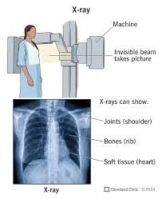

Slide 9
Computed Tomography (CT)
Spinning X-rays → cross-sectional images.
Provides 3D internal views.
Useful for trauma, cancer, stroke.
Fast for emergencies.
Notes:
Tomos, meaning "slice" or "section"
Graphia or graphein, meaning "to write" or "to describe/draw"

Slide 10
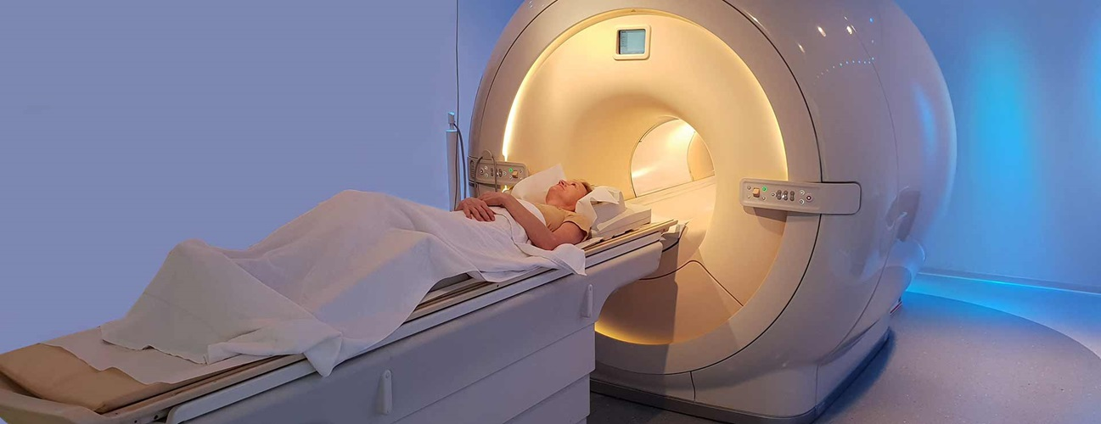

Slide 11
Magnetic Resonance Imaging (MRI)
Uses magnets + radio waves.
No radiation.
Excellent for brain, spine, joints.
Takes longer than CT.
Not suitable with metal implants.

Slide 12
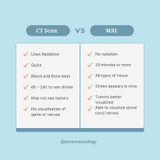

Slide 13
Ultrasound Imaging
High-frequency sound waves.
Safe for pregnancy.
Real-time images.
Common: abdomen, heart, pregnancy.

Slide 14
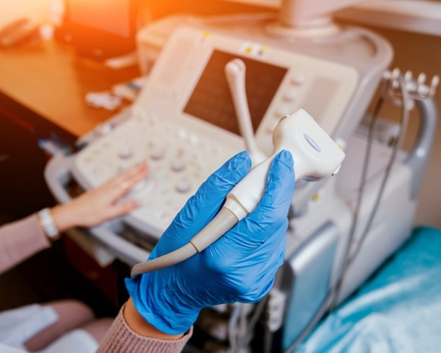

Slide 15
Nuclear Medicine
Medical specialty that uses radioactive substances to diagnose and treat diseases
Uses radioactive tracer.
Shows organ function.
Common: thyroid, bone, PET scans.
Detects cancer, infections.

Slide 16
Fluoroscopy
fluoroscopy uses a continuous X-ray beam to create a continuous video of internal motion
Continuous X-ray video.
Used for swallowing exams, catheter placement, orthopedic procedures.

Slide 17
Interventional Radiology
Minimally invasive, image-guided.
Examples: angiography, stents, tumor ablation, biopsies.
Less risk & faster recovery.

Slide 18
Radiation Safety
ALARA principle.
Use shielding.
Limit exposure time.
Increase distance.
Use proper settings.
Notes:
a guiding principle meaning "As Low As Reasonably Achievable," which advocates for minimizing radiation exposure by using all reasonable methods. Its purpose is to protect people and the environment from unnecessary radiation risks,

Slide 19
Patient Care in Radiology
Explain procedures.
Ensure comfort & privacy.
Check history.
Communicate to reduce anxiety.

Slide 20
Image Quality
Exposure settings.
Positioning.
Motion control.
Contrast usage.
Images must be diagnostic(clear).

Slide 21
Positioning Techniques
Correct positioning vital.
Standard views: AP, lateral.
Adapt for mobility issues or injuries.

Slide 22
Equipment Operation
Know controls & settings.
Check equipment.
Coordinate with engineers.
Follow safety protocols.

Slide 23
Ethics in Radiology
Confidentiality.
Informed consent.
Equal treatment.
Report make by honestly.

Slide 24
Education Requirements
Associate/bachelor's degree.
Clinical training.
Knowledge: anatomy, physics, patient care, imaging.
Requires ARRT or equivalent.

Slide 25
Work Environments
Hospitals.
Clinics.
Imaging centers.
Outpatient centers.
Mobile units.
Research institutions.

Slide 26
Future of Radiology
AI image analysis.
Robotic procedures.
Better dose control.
Faster, clearer scans.
Notes:
In radiology, "better dose control" refers to the use of techniques and technologies to achieve the lowest possible radiation dose to the patient and staff while maintaining the image quality necessary for accurate diagnosis and treatment, a principle known as ALARA (As Low As Reasonably Achievable).

Slide 27


