Slide 1

GENERAL ANATOMY
DPT
1ST SEMESTER
DR DANISH

Slide 2
Skeletal Muscles & Muscle Fibers
Introduction to Skeletal Muscles
The human body contains about 600 skeletal muscles.
Skeletal muscles form the muscular system, enabling movement and stability.
A muscle = collection of muscle fibers bound together by connective tissue.

Slide 3
Skeletal Muscle Fibers
Muscle fibers are long, cylindrical, multinucleated cells.
Diameter ranges from 10–100 micrometers.
Average length = 25 mm, but can be much longer depending on muscle type.
Sarcolemma → cell membrane of the muscle fiber.
Sarcoplasm → cytoplasm of the muscle fiber.

Slide 4
Types of Muscle Fibers (Red, White & Intermediate)
1. Red Fibers (Slow-twitch)
Smaller diameter.
Rich in myoglobin> THE OXYGEN & IRON BINDING PROTEIN (gives reddish color).
Numerous mitochondria → high endurance.
Suitable for long-term, low-intensity activities (e.g., posture, walking).

Slide 5
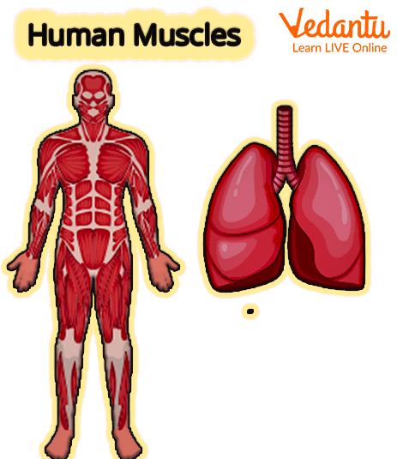

Slide 6
2. White Fibers (Fast-twitch)
Larger diameter.
Low myoglobin, fewer mitochondria.
Fatigue quickly but produce rapid, powerful contractions.
Used in sprinting, weightlifting, explosive movements.

Slide 8
3. Intermediate Fibers
Properties between red and white fibers.
More fatigue-resistant than white fibers; stronger than red fibers.

Slide 9
Connective Tissue Associated With Skeletal Muscles
Fascia:
Band of fibrous connective tissues that stabilizes, support & covering

Slide 10
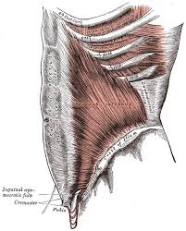

Slide 11
Superficial Fascia
Located just beneath the skin.
Contains fat, nerves, blood vessels, and lymphatics.
Helps insulate the body, store fat, and provide padding.

Slide 12
Deep Fascia
Dense, tough connective tissue covering muscles.
Forms compartments separating muscle groups.
Helps muscles transmit force efficiently.
Also creates pathways for nerves and blood vessels.

Slide 13
Connective Tissue Components of Muscle
Endomysium: surrounds individual muscle fibers.
Perimysium: surrounds bundles (fascicles) of fibers.
Epimysium: outermost covering of the entire muscle.
These layers merge to form tendons and aponeuroses.

Slide 14
Tendons
Tough bands of dense regular connective tissue.
Anchor muscles to bones, allowing movement.
Very strong with minimal stretch.

Slide 15
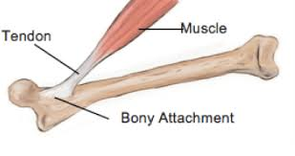

Slide 16
Summary
Skeletal muscles are complex structures made of fibers, fascia, and connective tissue layers.
Muscle fibers vary in structure and function → adapted for endurance or power.
Connective tissues play crucial roles in support, force transmission, and movement.
Understanding these components helps explain muscle performance and biomechanics.

Slide 17


Slide 18


