Slide 1

BASIC MEDICAL SCIENCE
FSC MEDICAL TECHNOLOGIES I
DR DANISH

Slide 2
SALIVARY GLANDS
OVERVIEW:
Essential structures in the human body responsible for producing saliva, which plays crucial roles in digestion, oral hygiene, and speech.
Saliva contains enzymes and lubricants that aid digestion of food, protect oral tissues, and maintain pH balance.

Slide 3
Types of Salivary Glands
Major Salivary Glands: Primary producers of saliva; larger in size.
Include the parotid, submandibular, and sublingual glands.
Minor Salivary Glands: Numerous small glands distributed throughout the oral cavity (lips, cheeks, palate, tongue).
Contribute to overall saliva production.

Slide 4
Parotid Glands
Located bilaterally in front of the ears, just below and in front of the ear lobes.
Largest of the major salivary glands.
Parotid duct (Stensen’s duct) extends from each gland and opens into the oral cavity near the second upper molar.

Slide 5
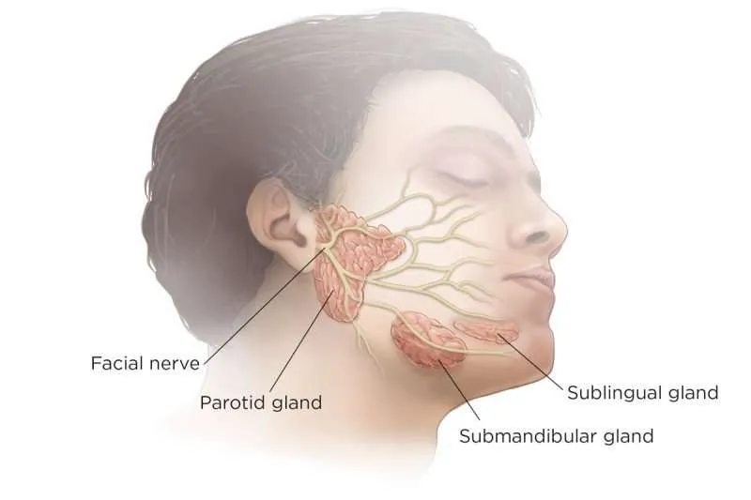

Slide 6
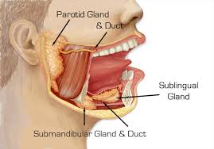

Slide 7
Submandibular Glands
Positioned below the mandible, along its posterior aspect.
Smaller than parotid but larger than sublingual glands.
Submandibular duct (Wharton’s duct) runs forward from each gland and opens into the floor of the mouth on either side of the frenulum linguae.

Slide 10
Sublingual Glands
Located beneath the tongue, in the floor of the mouth.
Smallest of the major salivary glands.
Multiple ducts (Rivinus’ ducts) open into the floor of the mouth along with the submandibular ducts.

Slide 13
Structure of Salivary Glands
Composed of clusters of secretory cells called acini that produce saliva.
Acini are surrounded by myoepithelial cells that contract to facilitate expulsion of saliva from the acini into the ducts.
Ducts transport saliva from the acini to the oral cavity.

Slide 14
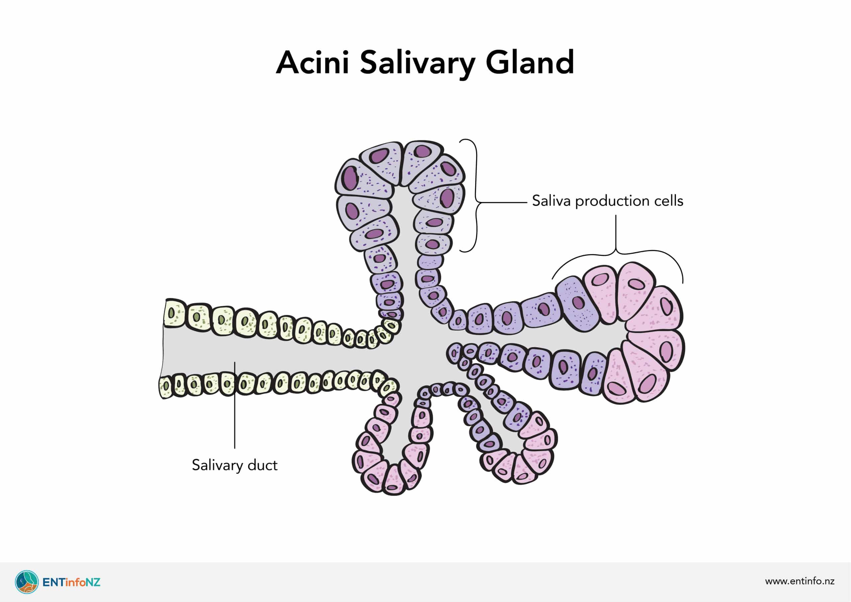

Slide 15
Salivary Gland Secretions
Saliva consists of water, electrolytes (sodium, potassium, chloride, bicarbonate ions), enzymes (amylase for carbohydrate digestion), mucins, and antibacterial agents.

Slide 16
Nerve Supply
Salivary glands are innervated by the autonomic nervous system.
Parasympathetic stimulation, mediated by the facial nerve (for submandibular & sublingual glands) and the glossopharyngeal nerve (for parotid gland), increases saliva production.

Slide 17
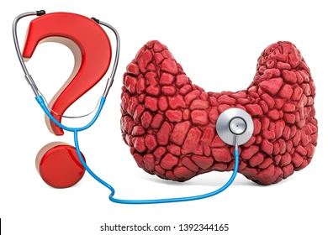

Slide 18


