Slide 1

GENERAL ANATOMY
DPT
1ST SEMESTER
DR DANISH

Slide 2
The Muscular System
Introduction
The muscular system is made up of muscles composed mainly of muscular tissue, a contractile tissue that allows movement.
Muscles contract and relax, enabling movement of the whole body or specific parts.

Slide 3
Functions of the Muscular System
1. Mobility
Main function: movement.
Enables:
  Gross movements — walking, running, swimming.
  Fine movements — writing, speaking, facial expressions.
Movement is possible due to contraction of skeletal muscles.

Slide 4
Continued
2. Maintenance of Posture
Muscles maintain body posture during sitting, standing, and other static positions.
They make constant slight adjustments to keep the body balanced.

Slide 5
Continued
3. Blood Circulation
Cardiac muscle pumps blood through the circulatory system.
Smooth muscle in blood vessel walls regulates blood pressure by contracting (increasing pressure) and relaxing (decreasing pressure).
Calf muscles, especially the soleus, help pump blood back to the heart → called the “peripheral heart.

Slide 6
Continued
4. Heat Generation
Heat is a by-product of muscle activity.
Muscle contractions help maintain the body's internal temperature at 37°C.
During cold exposure, rapid muscle contractions cause shivering to produce heat.

Slide 7
Types of Muscular Tissue
1. Skeletal Muscle
2. Smooth Muscle
3. Cardiac Muscle

Slide 8
1. Skeletal Muscle
Most abundant muscle type (≈40% of body weight).
Attached mostly to bones → responsible for body movements.
Characteristics:
  Long, cylindrical, multinucleated fibers.
  Striated appearance (due to dark & light bands).
  Voluntary control (can be consciously controlled).
Also involved in some involuntary movements like breathing and blinking.
Called somatic muscle to distinguish from visceral muscle.

Slide 9
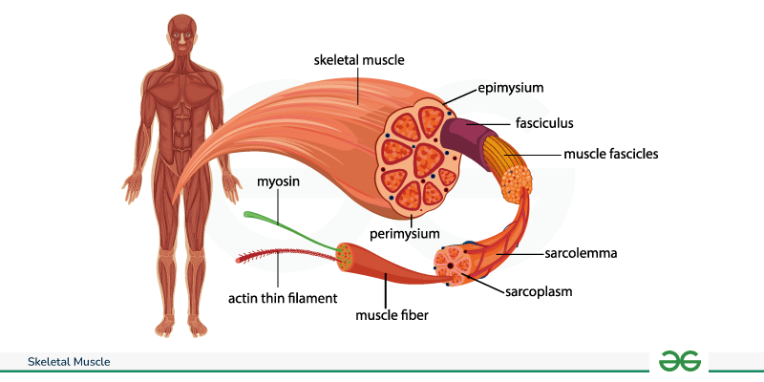

Slide 10
2. Smooth Muscle
Not striated → looks smooth under a microscope.
Found in walls of hollow organs (stomach, intestines, blood vessels, uterus).
Characteristics:
  Spindle-shaped cells with a single nucleus.
  Involuntary control → controlled by the autonomic nervous system.
  Forms sheets or layers.
Also called visceral muscle.

Slide 11
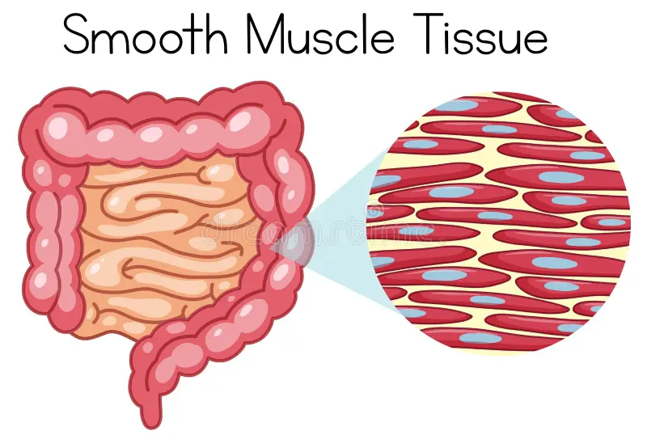

Slide 12
3. Cardiac Muscle
Found only in the heart (myocardium).
Characteristics:
  Short, branched fibers.
  One nucleus per cell.
  Striated, but not as distinctly as skeletal muscle.
  Intercalated discs allow synchronized contractions.
Involuntary, controlled by autonomic nervous system.

Slide 13
Continued
Cardiac muscle has a high number of mitochondria for constant energy.
It has a self-initiating rhythmic contraction (myogenic property), meaning the heart can beat without brain signals.

Slide 14
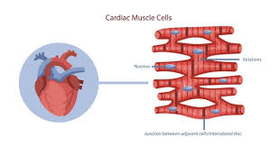

Slide 15
Summary
Muscular system allows movement, posture, blood flow, and heat regulation.
Three main muscle types:
  Skeletal – voluntary, striated, body movements.
  Smooth – involuntary, non-striated, organ walls.
  Cardiac – involuntary, striated, heart only.
Essential for overall body functioning and maintaining homeostasis.

Slide 16
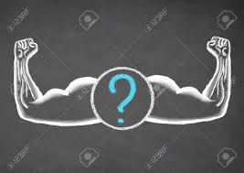

Slide 17
