Slide 1

PHYSIOTHERAPY TECHNIQUES
FSC PT I
DR DANISH

Slide 2
Ataxia
Introduction to Ataxia
Definition:
Ataxia refers to a group of neurological disorders that affect coordination, balance, and speech.
▸ It results from damage or dysfunction in the cerebellum, spinal cord, or peripheral nerves.
Key feature:
Difficulty performing voluntary, coordinated movements.

Slide 3
Types of Ataxia
A. Cerebellar Ataxia
B. Sensory Ataxia
C. Vestibular Ataxia
D. Hereditary Ataxias
E. Acquired Ataxias

Slide 4
Cerebellar Ataxia
Caused by damage to the cerebellum.
▸ Leads to gait abnormalities, eye movement issues, and impaired fine motor skills.

Slide 5
Sensory Ataxia
Results from impaired sensory nerves or dorsal columns of the spinal cord.
▸ Patients rely heavily on visual input to maintain balance and worsen in the dark.

Slide 6
Vestibular Ataxia
Due to inner ear or vestibular system dysfunction.
▸ Causes vertigo, nausea, and imbalance.

Slide 7
Hereditary Ataxias
Linked to inherited genetic mutations.
▸ Examples include Friedreich’s ataxia and Spinocerebellar Ataxias (SCAs).

Slide 8
Acquired Ataxias
Develop due to external or medical causes.
▸ Causes include stroke, alcohol abuse, infections, autoimmune disorders, tumors, and vitamin deficiencies.

Slide 9
Causes of Ataxia
Genetic mutations
▸ Responsible for many chronic, progressive forms.
Traumatic brain injury
▸ Can damage cerebellar pathways.
Stroke or hemorrhage
▸ Interrupts blood supply to brain regions regulating coordination.
Alcohol toxicity
▸ Long-term excessive use can cause cerebellar degeneration.
Vitamin deficiencies (B12, E, thiamine)
▸ Affect nerve health and coordination.
Autoimmune disorders (e.g., multiple sclerosis)
▸ Attack parts of the nervous system.
Infections
▸ Viral infections like varicella can cause acute ataxia in children.

Slide 10
Symptoms of Ataxia
Gait disturbance:
▸ Unsteady, wide-based walk.
Poor coordination of limbs:
▸ Difficulty performing tasks like writing or buttoning clothes.
Dysarthria:
▸ Slow or slurred speech.
Nystagmus:
▸ Involuntary eye movements.

Slide 11
Continued
Tremors:
▸ Especially intention tremors (worse when trying to perform precise tasks).
Difficulty swallowing (dysphagia)
▸ Seen in advanced or severe forms.
Fatigue and muscle weakness
▸ Common in hereditary or chronic types.

Slide 12
Diagnosis of Ataxia
Clinical neurological examination
▸ Evaluates gait, balance, speech, reflexes, and coordination.
MRI or CT scan
▸ Checks for cerebellar damage, tumors, or structural abnormalities.
Blood tests
▸ Detect vitamin deficiencies, autoimmune markers, or infections.
Genetic testing
▸ Identifies hereditary ataxias.
Nerve conduction studies
▸ Assess sensory nerve function.
Lumbar puncture (when needed)
▸ To rule out infections or inflammatory diseases.

Slide 13
Management and Treatment
Treat underlying cause
▸ Vitamin supplementation (B12, E, thiamine) if deficient.
▸ Treat infections or autoimmune conditions.
▸ Manage tumors or hydrocephalus if present.

Slide 14
Rehabilitation therapies
  Physical therapy:
  ▸ Improves strength, coordination, and balance.
  Occupational therapy:
  ▸ Helps adapt to daily tasks and maintain independence.
  Speech therapy:
  ▸ Supports communication and swallowing.
Medications
▸ May help manage symptoms like tremors or muscle stiffness.
Assistive devices
▸ Canes, walkers, wheelchairs for mobility support.

Slide 15
Prevention Strategies
Avoid excessive alcohol use
▸ Reduces risk of cerebellar degeneration.
Maintain adequate vitamin intake
▸ Especially B12 and E.
Protect against head injuries
▸ Use helmets and follow safety practices.
Manage chronic diseases
▸ Conditions like diabetes or autoimmune diseases can contribute to nerve damage.

Slide 16
Peripheral Nerve Injury
Introduction
Peripheral nerve injury refers to damage to the nerves outside the brain and spinal cord.
Leads to loss of motor, sensory, or autonomic function depending on the nerve involved.
Common in trauma, compression, or systemic diseases.

Slide 17
Anatomy Review (Brief)
Peripheral nerves consist of:
  Axons (nerve fibers)
  Myelin sheath
  Connective tissue layers: Endoneurium, Perineurium, Epineurium
Carry signals from CNS to muscles and from skin/organs to CNS.

Slide 18
Causes of Peripheral Nerve Injury
Trauma
  Lacerations, fractures, crush injuries.
Compression / Entrapment
  Carpal tunnel syndrome, thoracic outlet syndrome.
Ischemia
  Reduced blood supply to nerves.
Inflammatory conditions
  Guillain-Barré syndrome, autoimmune neuropathies.
Metabolic diseases
  Diabetes causing diabetic neuropathy.
Iatrogenic causes
  Surgical injuries, injections.

Slide 19
Types of Peripheral Nerve Injuries
A. Neurapraxia
Mildest form.
Myelin damage without axonal disruption.
Temporary loss of function; recovery within days to weeks.

Slide 20
Continued
B. Axonotmesis
Axon is damaged but connective tissue sheaths remain intact.
Wallerian degeneration occurs.
Recovery possible but slower—weeks to months.

Slide 21
Continued
C. Neurotmesis
Most severe form.
Complete nerve transection.
No spontaneous recovery; requires surgery.

Slide 22
Clinical Features
Motor symptoms
  Weakness, paralysis, muscle atrophy.
Sensory symptoms
  Numbness, tingling, burning pain, loss of sensation.
Autonomic symptoms
  Loss of sweating, temperature dysregulation.
Reflex changes
  Diminished or absent reflex

Slide 23
Specific Signs of Nerve Injury
Tinel’s sign: Tingling when tapping over the damaged nerve.
Muscle wasting: Seen with chronic injury.
Functional deficits: Depends on nerve involved (e.g., wrist drop in radial nerve palsy).

Slide 24
Diagnosis
Clinical examination
  Sensory mapping, motor strength testing, reflexes.
Electrodiagnostic tests
  Nerve conduction studies to assess speed and amplitude.
  Electromyography (EMG) for muscle activation patterns.
Imaging
  Ultrasound or MRI for nerve continuity and compression.
Blood tests
  If metabolic or autoimmune causes suspected.

Slide 25
Management & Treatment
Conservative Treatment
Rest and splinting.
Anti-inflammatory medications.
Physical therapy for strength and mobility.
Occupational therapy for functional recovery.
Surgical Treatment
Indicated for severe injuries (neurotmesis) or failed conservative therapy.
Techniques:
  Nerve repair (end-to-end suturing)
  Nerve grafting
  Nerve transfer
  Release of compression (decompression surgery)

Slide 26
Complications
Chronic pain (neuropathic).
Permanent muscle weakness or atrophy.
Contractures due to prolonged immobility.
Loss of sensation leading to repeated injuries.

Slide 27
Prognosis
Depends on type of injury, timing of treatment, and location.
Neurapraxia → Excellent recovery.
Axonotmesis → Partial to good recovery.
Neurotmesis → Poor without surgical repair.
Younger age and shorter distance to target muscle improve outcomes.

Slide 28
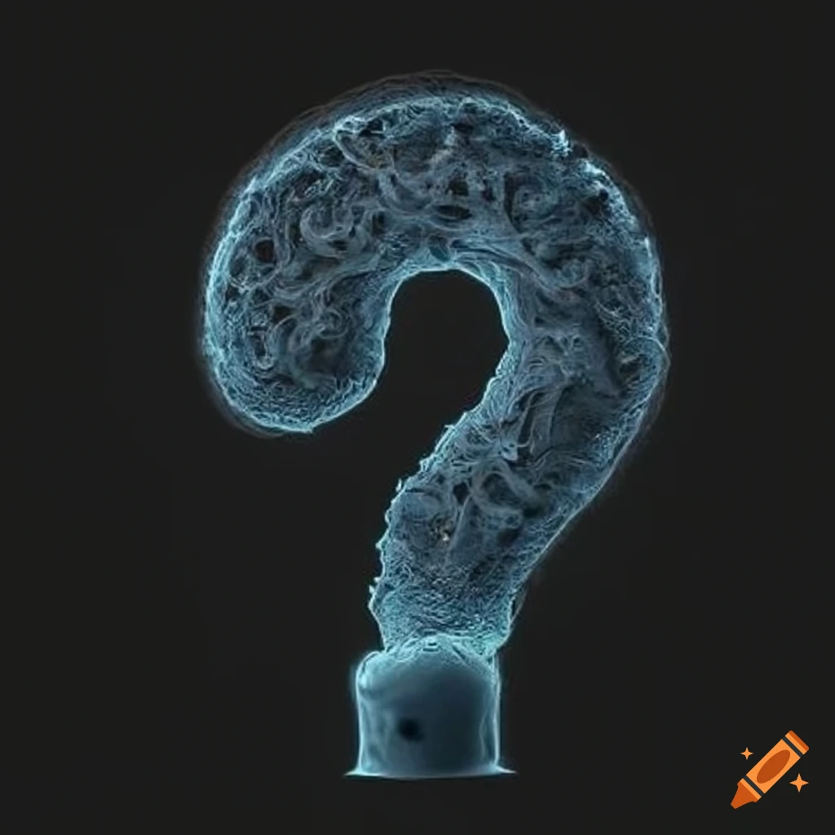

Slide 29


