Slide 1

GENERAL ANATOMY
BS RIT,OTT,MLT
1ST SEMESTER
DR DANISH

Slide 2
Synovial Joints – Structures
Menisci:
Definition: Crescent-shaped wedges of fibrocartilage found in certain joints.
Location: Each knee joint contains two menisci – medial and lateral.
Function:
  Act as shock absorbers between femoral and tibial condyles.
  Improve congruence between bone surfaces, enhancing joint stability.

Slide 3
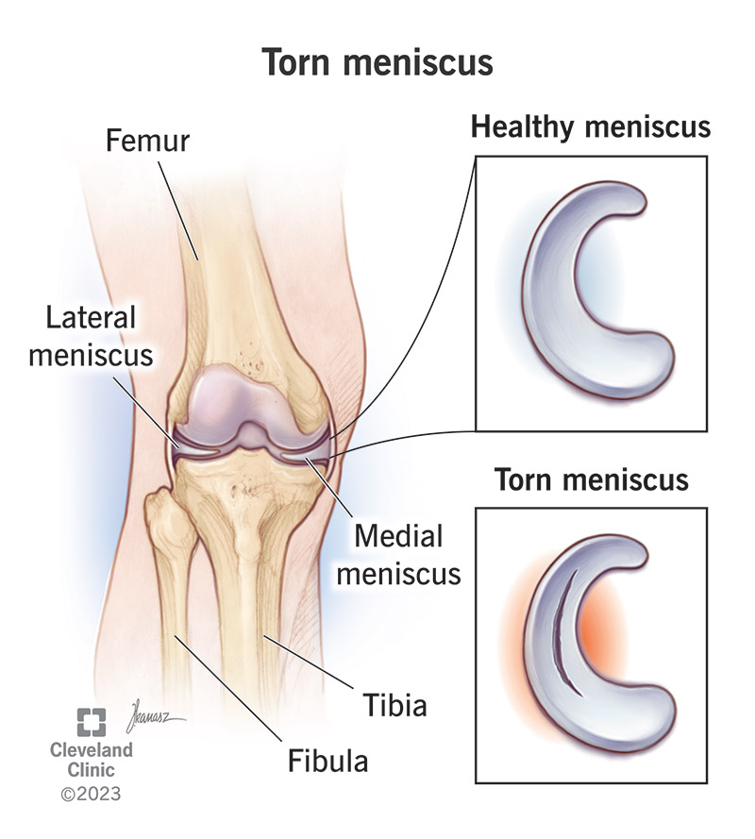

Slide 4
Continued
Labra (Labrum)
Definition: A lip-like ring of fibrocartilage attached to the rim of a bony socket in synovial joints.
Role:
  Deepens the socket, increasing joint stability.
  Helps hold the head of the bone more firmly in place.

Slide 5
Types:
Types:
Labrum glenoidale:
  Located in the shoulder joint.
  Attached to the edge of the glenoid cavity of the scapula.
Labrum acetabulare:
  Found in the hip joint.
  Attached to the rim of the acetabulum.

Slide 6
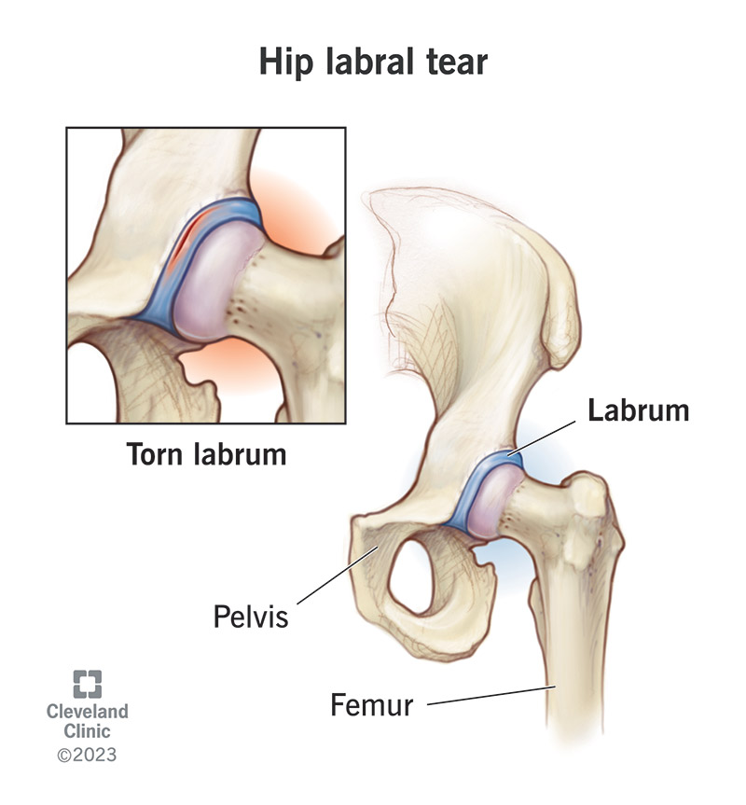

Slide 7
Movements at Synovial Joints
A. Gliding Movements
Occur in plane synovial joints.
One flat surface slides over another.
No significant rotation or angular change.
Example: small bones of wrist and ankle.

Slide 8
B. Angular Movements
Involve increase or decrease in the angle between bones.
Types:
  Flexion
  Extension
  Abduction
  Adduction

Slide 9
C. Rotatory Movements
Bone rotates around a longitudinal axis.
Examples:
  Medial/lateral rotation of the femur at the hip.
  Rotation of the atlas (C1) and axis (C2) allowing side-to-side head movement.

Slide 10
D. Circumduction
Combination of flexion, extension, abduction & adduction.
Distal end of limb moves in a circular cone-like motion.
Occurs in:
  Ball-and-socket joints (shoulder, hip).
  Sellar joints (thumb’s carpometacarpal joint).

Slide 11
Classification of Synovial Joints
A. Based on Complexity
Simple Joints:
  Two articulating surfaces.
  Example: shoulder joint.
Compound Joints:
  More than two articulating surfaces.
  Example: elbow joint (humerus + radius + ulna).

Slide 12
Continued
Complex Joints:
  Contain an articular disc or meniscus.
  Example: knee joint, sternoclavicular joint.

Slide 13
Based on Degree of Freedom (Axes of Movement)
1. Uniaxial Joints
Movement around one axis only.
Mostly allow flexion/extension.
Example: interphalangeal joints.
2. Biaxial Joints
Movement around two principal axes.
Example: wrist joint → flex/extend + ab/adduct.

Slide 14
Continued
3. Multiaxial Joints
Movement around three axes (most mobile).
Example: shoulder joint.
  Transverse axis: flexion/extension
  Anteroposterior axis: abduction/adduction
  Vertical axis: medial/lateral rotation

Slide 15


Slide 16


