Slide 1
Infinitives, Gerunds & Participles
Hafsa Rasheed

Slide 2

What is an Infinitive?
Infinitive = to + base verb
Meaning: shows purpose or intention.
✔ to eat
✔ to read
✔ to sleep

Slide 3
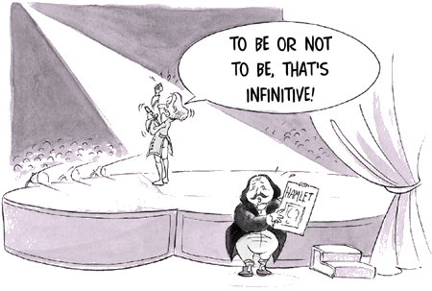
Types of Infinitives
1. To-infinitive: to go, to write, to help
2. Bare infinitive (no “to”): go, write (after can, will, must, let, make)
3. Perfect infinitive: to have gone, to have seen

Slide 4
Using Infinitives
After certain verbs: I want to eat.
To show purpose: She came to study.
After adjectives: He is easy to talk to.
After question words: I don’t know what to do.

Slide 5
“In My Opinion…” — Expressing Views
✔ I need to sleep.
✔ They plan to travel.
✔ She refused to help.
✔ His dream is to become a doctor.

Slide 6
Common Verbs That Take Infinitives
want to • need to • hope to • decide to • plan to • learn to • promise to
✔ Example: I hope to win.
✔ Example: She promised to call.

Slide 7
What is a Gerund?
Gerund = verb + ing used as a noun
✔ Swimming is fun.
✔ Reading calms me.
✔ I enjoy dancing.

Slide 8
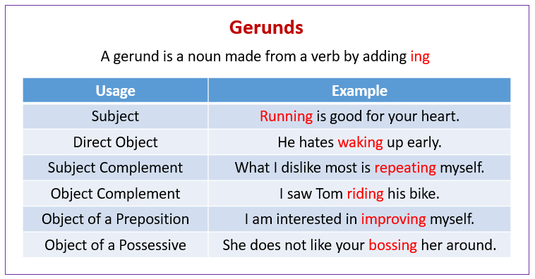
When Do We Use Gerunds?
After certain verbs: enjoy, avoid, finish, suggest, keep

Slide 9
More simple examples
✔ Writing improves vocabulary.
✔ He finished eating.
✔ She avoided going out.

Slide 10
Common Verbs Followed by Gerunds
enjoy • avoid • suggest • finish • keep • consider • deny • imagine
✔ I enjoy singing.
✔ He suggested meeting early.

Slide 11
What is a Participle?
Participle = verb form used as an adjective
Two types
1. Present participle (-ing):
✔ The crying baby
2. Past participle (-ed / irregular):
✔ A broken toy
✔ A written note

Slide 12
More examples
✔ The barking dog is loud.
✔ The fallen leaves look pretty.
✔ Tired, he sat down.
✔ Confused, the student asked again.

Slide 14
Common Participle Examples
Present participles: doing, going, eating, talking
Past participles: done, gone, eaten, written, broken, bought

Slide 15
Infinitive vs Gerund – Super Simple
Infinitive = usually future purpose
✔ I want to eat.
Gerund = already happening / general activity
✔ I enjoy eating.

Slide 16
Activity 1 – Identify
Tell whether it’s an infinitive, gerund, or participle:
1. I love to dance.
2. The broken chair was repaired.
3. Swimming is my hobby.
4. The crying child needs help.
5. She wants to travel.

Slide 17
Activity 2 – Fill in the Blanks
1. She decided ______ (go).
2. ______ (read) is good for the mind.
3. The ______ (fall) leaves covered the ground.
4. I enjoy ______ (cook).
5. They came ______ (help).

Slide 18
Activity 3 – Make Your Own
Write:
1 sentence with an infinitive
1 sentence with a gerund
1 sentence with a participle

Slide 19


