Slide 1

BASIC MEDICAL SCIENCE
FSC MEDICAL TECHNOLOGIES I
DR DANISH

Slide 2
Changes in Taste
Dysgeusia → Altered taste
Ageusia → Loss of taste
Causes:
  Infections
  Nerve problems
  Certain medications
  Damage to taste buds

Slide 3
Numb Tongue
Possible causes:
  Allergic reactions to foods/chemicals
  Autoimmune disorders (e.g., lupus, scleroderma, MS)
  Raynaud’s phenomenon
  Nerve damage (e.g., dental procedure, nerve injury)
  Vitamin/mineral deficiencies (calcium, iron, zinc, phosphorus)

Slide 4
Continued
Warning signs of stroke (seek emergency help):
Tongue numbness + facial droop
Difficulty speaking
Confusion, dizziness
Vision problems or severe headache

Slide 5
Sore or Bumpy Tongue
Causes:
  Irritation or minor infections
  Smoking
  Canker sores
  Ill-fitting dentures
Can rarely indicate oral cancer (not all are painful)

Slide 6
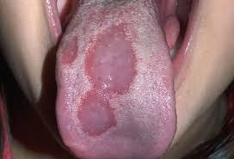

Slide 7
Burning Tongue
Known as burning mouth syndrome
Not harmful but uncomfortable
More common in postmenopausal women
May affect anyone

Slide 8
Enlarged & Bald Tongue
Enlarged Tongue (Macroglossia)
Normal tongue: ~3 inches long, ~2.52 inches wide
Causes:
  Trauma
  Inflammatory conditions
  Health disorders (e.g., primary amyloidosis)

Slide 9
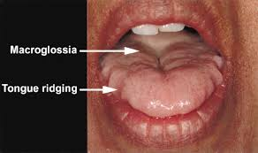

Slide 10
Bald Tongue (Atrophic Glossitis)
Smooth tongue due to loss of bumps
Causes:
  Anemia
  Vitamin B deficiency

Slide 11
Cold Sores
Caused by herpes simplex virus
Most common on lips but can appear on tongue
Highly contagious

Slide 12
Changes in Tongue Color
White tongue → Thrush, leukoplakia, other infections
Red/Purple tongue → Geographic tongue, vitamin deficiencies, scarlet fever, Kawasaki disease
Black tongue → “Black hairy tongue”; harmless but caused by trapped bacteria/debris
Yellow tongue → Bacterial overgrowth, food habits, smoking; rarely jaundice

Slide 13
Taste
Chemical sense detected by chemoreceptors in tongue & pharynx
Four primary tastes:
  Bitter
  Sour
  Salty
  Sweet

Slide 14
Taste Sensation Details
Caused by long-chain molecules or nitrogen-containing substances
Detected at back of tongue

Slide 15
Sour Taste
Caused by H⁺ ions (acids like HCl, HNO₃, H₂SO₄)
Detected at posterior sides of tongue

Slide 16
Salty Taste
Caused by ionized salts (Na⁺, K⁺, Mg²⁺, Ca²⁺)
Detected at anterior sides of tongue

Slide 17
Sweet Taste
Caused by organic compounds (sugars, glucose, aldehydes, ketones)
Detected at tip of tongue

Slide 18
Taste Receptors
Lingual Papillae
Filiform papillae
Fungiform papillae
Circumvallate papillae
Folate papillae

Slide 19
Taste Buds
Primary taste receptors
About 10,000 taste buds in humans
Located in:
  Epiglottis
  Palate
  Tonsillar pillars
  Pharynx

Slide 20
Mechanism of Taste Stimulation
Taste substance stimulates taste hairs
Substance adsorbs on taste hairs
Taste cells become permeable to Na⁺ ions
Taste cells depolarize
Impulses sent to CNS via taste nerve fibers

Slide 21
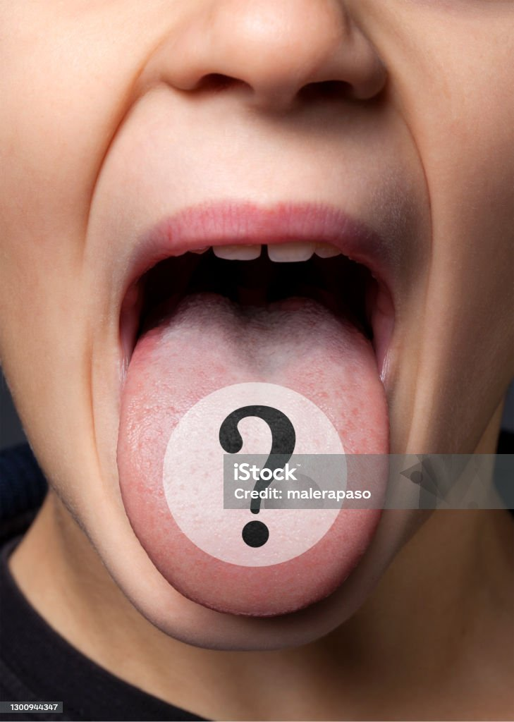

Slide 22
