Slide 1
Blood Transfusion
ADNAN RAMZAN
FSC(OTT)
Doctors Institute of Medical & Emerging Science

Slide 2
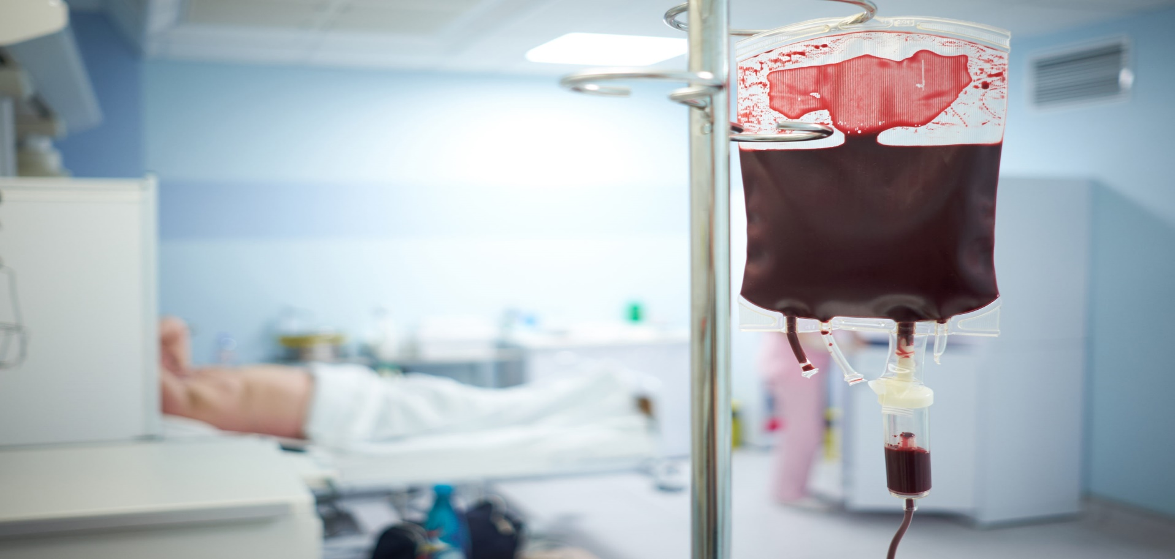

Slide 3
Introduction
Blood transfusion is the process of transferring blood or blood components into a patient's bloodstream.
It is a life-saving procedure used in surgery, trauma, and various medical conditions.

Slide 4
Objectives
Understand the types of blood and components
Know indications and contraindications
Learn the procedure
Identify transfusion reactions and management

Slide 5
Components of Blood
Whole Blood
Packed Red Blood Cells (PRBCs)
Platelets
Fresh Frozen Plasma (FFP)
Cryoprecipitate
Serum / Plasma
Notes:
Fresh frozen plasma (FFP) is the liquid portion of whole blood, containing a broad range of clotting factors, while cryoprecipitate is a concentrated product derived from FFP that is rich in specific factors like fibrinogen, factor VIII, and von Willebrand factor

Slide 6
Cross matching
Doner and recipient blood comparison
Ensure compatibility
Reduce risk of transfusion reaction

Slide 7
Indications for Blood Transfusion
Severe anemia
Major blood loss (trauma, surgery)
Shock
Coagulation disorders
Thrombocytopenia
Burns & severe infections
Notes:
Low level of platelets (thrombocytopenia)

Slide 8
Equipment Required
IV cannula (18–20G)
Blood transfusion set with filter
Tourniquet
Sterile gloves
Vital signs monitoring equipment

Slide 9
Pre-Transfusion Checks
Patient identification
Check blood bag label
Inspect blood (colour, expiry, clots)
Record baseline vitals
Obtain informed consent

Slide 10
Transfusion Procedure
Maintain aseptic technique
Start transfusion slowly
Monitor vitals every 15 minutes initially
Adjust flow rate as needed
Complete transfusion within 4 hours
Notes:
120 mL/hour for the initial 15 minutes, increasing to 150-250 mL/hour if no reaction occurs

Slide 11
Monitoring During Transfusion
Pulse
Blood pressure
Temperature
Respiratory rate
Watch for any signs of reaction
Notes:
A normal resting respiratory rate for an adult is 12 to 20 breaths per minute

Slide 12
Signs & Symptoms of Reaction
Fever and chills
Rash, itching
Back or chest pain
Dyspnea
Hypotension
Dark urine
Notes:
Shortness of breath (Dyspnea)

Slide 13
Management of Transfusion Reaction
STOP transfusion immediately
Keep IV line open with normal saline
Check vitals
Inform doctor and blood bank
Send blood bag and tubing for investigation
Provide supportive treatment

Slide 14
Storage of Blood
Whole Blood & PRBCs: 2–6°C
Platelets: 20–24°C with continuous agitation
FFP & cryoprecipitate: –30°C or below

Slide 15
Safety Measures
Donor screening
Proper labeling
Sterile equipment
Correct storage & handling
Documentation and record-keeping

Slide 16
Role of OT Technician
Assist in preparation
Perform cross-check of blood pack
Monitor patient during surgery
Report any reaction immediately
Maintain sterility & safety standards

Slide 17


