Slide 1

GENERAL ANATOMY
DPT
1ST SEMESTER
DR DANISH

Slide 2
Diarthroses(synovial joints)
Permit free movement
E.g shoulder joint,elbow joint,knee joint

Slide 3
Synovial Joints – Structure & Key Features

Slide 4
1. Articular Cartilage
A special type of hyaline cartilage covering the articular (joint) surfaces of bones.
Provides a smooth, glistening, wear-resistant, lubricated surface for bone movement.
Acts as a shock absorber due to its elastic and compressible nature.
Thickness: 5–7 mm in young individuals; becomes thinner, firmer, more brittle with age.
Avascular & aneural → cannot feel pain, gets nutrients from synovial fluid by diffusion.
Surface facing the joint cavity lacks perichondrium.

Slide 5
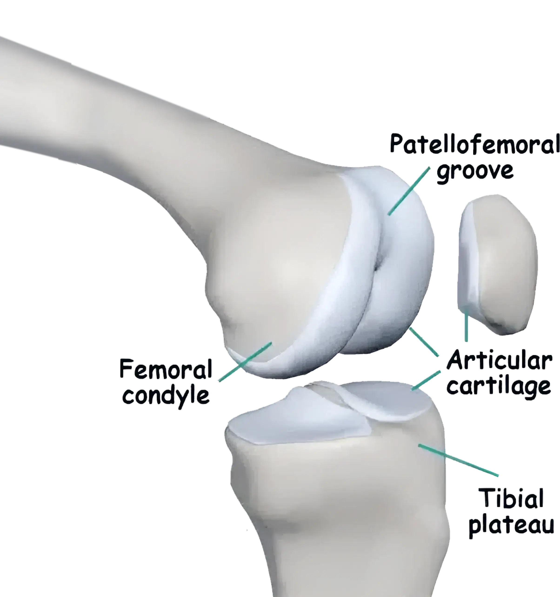

Slide 6
Continued
Articular cartilage damage heals poorly due to lack of blood supply.
Composed mainly of water (70–80%), collagen type II

Slide 7
Fibrous Capsule (Articular Capsule)
A tough fibrous cuff surrounding the synovial joint.
Attached around the articular ends of bones.
In long bones, attachment may be far from the articular surface.
Holds bones together while remaining flexible and lax to allow movement.
Contains apertures for bursae and is penetrated by blood vessels and nerves.

Slide 8
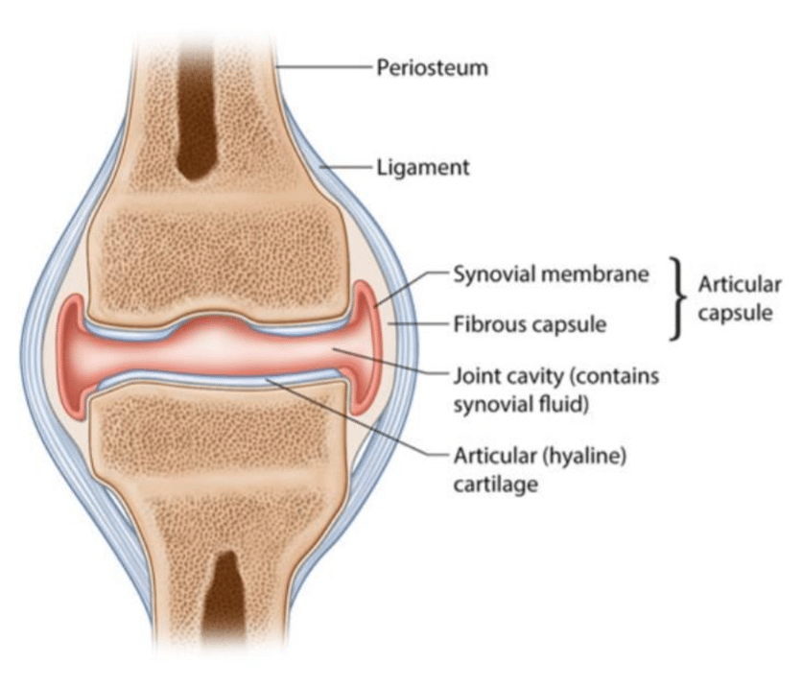

Slide 9
Continued
Provides static stability to joints.
Reinforced by ligaments and sometimes muscles crossing the joint.

Slide 10
3. Ligaments
Fibrous connective tissue bands that support and strengthen joints.
May be:
Capsular ligaments: thickenings of the capsule.
Accessory ligaments: separate from the capsule (extracapsular or intracapsular).

Slide 11
Continued
Tough and inelastic but flexible enough to allow normal movement.
Prevent excessive or abnormal joint movements.
Rich nerve supply → pain when overstretched helps prevent injury.
Excessive stretch → sprain (pain + swelling).

Slide 12
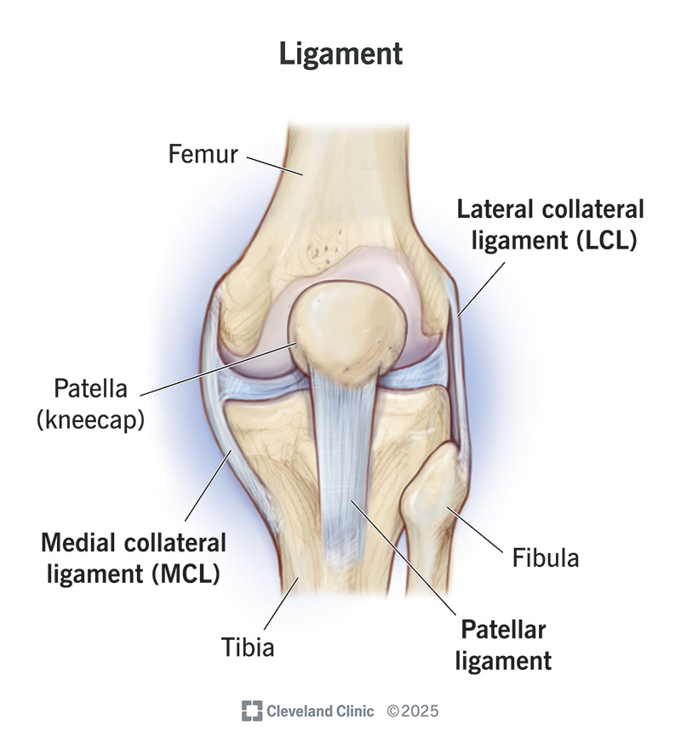

Slide 13
Continued
Ligament healing is slow due to poor blood supply.
Some ligaments strengthen joints dynamically through muscle attachments.

Slide 14
4. Synovial Membrane
A thin connective tissue sheet lining the inner surface of the fibrous capsule.
Does not cover articular cartilage, discs, or menisci.
Rich in blood vessels & lymphatics.
Forms folds and may contain fat pads (articular fat pads) → act as joint cushions.
Secretes synovial fluid.

Slide 15
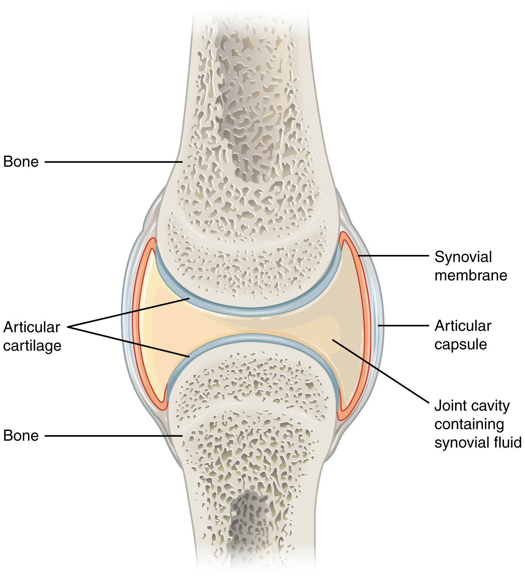

Slide 16
5. Synovial Fluid
A clear, pale-yellow, viscous (egg-white-like) fluid within the joint cavity.
Normally present in small amounts (<0.5 ml in large joints).
Two main functions:
  Lubricates articular surfaces.
  Nourishes articular cartilage, discs, and menisci.

Slide 17
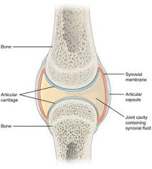

Slide 18
6. Articular Discs & Menisci
Found in some joints (e.g., sternoclavicular, temporomandibular joint).
Made of fibrocartilage, dividing the joint cavity into compartments.
Improve joint congruence, absorb shock, and increase stability.
Menisci (e.g., in the knee) enhance load distribution and improve joint lubrication.

Slide 19
Summary
A synovial joint consists of:
✔ Articular cartilage
✔ Synovial cavity
✔ Synovial fluid
✔ Synovial membrane
✔ Fibrous capsule
✔ Ligaments (capsular & accessory)
✔ Optional structures – Discs, menisci, fat pads, bursae
Together, these enable smooth, pain-free, and stable movement.

Slide 20
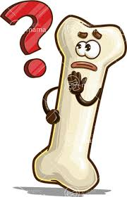

Slide 21


