Slide 1
Blood Transfusion
ADNAN RAMZAN
FSC(OTT)
Doctors Institute of Medical & Emerging Science

Slide 2
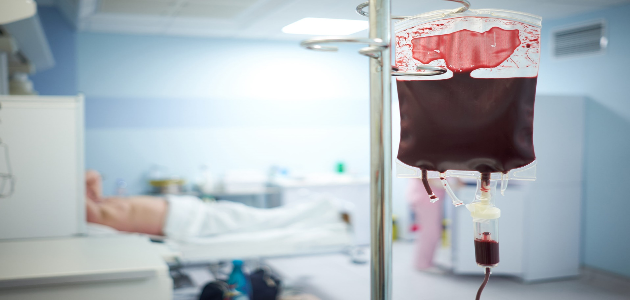

Slide 3
Introduction
Blood transfusion is the process of transferring blood or blood components into a patient's bloodstream.
It is a life-saving procedure used in surgery, trauma, and various medical conditions.

Slide 4
Objectives
Understand the types of blood and components
Know indications and contraindications
Learn the procedure
Identify transfusion reactions and management

Slide 5
Components of Blood
Whole Blood
Packed Red Blood Cells (PRBCs)
Platelets
Fresh Frozen Plasma (FFP)
Cryoprecipitate
Serum / Plasma
Notes:
Fresh frozen plasma (FFP) is the liquid portion of whole blood, containing a broad range of clotting factors, while cryoprecipitate is a concentrated product derived from FFP that is rich in specific factors like fibrinogen, factor VIII, and von Willebrand factor

Slide 6
Cross matching
Doner and recipient blood comparison
Ensure compatibility
Reduce risk of transfusion reaction

Slide 7
Indications for Blood Transfusion
Severe anemia
Major blood loss (trauma, surgery)
Shock
Coagulation disorders
Thrombocytopenia
Burns & severe infections
Notes:
Low level of platelets (thrombocytopenia)

Slide 8
Equipment Required
IV cannula (18–20G)
Blood transfusion set with filter
Tourniquet
Sterile gloves
Vital signs monitoring equipment

Slide 9
Pre-Transfusion Checks
Patient identification
Check blood bag label
Inspect blood (colour, expiry, clots)
Record baseline vitals
Obtain informed consent

Slide 10
Transfusion Procedure
Maintain aseptic technique
Start transfusion slowly
Monitor vitals every 15 minutes initially
Adjust flow rate as needed
Complete transfusion within 4 hours

