Slide 1

FUMIGATION
ADNAN RAMZAN
FSC(OT)
Doctors Institute of Medical & Emerging Science

Slide 2
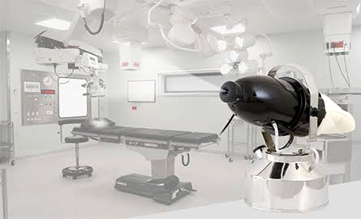
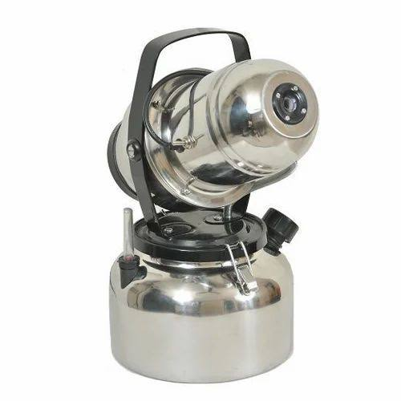
FUMIGATION

Slide 3
Definition:
Fumigation is the process of gaseous sterilization (mostly by formaldehyde), which is used for killing microbial organisms and preventing microbial growth in air, on the surface of walls or floors.
Within a hospital OT ROOMS, WARDS, ICU, and PACU can be fumigated.

Slide 4
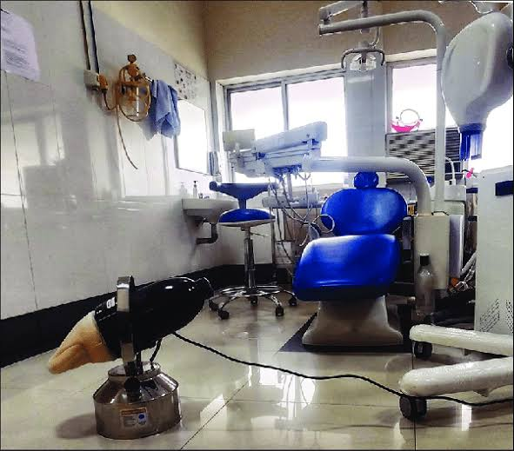

Slide 5
Fumigator:
Application: Aerial Sterilisation of Operation Theatre, Clean Room, and Microbiology Lab
Droplet Size: Less than 1 micron
Voltage: 220-240
Tank Capacity: 5 Litres
Feature: Portable
Volume Coverage: 7000 to 8000 cubic feet
Weight of the Machine: 5 kg

Slide 6
Preparation for Fumigation:
Thoroughly clean windows, doors, floor, walls, surgery table, and all washable equipment with soap and water
Close windows and ventilators tightly. If any openings are found, seal them with cellophane tape or other material to avoid the leak of fume.
Switch off all lights, A/C and other electronical items.
Calculate the room size (surgical theatre only) in cubic feet (LxWxH) and calculate the required amount of formaldehyde.

Slide 7

OT

Slide 8
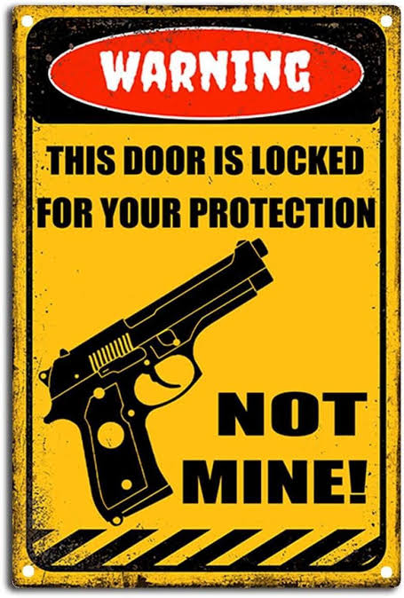
Adequate care must be taken by wearing cap, mask, foot cover, spectacle etc.
Formaldehyde is irritant to eye & nose; and it has also been recognized as a potential carcinogen.
So the fumigating person must be provided with the personal protective equipments (PPE).
Paste a warning notice on the front door indicating fumigation is in progress.

Slide 9
Method 1: “FORMALDEHYDE METHOD”
Formaldehyde vapor is an extremely effective biocidal agent. Fumigation is effective at temperatures above 20°C and relative humidity of 65%.
Formalin is commercially available as 40% solution of formaldehyde in water.
When formalin is heated, formaldehyde vapor is generated.
Surgical Theatre Volume = LxWxH = 20 x 15 x 10 = 3000 cubic feet
Formaldehyde required for fumigation = 500 ml for 1000 cubic feet or ½ of OT volume
A few hours or overnight (8-12 hours)

Slide 10
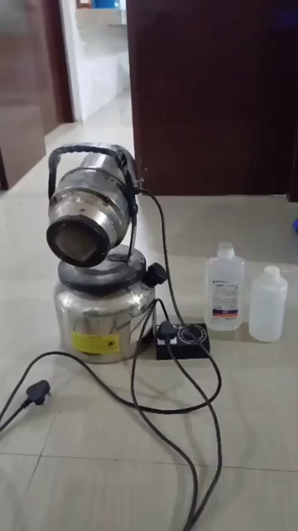

Slide 11

Surgical Theatre Volume = LxWxH = = 3500 cubic feet
How much formaldehyde is required for fumigation???
Ans: 3500/1000*500 = 1750ml

Slide 12
What is Neutralization?
Before neutralization, formaldehyde fumigation system should be taken out from the surgical theater. Then the toxicity of formaldehyde vapor should be neutralized with ammonia solution.
Place a cotton ball and pour 300 ml of 10% ammonia (for each 500 ml of formaldehyde used) on the floor of surgical theater, at least 4 hours before (07 a.m.) the "Sterility Test".
Formaldehyde gas reacts with ammonia gas and produce hexamine (synonym hexamethylenetetramine) which is considered a harmless substance. • Switch on the A/C, at least 2 hours before the "Sterility Test".

Slide 13
Examples :
Surgical Theater Volume = LxWxH = 20 x 15 x 10 = 3000 cubic feet
Formaldehyde required for fumigation = 500 ml for 1000 cubic feet
So, 1500 ml of formaldehyde required (to be diluted in 3000 ml of distilled water)
Ammonia required for neutralization = 300 ml of 10% ammonia for 500 ml of formaldehyde
How much??
So 900 ml of 10% ammonia required

Slide 14
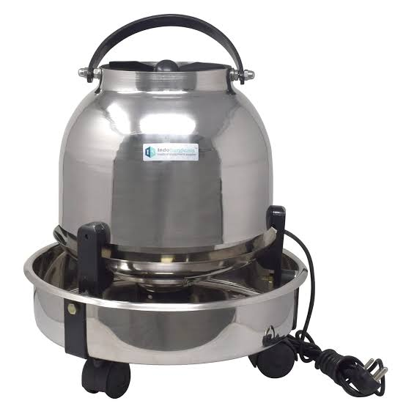
3- ELECTRIC BOILER FUMIGATION METHOD:
For each 1000 cubic feet, 500 ml of formaldehyde (40% solution) is added to 1000 ml of distilled water in an electric boiler.
Switch on the boiler, leave the room, and seal the door.
After 45 minutes, switch off the boiler without entering the room (Switch off the main from outside).

Slide 15
Mostly Used Chemicals: (for fumigation)
1- Hydrogen cyanide:
2- Iodoform:
3- Formaldehyde:
4- Magnesium Phosphide:
5- Methyl Bromide:
6- Sulfuryl Fluoride:
7- Phosphine:
8- 1,3-Dichloropropene:

Slide 16
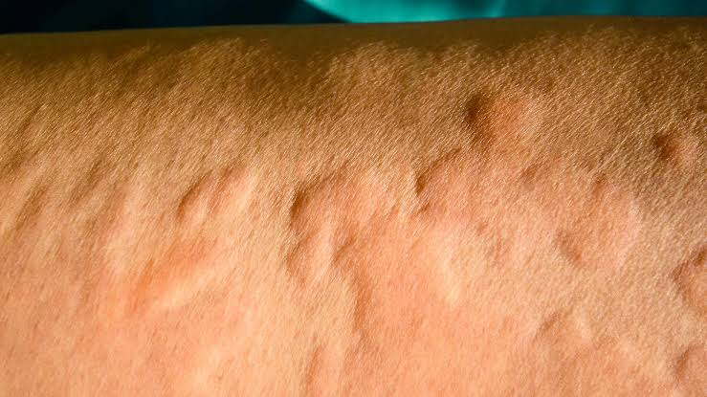
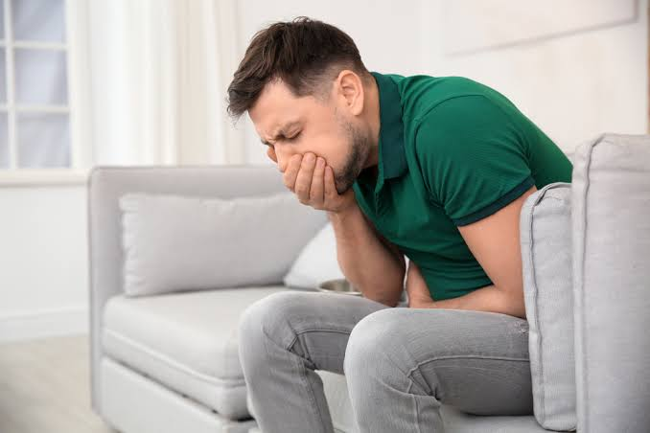
Side Effects
Coughing
Nausea
Vomiting
Secretion of more saliva
Sweating
Red eyes
Itchy skin
A running stomach

Slide 17
Treatment:
At the hospital, the stomach will be emptied using oral or IV (intravenous) medication, a process called regurgitation, such that the concentration of the chemicals in the body is reduced.
A corticosteroid (usually a drug called hydrocortisone) will also be given to dilute the poison further and reduce the possible damage the chemicals might have on the liver and the kidneys

Slide 18

Quiz :
Operation Theatre Size = 2500 Cubic Feet
How much :
Formaldehyde needed for fumigation?
Ammonia needed for neutralization?

Slide 19
Answer :
Formaldehyde needed for fumigation = 2500/1000*500= 1250ml
Ammonia is required for neutralization =2500/1000*300= 750ml

Slide 20



