Slide 1

ANATOMY
BS RIT,OTT,MLT
1ST SEMESTER
DR DANISH

Slide 2
Joints
A joint (articulation) is a point where two or more bones meet.
E.g: head of femur articulate with the acetabulum of hip making hip joint.
Head of humerus articulate with glenoid cavity of scapula making glenohumeral joint

Slide 3
Classification of Joints
Synarthroses
Diarthroses

Slide 4
Synarthroses (Definition)
Synarthroses are immovable joints.
Bones are firmly united, allowing no mobility.
Provide strength and stability, especially in the skull.
Syn:together
Arthros:joint

Slide 5
Types of Synarthroses
A. Fibrous Synarthroses
B. Cartilaginous Synarthrosis

Slide 6
Fibrous joints
Sutures
Gomphosis
syndysmosis

Slide 7
Sutures
Found only in the skull.
Bones are joined by a thin layer of dense fibrous tissue.
Become ossified in adulthood (forming synostosis).
Provide strength to protect the brain.

Slide 8
Types of sutures
Plane suture – straight edges (e.g., nasal bones).
Serrate suture – saw-toothed edges (e.g., sagittal suture).
Denticulate suture – tooth-like projections (e.g., lambdoid suture).

Slide 9
Gomphosis
Also known as peg-and-socket joint.
Occurs between:
  Root of tooth
  Alveolar socket of mandible or maxilla
Held together by periodontal ligament.
Function: provides firm anchorage to the tooth.

Slide 10
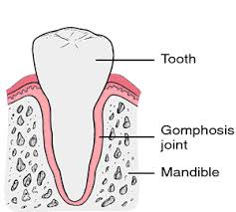

Slide 11
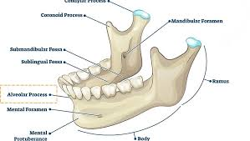

Slide 12
Syndesmosis
Bones connected by ligament or interosseous membrane.
Examples:
  Inferior tibiofibular joint
Movement is minimal or absent when the ligament is very tight → functionally synarthrosis.

Slide 13
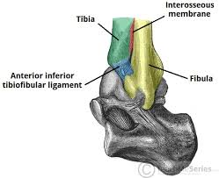

Slide 14
Cartilaginous joints
Type in which two bones are connected by cartilage

Slide 15
Types of cartilaginous joints
Synchondrosis
symphysis

Slide 16
Synchondrosis (Primary Cartilaginous Joint)
Bones are united by hyaline cartilage.
Immovable (Synarthrosis).
Found mainly in developing skeleton.
Many of them ossify with age → become synostosis(fusion of two or more bones)
Provide a temporary but strong union during bone growth.

Slide 17
Features of Synchondrosis
Hyaline cartilage is smooth and glassy.
No joint cavity.
Allow growth in length (e.g., long bones).
Low vascularity, hence slow healing.
Strong, rigid union.

Slide 18
Examples of Synchondrosis
Epiphyseal (growth) plate:
Between epiphysis & diaphysis of long bones.
Responsible for bone elongation in children.
Ossifies after puberty → synostosis.

Slide 19
Continued
First sternocostal joint
Between first rib & manubrium of sternum.

Slide 20
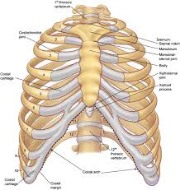

Slide 21
Symphysis (Secondary Cartilaginous Joint)
Bones are united by fibrocartilage.
Covered by thin hyaline cartilage at the articulating surfaces.
Slightly movable
Strong but flexible due to fibrocartilage.
Found in midline of the body (central axis).

Slide 22
Examples of Symphysis
Pubic symphysis
Between right & left pubic bones.
Intervertebral disc joints
Between bodies of vertebrae.
Manubriosternal joint
Between manubrium & body of sternum.

Slide 23
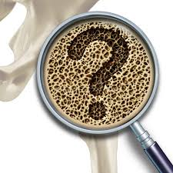

Slide 24
