Slide 1

BASIC MEDICAL SCIENCE
FSC MEDICAL TECHNOLOGIES I
DR DANISH

Slide 2
MECHANISM OF HEARING
Sound waves strike external ear

Slide 3
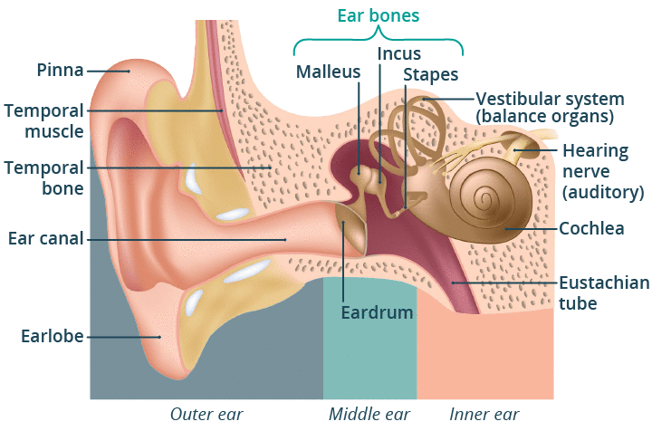

Slide 4
continued
Enter into external auditory meatus

Slide 6
Continued
Strike to tympanic membrane
Produce motion in tympanic membrane

Slide 7
Continued
Foot steps transmit vibrations at oval window

Slide 8
Continued
Pressure wave transmit to peri lymph in scala vestibule and scala tympani
Sound waves causes oval widow to buldge inward and round widow to bulge outward
Foot steps moves inward
Stimulation of hair cells
Vestibulochochlear nerve in auditory cortex

Slide 9
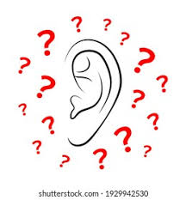

Slide 10
