Slide 1

BASIC MEDICAL SCIENCE
FSC MEDICAL TECHNOLOGIES I
DR DANISH

Slide 2
Tongue
Overview:
Muscular organ in the mouth.
Functions: chewing, swallowing, speaking, and helping breathing by keeping the airway open.
Changes in appearance may indicate an underlying health condition; consult a healthcare provider if symptoms persist >2 weeks.

Slide 3
What is the tongue?
A muscular organ aiding in chewing, speaking, and breathing.

Slide 4
Types of Papillae on the Tongue:
Filiform: small, thread-like structures covering the tongue surface.
Fungiform: mushroom-shaped papillae containing taste buds.
Foliate: leaf-like papillae on the sides of the tongue.
Circumvallate: large, circular papillae at the back of the tongue.

Slide 5
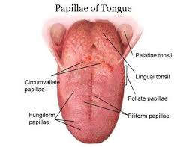

Slide 6
What does the tongue do?
Moves food for chewing and swallowing.
Helps form sounds for clear speech.
Keeps the airway open for proper breathing.

Slide 7
Location of the Tongue
Extends from the hyoid bone (middle of the neck) to the floor of the mouth.

Slide 8
What is the tongue made of?
The tongue is mostly made of muscles and connective tissue.
It is covered by mucosa (a moist, pink lining).
The tongue has four types of papillae that contain taste buds:
Filiform: thread‑like papillae on the front two‑thirds; no taste buds.
Fungiform: mushroom‑shaped bumps on the sides & tip; ~1,600 taste buds.
Circumvallate: large papillae at the back; ~250 taste buds.
Foliate: rough folds on the back sides; several hundred taste buds.

Slide 9
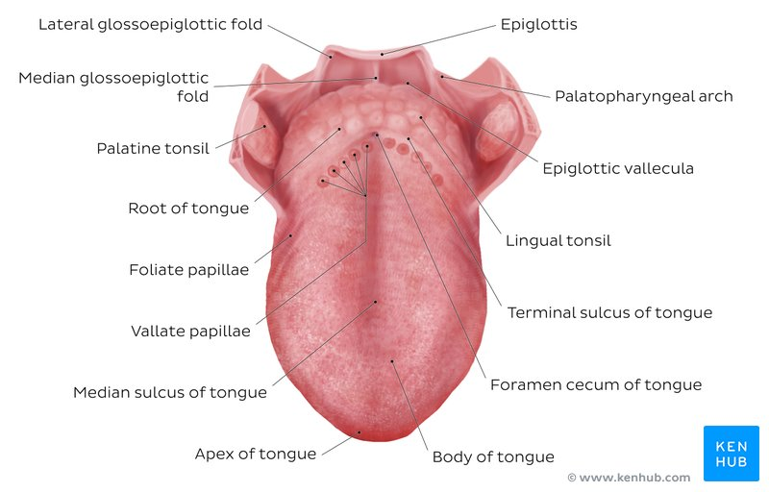

Slide 10
How do taste buds work?
Taste buds are clusters of nerve cells that send sensory messages to the brain. -
There are five basic tastes: sweet, salty, bitter, sour, umami (savory).
All taste buds can detect all five flavors; some areas are just slightly more sensitive to certain tastes

Slide 11
What color should a healthy tongue be?
A healthy tongue is typically pink, with shades of light to dark.
Discoloration can indicate a health problem.

Slide 12
What conditions or problems affect the tongue?
Difficulty moving your tongue:
Tongue symptoms can reveal overall health issues.
Nerve damage may cause weak or paralyzed tongue movement (affects the nerves that control tongue muscles).

Slide 13
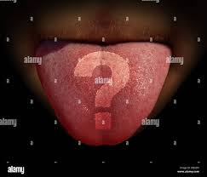

Slide 14


