Slide 1
RIT
Fsc RIT
Awais Hamza

Slide 2
Production of X-Rays & Interaction With Matter
What Are X-Rays?
High-energy electromagnetic radiation
Wavelength: 0.01–10 nm
Energy: keV range
Produced when high-speed electrons interact with matter
Ionizing radiation → can remove electrons from atoms

Slide 3
Electromagnetic (EM) Spectrum & X-Rays
X-rays lie between UV radiation and Gamma rays
Short wavelength → high frequency → high penetrating power
Diagnostic X-rays: 30–150 kVp
X-rays are man-made; gamma rays are emitted from nuclei

Slide 4
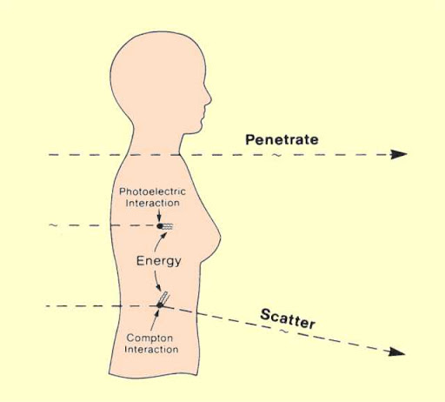
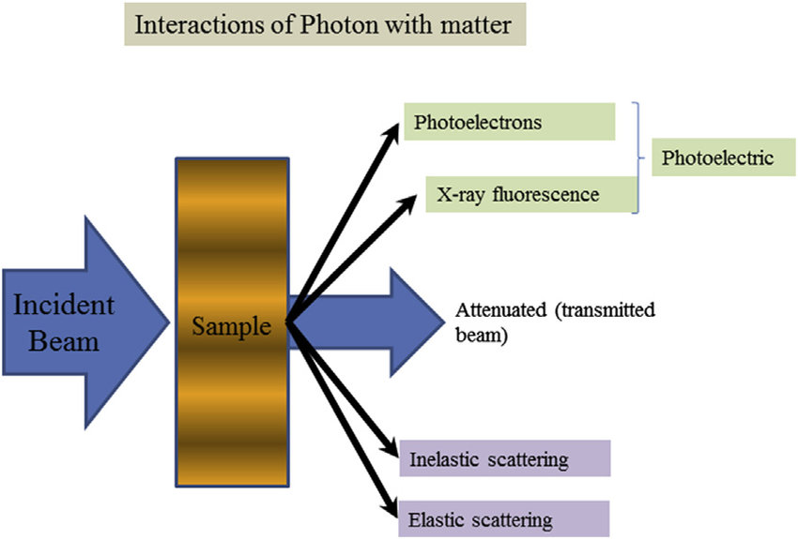

Slide 5
Production of X-Rays (Basic Requirements)
Source of electrons → Heated filament (thermionic emission)
Acceleration of electrons → High kVp
Sudden deceleration of electrons → Anode target
Vacuum tube → Prevents electron collision with air
Target material → Tungsten (W) due to high Z, melting point

Slide 6
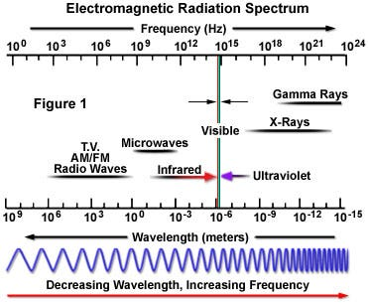

Slide 7
Steps of X-Ray Production
Thermionic emission: mA → heats filament → electrons boil off
Electron acceleration: kVp → drives electrons to anode
Electron–target interaction:
99% heat
<1% X-rays
Two main radiation types produced:
Bremsstrahlung (Continuous spectrum)
Characteristic radiation (Discrete peaks)

Slide 8
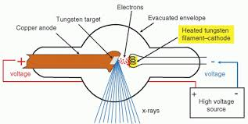

Slide 9
Bremsstrahlung Radiation
“Braking radiation”
Produced when electrons are decelerated near nucleus
Produces a continuous spectrum
Maximum photon energy = kVp
Contributes majority of diagnostic X-ray beam

Slide 10
Characteristic Radiation
Incident electron ejects inner-shell electron (usually K-shell)
Outer-shell electron fills vacancy → emits photon with fixed energy
Produces discrete peaks in emission spectrum
Tungsten K-shell characteristic peaks: ~59 & 67 keV

Slide 11
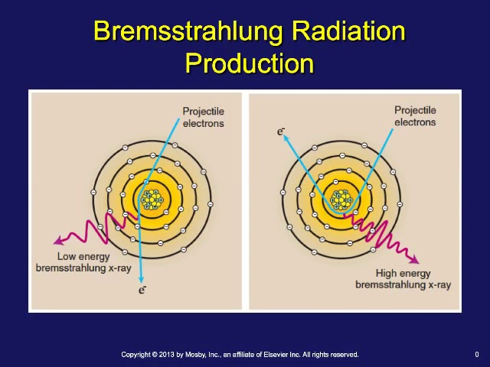

Slide 12
Combined X-Ray Spectrum
Diagnostic spectrum = Continuous (Brems) + Discrete (Characteristic)
Influenced by:
kVp → affects maximum energy & beam penetration
mA → affects total quantity (intensity)
Filtration → removes low-energy photons
Target material → characteristic peaks depend on Z

Slide 13
X-Ray Emission Spectrum
Includes:
Continuous spectrum: Range of photon energies up to kVp
Characteristic spectrum: Sharp peaks at specific energies
Beam quality vs. quantity:
Quality: controlled by kVp
Quantity: controlled by mA & exposure time

Slide 14
Interaction of X-Ray With Matter
Major interactions in diagnostic range:
Photoelectric effect (PE):
  Photon completely absorbed
  Depends on Z³ / E³
  Important for bone contrast
Compton scattering:
  Photon ejects outer electron
  Causes scatter → reduces image quality
Coherent scattering (minor)

Slide 15
Photoelectric Effect (PE)
Occurs with low–moderate energy photons
Produces high contrast (bone appears white)
Increases patient dose
Probability ↑ with:
High Z (bone, iodine)
Low energy photons

Slide 16
Compton Scattering
Dominant in soft tissue
Photon loses energy + changes direction
Produces fog/scatter on image
Major factor reducing image contrast
Increases radiographer dose

Slide 17
Filtration
Purpose:
Remove low-energy, useless photons, Reduce patient skin dose
Types:
Inherent filtration: glass, oil, housing, Added filtration: aluminum sheets
Total filtration requirement:
  ≥ 2.5 mm Al for diagnostic systems
Effect:
↑ Beam quality (hardens beam)
↓ Quantity

Slide 18
Collimation
Purpose:
Restrict X-ray beam size
Reduce scatter radiation
Improve image quality
Reduce patient dose
Types:
Aperture diaphragms
Cones/cylinders
Variable collimators (light beam diaphragm)

Slide 19
Types of X-Rays
Soft X-rays: low energy, higher absorption
Hard X-rays: high penetration
Diagnostic X-rays: imaging (30–150 kVp)
Therapeutic X-rays: radiotherapy (> 1 MV, technically X-ray beams from linac)
Characteristic X-rays: fixed energies
Bremsstrahlung X-rays: continuous spectrum

Slide 20
Clinical Applications of X-Rays
Diagnostic:
Radiography
Fluoroscopy
CT scan
Angiography
Mammography
Dental imaging
Therapeutic:
External beam radiotherapy
Brachytherapy source imaging

