Slide 1

Social Cognition III
Social Psychology
Hafsa Rasheed

Slide 2
What’s Priming?
How exposure to one stimulus influences later behavior
• Priming = activation of mental concepts, ideas, or feelings
• Happens automatically without awareness
• Makes certain thoughts more accessible in memory
• Strongly influences impressions, decisions, and actions

Slide 3
Types of Priming
Different ways the mind gets activated
• Semantic priming — meaning-based connections (doctor → nurse)
• Conceptual priming — activating related ideas (honesty → truth)
• Affective priming — mood/emotion activation (sad music → sad judgments)
• Subliminal priming — stimuli flashed too fast for awareness
• Goal priming — activating motivation (money primes → competitiveness)

Slide 4
Foundational Researchers
• John A. Bargh (American, Yale University) — pioneer of automaticity & priming
• Mark Chen (American, NYU) — social behavior priming
• Lara Burrows (American, Yale) — politeness/rudeness priming
• Anthony Greenwald (American, University of Washington) — subliminal priming
• Ap Dijksterhuis (Dutch, Radboud University) — unconscious thought & goal priming

Slide 5
How Priming Works in the Brain
Why priming is automatic
• Exposure activates a “node” in memory
• Related ideas become easier to access
• Amygdala responds quickly to emotional primes
• Prefrontal cortex becomes active only in conscious, controlled thought
• Priming works even when we are not paying attention

Slide 6
Bargh, Chen & Burrows (1996)
Rudeness vs Politeness Priming Experiment
Published in: Journal of Personality and Social Psychology (1996)
Researchers:
• John A. Bargh (American, Yale University)
• Mark Chen (Taiwanese-American, Yale/NYU)
• Lara Burrows (American, Yale University)

Slide 7
Continued
Method:
• Participants—Students— unscrambled sentences with either:
– Rude words
– Polite words
– Neutral words
This activated the concepts of politeness or rudeness in memory.
Findings:
• Rude-primed → interrupted quickly
• Polite-primed → waited much longer
• Shows behavior is automatically activated by subtle cues
After task → participants approached an experimenter who acted “busy, and blocked the way intentionally”

Slide 8

This proved:
➡️ Behavior can be shaped without awareness
➡️ Reading words can activate a mental concept
➡️ The activated concept influences real actions
This experiment became the foundation of automatic social behavior research.

Slide 9
The “Elderly Walking” Priming Study
How stereotypes shape physical behavior
Researchers: Bargh, Chen, Burrows
Also in 1996
Prime: Words associated with old age (Florida, wrinkle, bingo)
Result: Participants walked slower after the experiment
Meaning: Stereotypes can influence physical actions without awareness

Slide 10
Conceptual Priming Examples
How ideas activate related ideas
• Thinking of “honesty” → more likely to recall truthful memories
• Seeing the word “library” → automatically lowers your voice
• Thinking of “confidence” → may stand straighter
Priming is subtle but powerful.

Slide 11
Affective (Emotion) Priming
How moods get activated
• Sad music → makes people interpret faces as sad
• Happy faces flashed briefly → improve mood
• Angry primes → increase aggressive interpretations
Affect primes shift mood and judgment instantly.

Slide 12
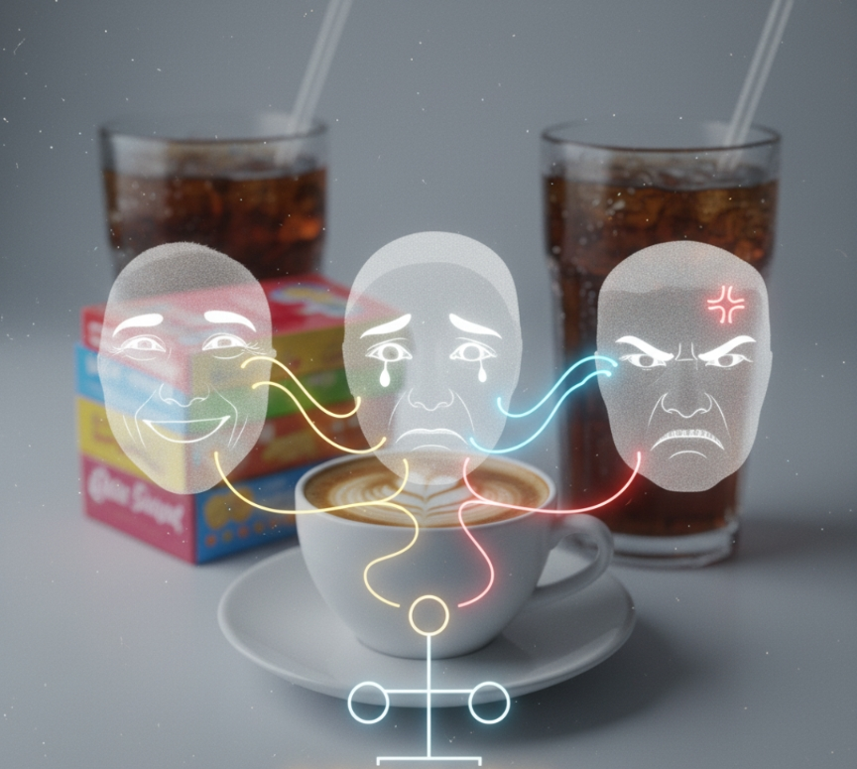
Subliminal Priming
Stimuli shown below conscious awareness
Anthony Greenwald (American, University of Washington)
• Flashed words/images at 30 milliseconds
• Participants could not consciously see them
• But behavior and choices changed subtly
Examples:
• Smile flashed → participants rate drink as tastier
• Threat word flashed → short-term anxiety increases

Slide 13
📌 MEANING
➡️ Subliminal stimuli influence emotions and decisions
➡️ Awareness is NOT necessary
➡️ The unconscious plays a major role in Social Cognition

Slide 14
Goal Priming
How environment triggers motivation
Researchers:
• Ap Dijksterhuis (Dutch, Radboud University)
• Henk Aarts (Dutch)
Findings:
• Money primes → people become more independent
• Achievement words (win, succeed) → increase task performance
• Religious primes → increase generosity (Shariff & Norenzayan, Canada)

Slide 15
Features of Automatic Thinking
Why it dominates everyday life
• Happens without intention
• Cannot be turned off
• Efficient but prone to bias
• Handles routine, emotional, or rapid tasks
Example:
Automatically assuming someone is angry based on tone.

Slide 16
Features of Controlled Thinking
Effortful but accurate
• Requires focus
• Used for calculations, planning, analyzing
• Reduces errors when we slow down
• Limited by fatigue and stress

Slide 17
When Automatic and Controlled Processing Interact
Both systems operate together
• Automatic creates quick impressions
• Controlled thinking can override them
• But under stress → we fall back to automatic thinking
• Explains panic reactions and overreactions

Slide 18
What Is Unpriming?
Reducing priming effects after expression
• Concept by John Bargh
• When a primed concept is expressed → its influence decreases
• “Releasing” the primed thought reduces later impact
Example:
• If you write about your mood, the emotional prime weakens.

Slide 19
Why Priming Matters?
Importance in real life
• Shapes first impressions
• Influences behavior in classrooms, workplaces, hospitals
• Used in advertising and political messaging
• Affects stereotypes and prejudice
• Helps understand unconscious biases

Slide 20
Role of Priming in Attitudes
Priming Makes Attitudes More Accessible
When a concept is activated → the attitude linked to it becomes easier to retrieve.
Example:
• Seeing a fast-food ad → activates “hunger” → positive attitude toward food increases.
Affective Priming Shapes Attitude Valence
Emotion = the quickest path to attitude change.
Examples:
• Sad music → negative judgments
• Happy faces → positive evaluations
• Emotional political speeches → activate strong attitudes

Slide 21
Continued
Subliminal Primes Alter Consumer Attitudes
Even without awareness:
• Smiling face flashed → drink feels better
• Threat word flashed → product seems unsafe
• “SALE” prime → attitude shifts toward buying
Priming Makes Attitudes Predict Behavior
If a primed attitude is fresh → it guides immediate actions.
Example:
Primed with “honesty” → more likely to speak truthfully in the next conversation.

Slide 22
Continued
Priming Influences Attitude Formation
If you have no strong attitude about something, priming may create one.
Example:
• Religious primes → increase generosity → form “giving is good” attitude
• Money primes → shift attitude toward independence
Priming Strengthens Stereotype-Based Attitudes
Schemas get activated automatically.
Example:
• Prime: “elite school” → activates “competent, disciplined”
• Prime: “government office” → activates “slow, paperwork”
These shape social attitudes instantly.

