Slide 1

GENERAL ANATOMY
DPT
1ST SEMESTER
DR DANISH

Slide 2
CARTILAGE
Specialized connective tissue with firm, flexible matrix.
Avascular(WITHOUT BLOOD SUPPLY): nutrition by diffusion.
Cells: Chondroblasts & chondrocytes.
Matrix: Ground substance + collagen/elastic fibers.
Perichondrium: Present except in articular cartilage and fibrocartilage.
Provides support, flexibility, shock absorption, and smooth surfaces for joints.

Slide 3
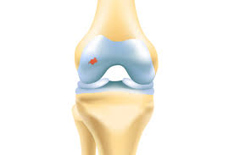

Slide 4
TYPES OF CARTILAGE & THEIR DISTRIBUTION
1. Hyaline Cartilage
2. Elastic Cartilage
3. Fibrocartilage

Slide 5
Hyaline Cartilage
Most common type; bluish-white and translucent.
Contains fine type II collagen fibers.
Has perichondrium (except at articular surfaces).

Slide 6
Distribution
Articular cartilages of synovial joints
Costal cartilages
Nose: septal & lateral nasal cartilages
Larynx: thyroid, cricoid, arytenoid (except epiglottis)
Trachea & bronchi
Epiphyseal (growth) plates in children

Slide 8
Elastic Cartilage
Yellow, flexible; contains elastic fibers + type II collagen.
Has perichondrium.

Slide 9
Distribution
Pinna of ear
Epiglottis
Eustachian tube
Corniculate & cuneiform cartilages of larynx

Slide 10
Fibrocartilage
Strongest type; contains dense type I collagen fibers.
No perichondrium.
Resists traction, compression, and shearing.

Slide 11
Distribution
Intervertebral discs
Pubic symphysis
Menisci of knee
TMJ articular disc
Glenoid & acetabular labrum
Interosseous ligaments (e.g., sternoclavicular joint)

Slide 12
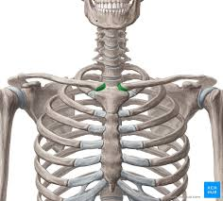

Slide 13
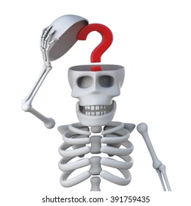

Slide 14


