Slide 1

ANATOMY
BS RIT,MLT,OTT
1ST SEMESTER
DR DANISH

Slide 2
Venous Drainage of Long Bones
Central venous sinus lies in the medullary cavity and collects blood from medullary sinusoids.
➤ It acts like the main drainage channel inside the long bone.
Receives veins formed from arterial loops of medullary arteries.
➤ Blood that enters through arteries returns through this sinus.

Slide 3
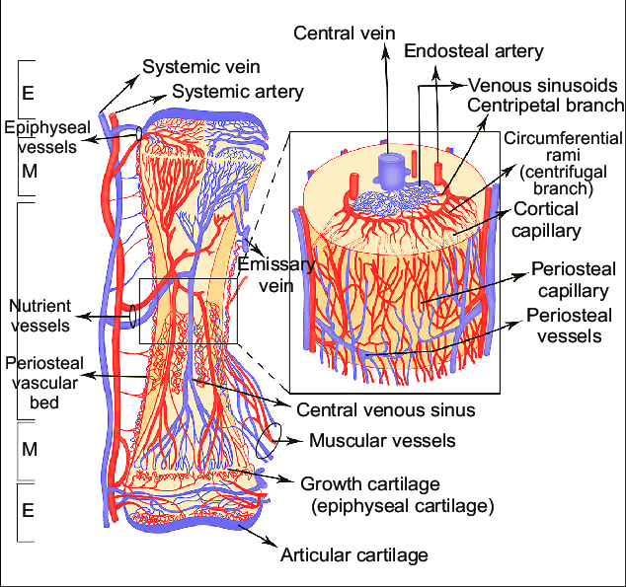

Slide 4
CONTINUED
The sinus drains out via the nutrient foramen, following the nutrient artery.
➤ This is the major exit path for venous blood.
Periosteal venous plexus drains cortical capillaries.
➤ Cortical bone drainage moves outward toward periosteal veins.
Metaphyseal and epiphyseal veins drain the bone ends through many foramina.
➤ Ends of long bones have rich venous networks.

Slide 6
Blood Supply of Short Bones
Supplied by numerous fine arteries entering through non-articular surfaces (areas without joints).
➤ These arteries nourish both compact and spongy bone.
Venous drainage occurs via 1–2 veins leaving through vascular foramina.
➤ Short bones have simpler venous routes compared to long bones.

Slide 7
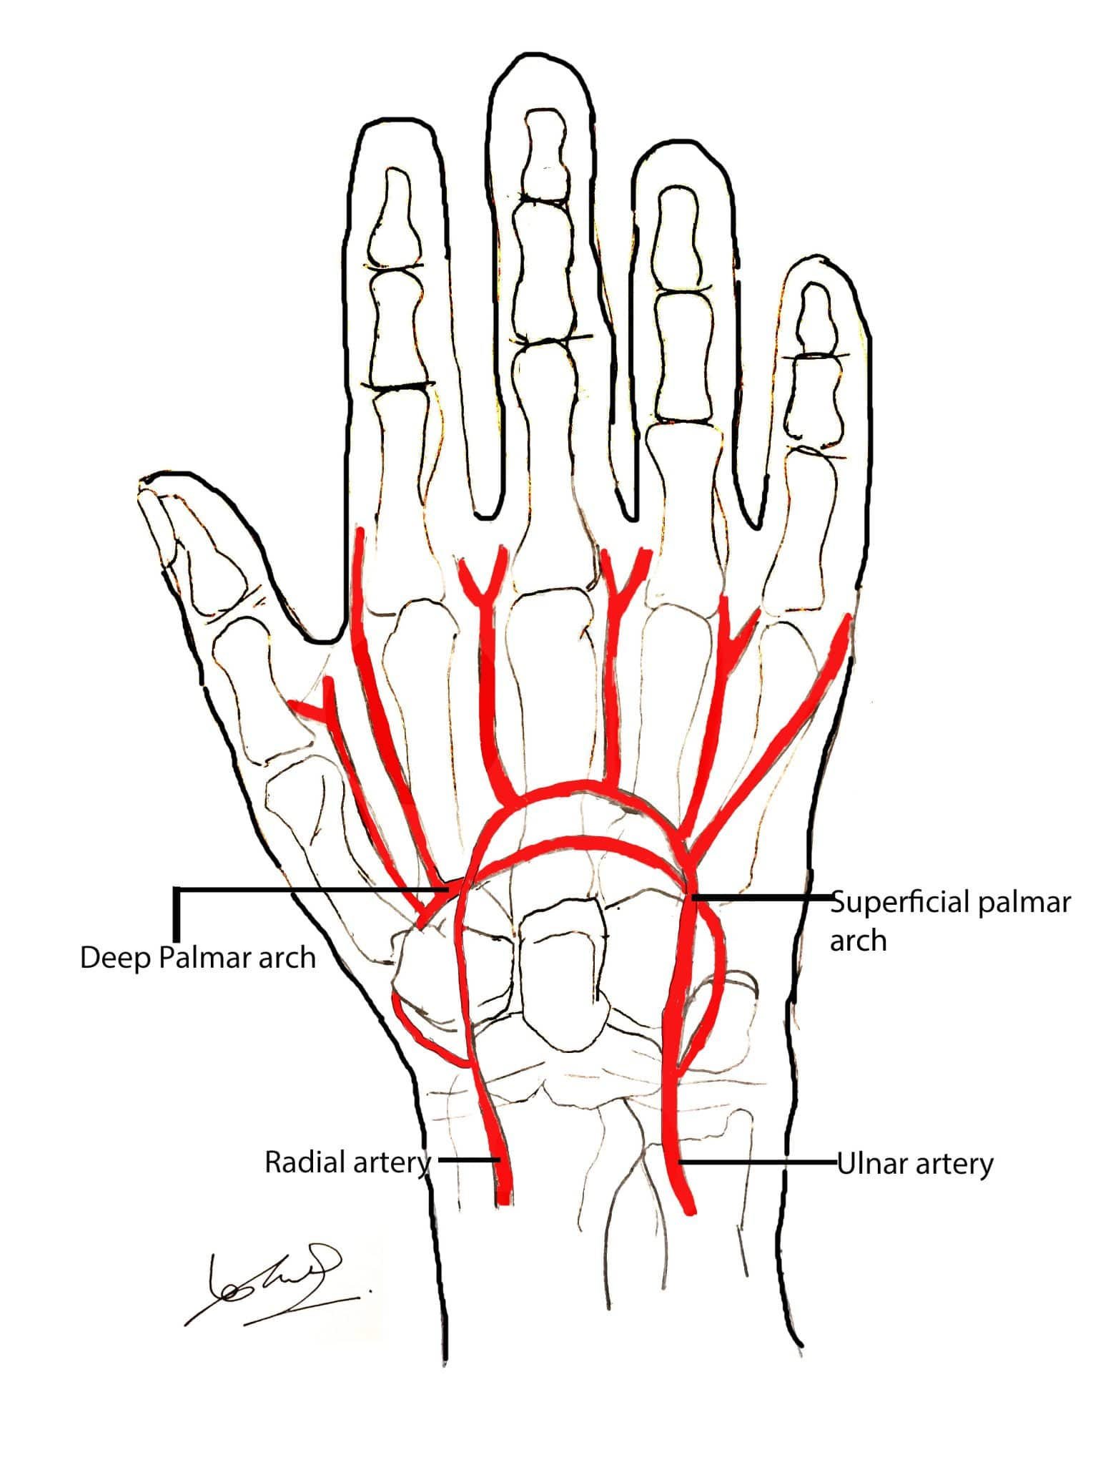

Slide 8
Blood Supply of Flat Bones
Supplied by periosteal arterial plexuses.
➤ Flat bones rely heavily on surface vessels.
Veins are large, thin-walled, running through diploë canals.
➤ Diploë = spongy layer between compact bone layers.
Example: Ribs receive blood from periosteal arteries + one nutrient artery near the tubercle.

Slide 9
Blood Supply of Irregular Bones
Receive many vessels from periosteal plexus.
➤ Surface vessels are significant in irregular bones.
Also supplied by large nutrient arteries entering cancellous bone.
➤ Internal regions also get strong blood flow.
Both systems anastomose freely (connect with each other).
➤ Ensures continuous blood supply even if one route is blocked.
Veins drain from the bone surface.

Slide 10
Bone Injury and Repair
Fracture
A break in bone continuity.
Closed (simple) fracture: skin remains intact.
Open (compound) fracture: skin is broken, external wound present.

Slide 11
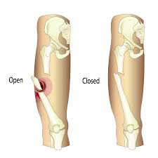

Slide 12
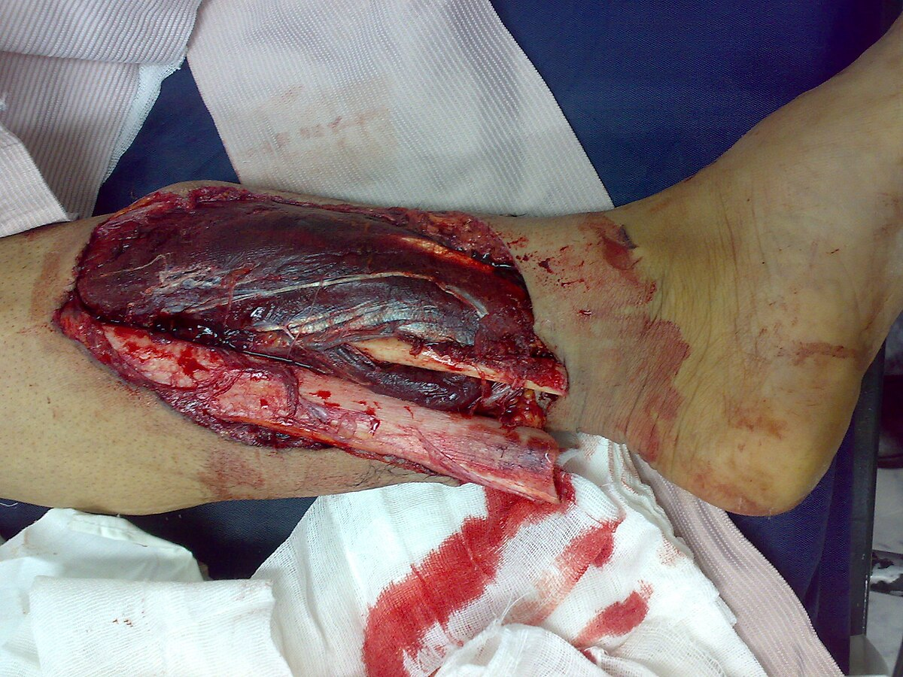

Slide 13
Healing of a Fracture
Bleeding occurs → a blood clot (hematoma) forms.
➤ Clot sets the stage for healing.
Fibroblasts + osteoprogenitor cells invade the clot and create granulation tissue.
➤ This early tissue bridges the fracture gap.
Osteoprogenitor cells → chondroblasts → form fibrocartilage callus.
➤ Soft callus stabilizes the fracture.

Slide 14
CONTINUED
Later, osteoprogenitor cells → osteoblasts → form bony callus.
➤ Soft callus turns into hard bone.
The bony callus is remodeled into mature bone, restoring shape and strength.
➤ Excess bone is reshaped to normal contour.

Slide 15


Slide 16


