Slide 1

Getting & Giving Information
Functional English | BS
Hafsa Rasheed

Slide 2
Learning Objectives
Students will be able to:
Ask for information clearly & politely
Give information accurately & concisely
Use correct grammar forms (tenses, question forms, past tense)
Understand formal vs informal requests
Narrate past events with clarity & sequence
Practice real-life medical communication
Use polite language & conversational structure

Slide 3
Why This Skill Is Essential
You use it in:
✅ Academic communication
✅ Professional conversations
✅ Medical history-taking
✅ Reporting incidents
✅ Group discussions
✅ Daily communication
✅ Writing paragraphs, essays, and summaries

Slide 4
Communication Theory
Breakdown of success depends on:
Clarity
Tone
Relevance
Timing
Body language
Grammar & word choice
Effective information exchange requires:
Sender
Message
Medium
Receiver
Feedback

Slide 5
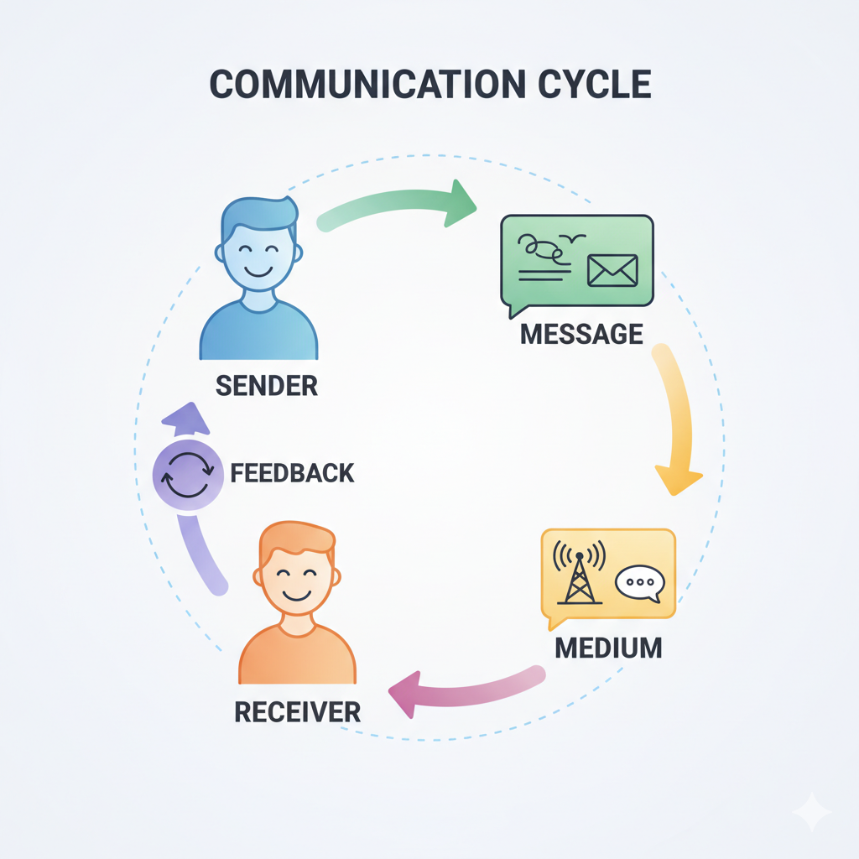

Slide 6
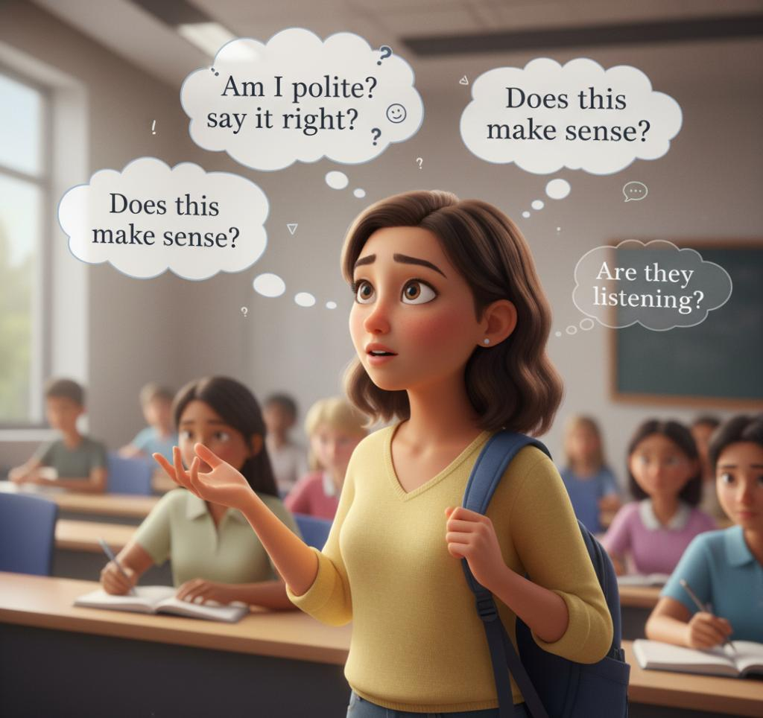
What Happens in the Mind of the Speaker
“Am I sounding rude?”
“Am I asking too many questions?”
“Is my English correct?”
“Am I looking confused?”
“Did I explain it properly?”
“Should I give more details or fewer?”
“Will the listener understand?”

Slide 7
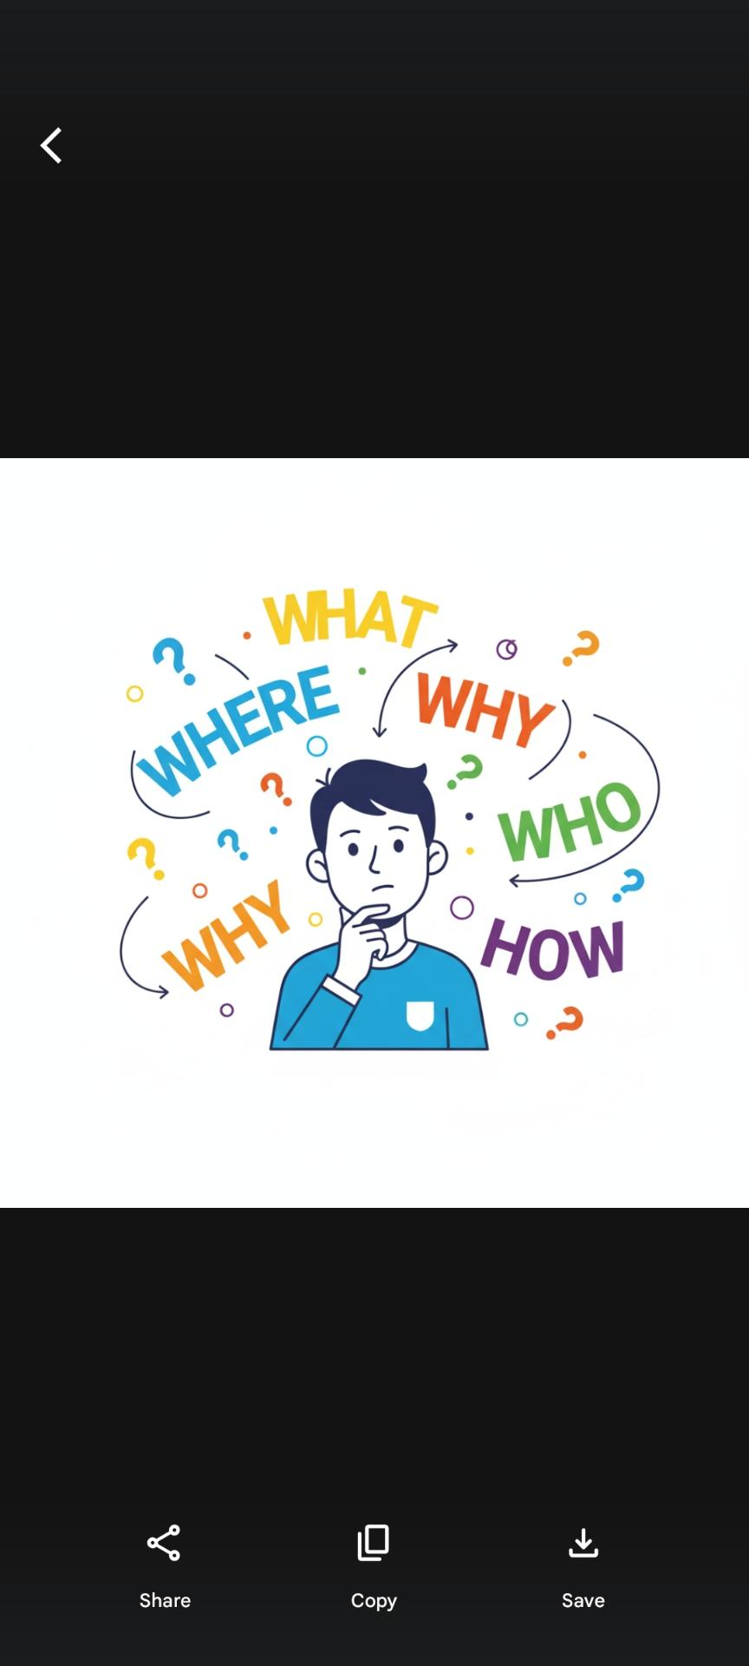
Grammar Behind Asking for Information
Question Types:
1. WH-questions: What, When, Where, Why, Who, How
2. Yes/No questions: Are you…? Do you…?
3. Indirect Questions:
“Could you please tell me…”
“Would you mind explaining…”
Indirect forms = polite tone.

Slide 8
Grammar Behind Giving Information
Useful sentence patterns:
“It is located…”
“This means that…”
“The reason is…”
“There are three main points…”
“Firstly… secondly… lastly…”
For recounting past events:
Past Simple (I went, I saw, I met)
Past Continuous (I was studying…)
Time markers: yesterday, last year, previously, later, at that moment

Slide 9
Language of Getting Information
Formal:
“Could you explain…?”
“Would you please tell me…?”
Neutral:
“Can you tell me…?”
“Do you know…?”
Informal:
“What’s this?”
“Where do we go now?”

Slide 10
Language of Giving Information
Useful starters:
“According to…”
“The main point is…”
“What happened was…”
“In summary…”
“To clarify…”

Slide 11
Structure of Recounting Past Events
Setting the scene
2️⃣ Sequence of events
3️⃣ Key details
4️⃣ Your response or feelings
5️⃣ Ending / result

Slide 12
“Yesterday, I visited the anatomy lab for the first time. I was nervous at first, but the instructor explained everything clearly. Later, we observed a demonstration. It was a new and exciting experience.” (Simple)
“The patient reported pain that started two days ago. At first, it was mild, but yesterday it increased. He was unable to sleep at night. Today, he came for a checkup.” (Medical)

Slide 13
✅ Ask politely
✅ Use short, clear questions
✅ Confirm understanding
✅ Keep details relevant
✅ Use past tense correctly
✅ Maintain eye contact
✅ Pause between ideas
❌ Asking too many questions at once
❌ Giving long explanations
❌ Using vague words
❌ Becoming defensive
❌ Using informal tone in formal settings
❌ Jumping between tenses

Slide 14
Acitivity
Write in 4 lines:
Ask a question formally
Give short information
Recount 1 past event
4. One learning from today

