Slide 1

ANATOMY
BS RIT,MLT,OTT
1ST SEMESTER
DR DANISH

Slide 2
Blood supply of long bones
Introduction:
Long bones have a rich and complex vascular system.
Adequate blood supply is essential for growth, nutrition, repair, and viability of bone.
Four main sources supply a long bone: nutrient artery, metaphyseal arteries, epiphyseal arteries, and periosteal arteries.

Slide 3
Nutrient Artery
The main and largest artery supplying the diaphysis.
Enters the shaft through the nutrient foramen, directed away from the growing end.
Once inside the medullary cavity, divides into ascending and descending branches.
Supplies:
  Inner 2/3 of compact bone
  Haversian system
  Medullary cavity

Slide 4
Continued
Plays a critical role in fracture healing—its injury delays union.

Slide 5
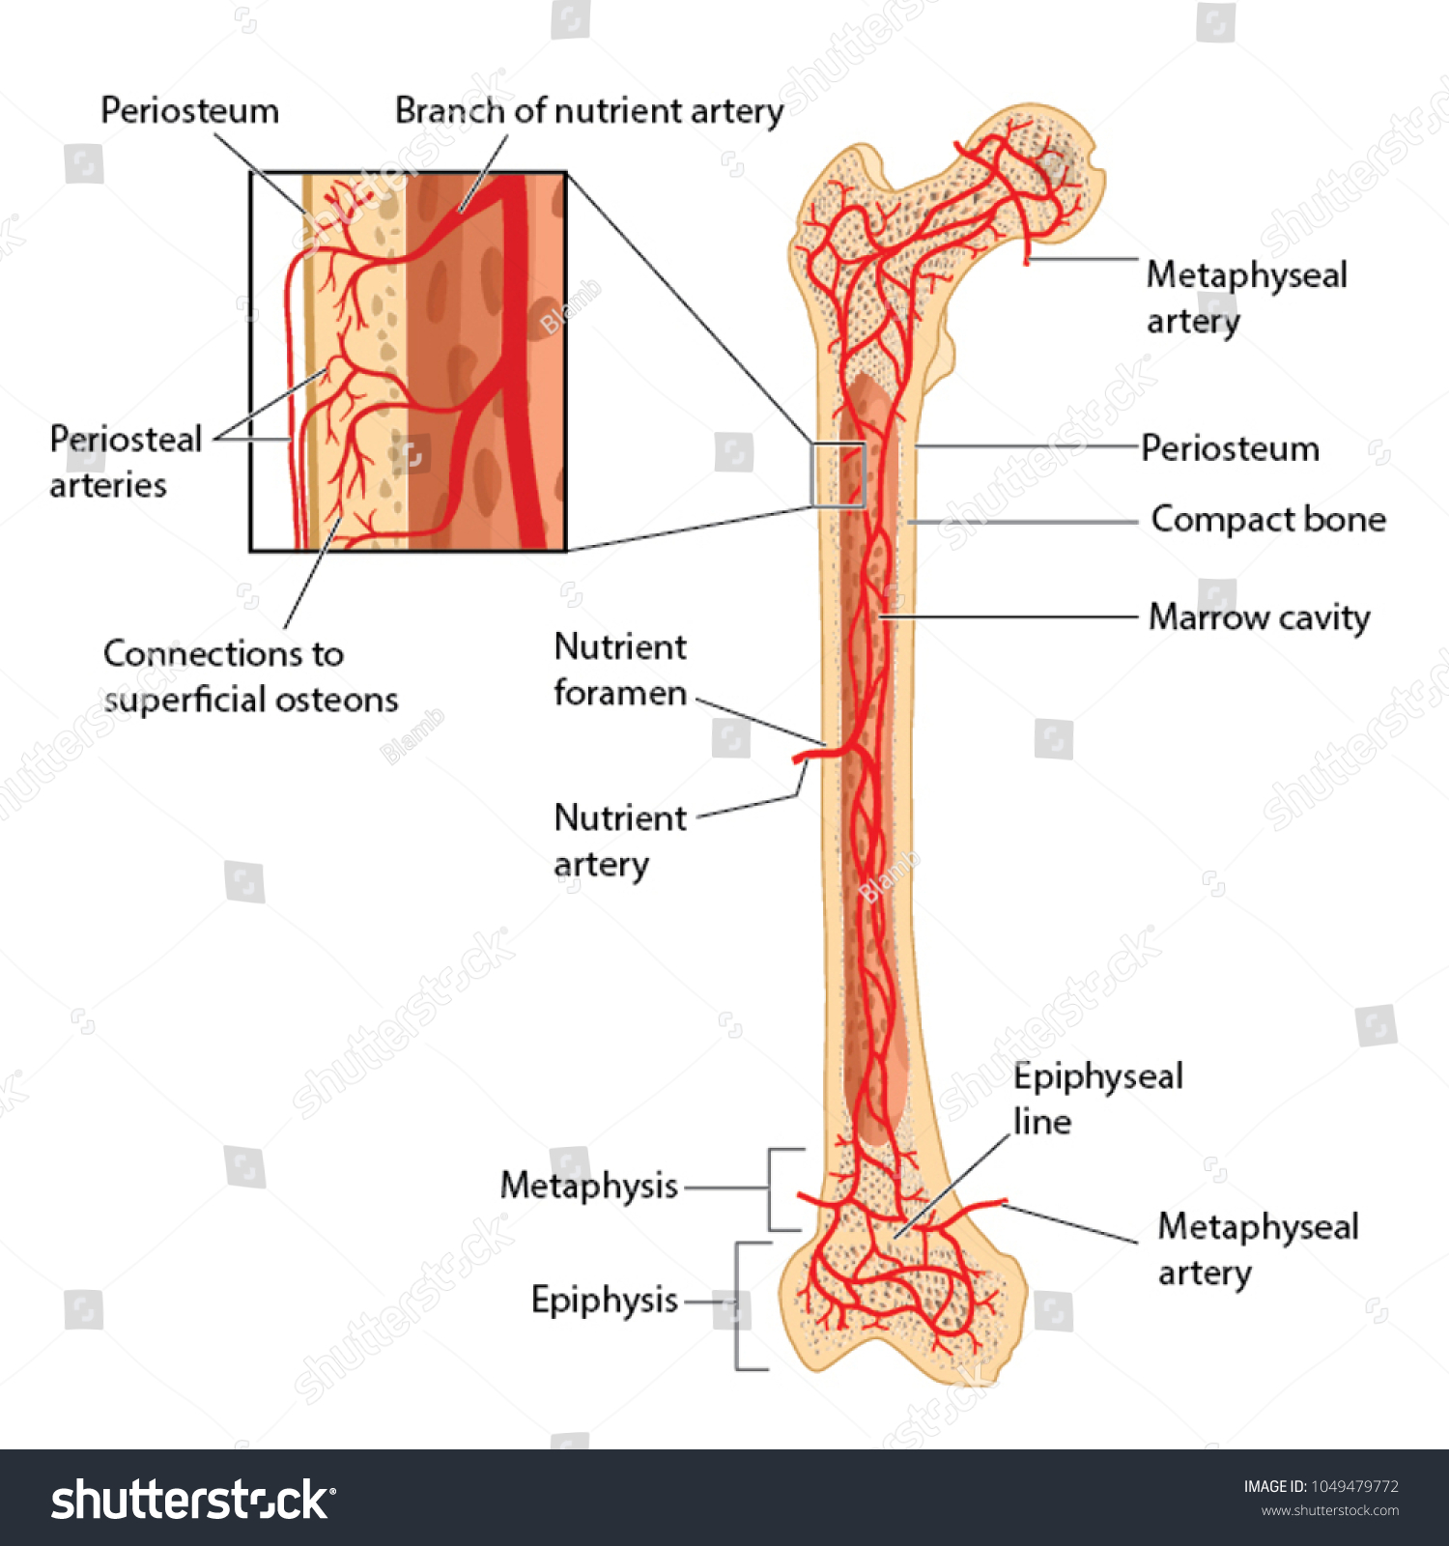

Slide 6
Metaphyseal Arteries
Arise from nearest systemic arteries (e.g., branches of periarticular vessels).
Enter the bone at the metaphysis, an area with high vascularity.
Function:
  Support the growth plate region.
  Supply the metaphyseal trabeculae.
  Provide collateral circulation if nutrient artery flow is compromised.

Slide 7
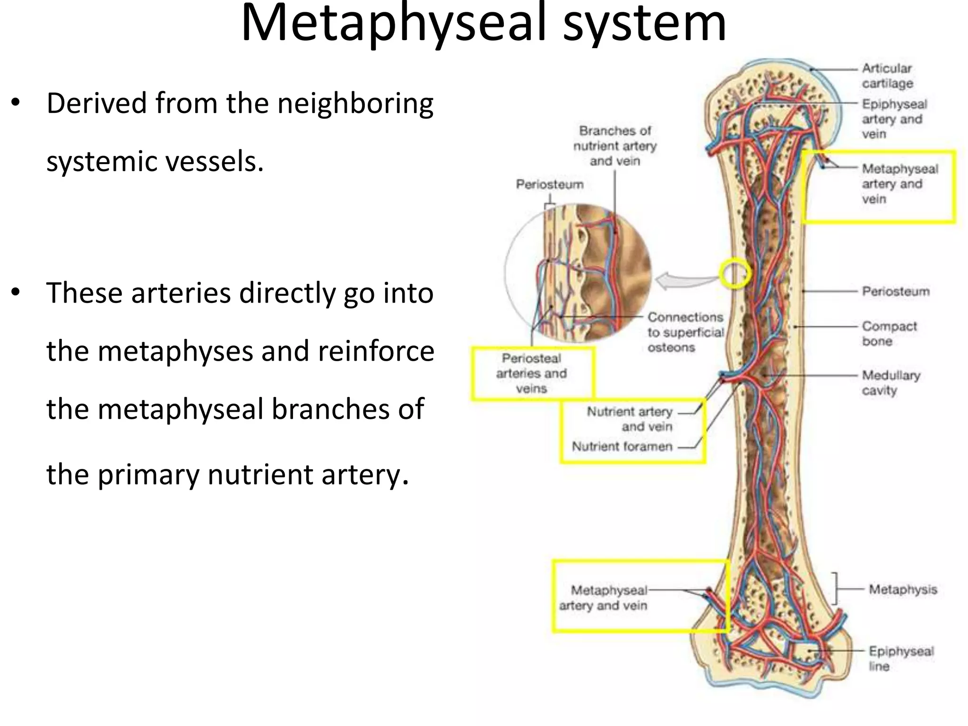

Slide 8
Epiphyseal Arteries
Originate from periarticular arterial anastomoses (networks of arteries that connect around a joint).
Supply:
  Epiphysis
  Articular ends
  Epiphyseal cartilage (in growing bones)
Damage may lead to growth disturbances, especially in children.

Slide 9
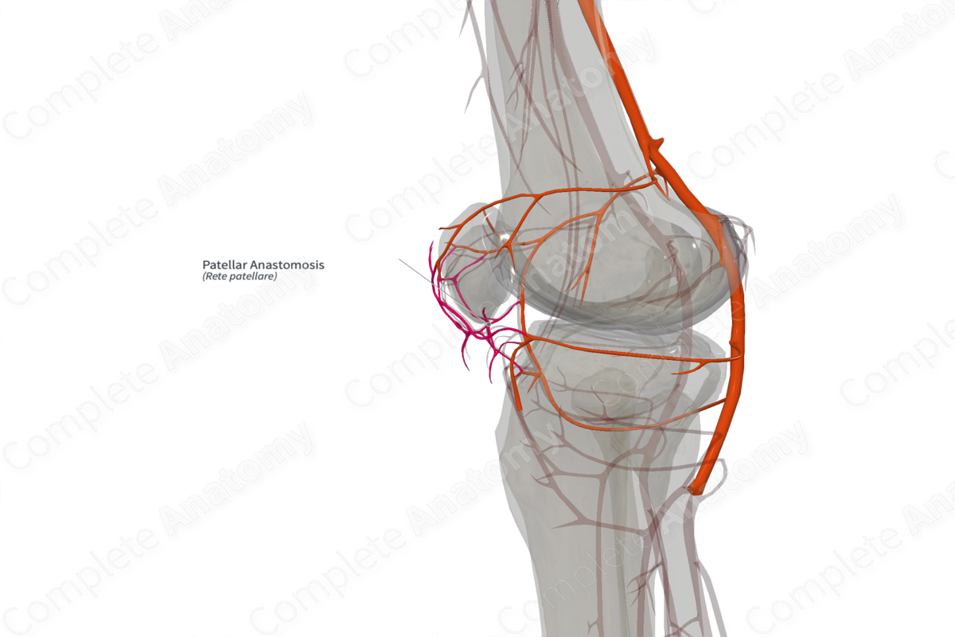

Slide 10
Periosteal Arteries
Numerous small vessels from muscle attachments and surrounding soft tissues.
Supply:
  Outer 1/3 of the compact (cortical) bone.
Most important in:
  Adults, since the periosteum is more vascular.
  Fracture healing, through external callus formation.

Slide 11
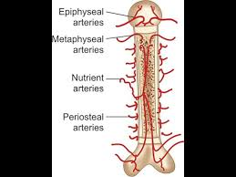

Slide 12
Summary
Nutrient artery → Inner diaphysis
Metaphyseal arteries → Metaphysis
Epiphyseal arteries → Epiphysis
Periosteal arteries → Outer cortex

Slide 13


Slide 14


