Slide 1

Adverbs
English| FSC
Hafsa Rasheed

Slide 2
Learning Objectives
By the end of this lecture, students will be able to:
✅ Define adverbs easily
✅ Identify adverbs in sentences
✅ Recognize types of adverbs
✅ Know where to place adverbs
✅ Compare adverbs (degrees)
✅ Use adverbs correctly in writing and speech.

Slide 3
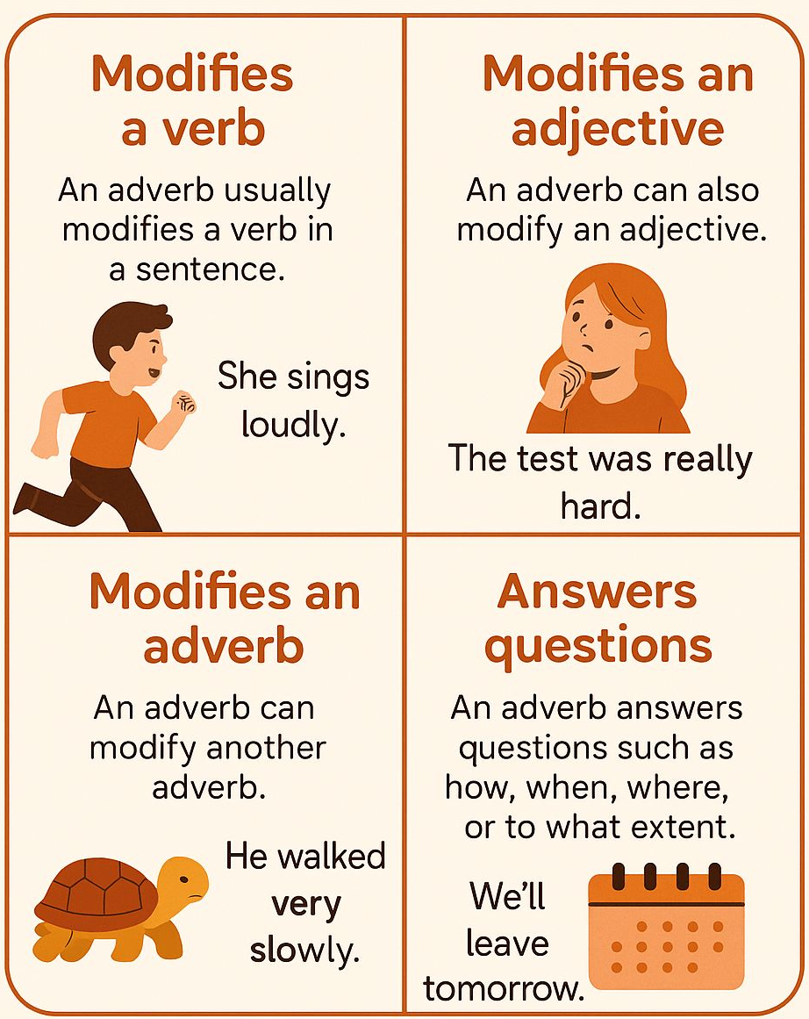
What is an Adverb?
An adverb is a word that tells more about a verb, an adjective, or another adverb.
It answers questions like:
➡️ How?
➡️ When?
➡️ Where?
➡️ How often?
➡️ To what extent?
Tip: If a word adds extra detail to how, when, or where something happens — it’s probably an adverb!

Slide 4
Examples:
She sings sweetly. (How?)
They came yesterday. (When?)
The cat is inside. (Where?)
He always wakes up early. (How often?)
It’s very hot today. (To what extent?)

Slide 5
1. Adverbs of Manner (How?)
➡️ Tell how an action happens.
Usually end in –ly.
Examples: slowly, quickly, beautifully, angrily
He speaks politely.

Slide 6
2. Adverbs of Time (When?)
➡️ Tell when an action happens.
Examples: yesterday, today, soon, now, later, before
We will leave tomorrow.

Slide 7
3. Adverbs of Place (Where?)
➡️ Tell where an action happens.
Examples: here, there, outside, upstairs, nearby, everywhere
Come here quickly.

Slide 8
4. Adverbs of Frequency (How often?
➡️ Tell how many times or how often.
Examples: always, never, often, sometimes, rarely, usually
I always brush my teeth.

Slide 9
5. Adverbs of Degree (How much?)
➡️ Tell to what extent or how much something happens.
Examples: very, too, almost, quite, enough, totally, extremely
She is very tired.

Slide 10
6. Adverbs of Reason (Why?)
➡️ Tell why something happens.
Examples: therefore, thus, hence, consequently
He was sick; therefore, he stayed home.

Slide 11
7. Interrogative Adverbs (for Questions)
➡️ Ask questions about actions.
Examples: when, where, why, how
How did you do that?

Slide 12
8. Relative Adverbs (to Join Clauses)
➡️ Join one idea to another.
Examples: when, where, why
That’s the place where I met her.

Slide 13
9. Adverbs of Affirmation & Negation
Show agreement or denial.
Examples: yes, surely, certainly, no, never, not
She will surely win the prize.

Slide 14
10. Adverbs of Condition
➡️ Show a condition for something to happen.
Examples: if, unless, provided that
You can play if you finish homework.

Slide 15
More Kinds (Based on Use)
Simple Adverb: He ran fast. One-word adverb
Compound Adverb: He came anywhere. Made of two parts
Adverb Phrase: She spoke in a low voice. A phrase doing adverb’s job
Adverb Clause: He went because he was late. A group with subject + verb

Slide 16
Position of Adverbs
Manner : After the verb ----- She smiled sweetly.
Place: After verb/object ----- He looked outside.
Time: Usually at end ----- We’ll go tomorrow.
Frequency: Before main verb / after “be”-----She always helps. / She is never late.
Degree: Before adjective/adverb/verb -----It’s too hot. / He runs very fast.

Slide 17
Adverbs are flexible — but meaning changes if you move them!
📘 Only I hate you. ≠ I only hate you.

Slide 18
Formation of Adverbs
Most adverbs are formed by adding –ly to adjectives.
Adjective+ly Adverb
quick: quickly -----She runs quickly.
Happy: happily -----They danced happily.
Slow : slowly -----The turtle moved slowly.

Slide 19
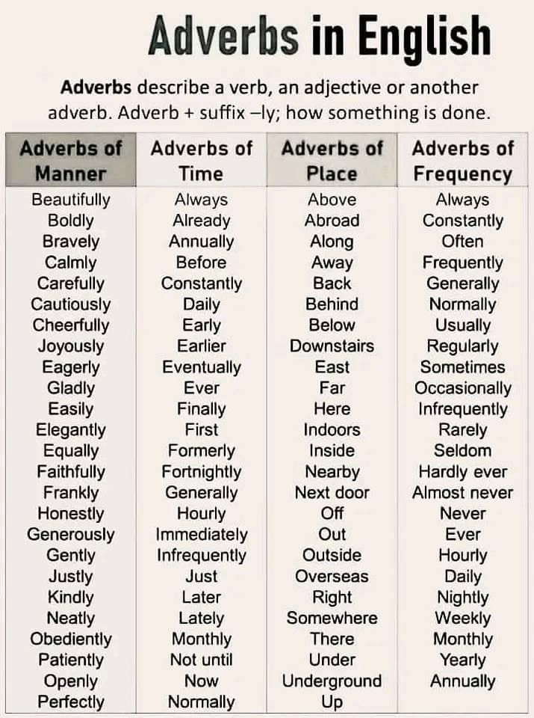
Irregular adverbs (no –ly rule):
Good → well
fast → fast
hard → hard
late → late

Slide 20
Degrees of Comparison of Adverbs
Positive: fast ----- He runs fast.
Comparative: faster ----- He runs faster than Ali.
Superlative: fastest ----- He runs the fastest.
Adverbs with –ly → use more and most:
beautifully → more beautifully → most beautifully

Slide 21
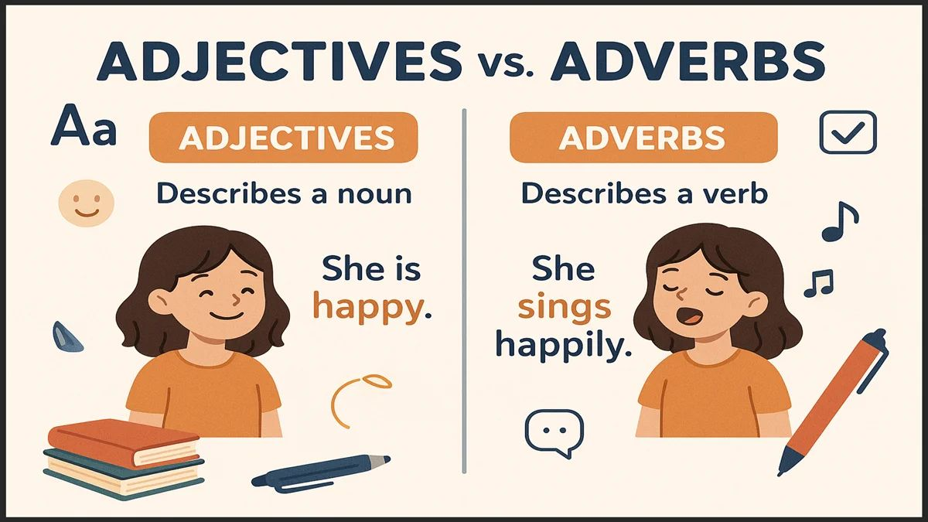
Adverb vs. Adjective
Trick: Adjectives describe nouns, adverbs describe verbs! vs. Adjective
She is a beautiful singer. | She sings beautifully.
He is a good player. | He plays well.

Slide 22
Spot the Adverb
He always helps others.
The train arrived late
She spoke softly to the child.

