Slide 1
Law of Conservation of Momentum
Awais Hamza
Fsc Medical Technologies

Slide 2
Law of conservation of momentum
The law of conservation of momentum states that when two objects collide in an isolated system, the total momentum before and after the collision remains equal. This is because the momentum lost by one object is equal to the momentum gained by the other. In other words, if no external force is acting on a system, its net momentum gets conserved.
The unit of momentum in the S.I system is kgm/s or simply Newton Second(Ns).

Slide 3
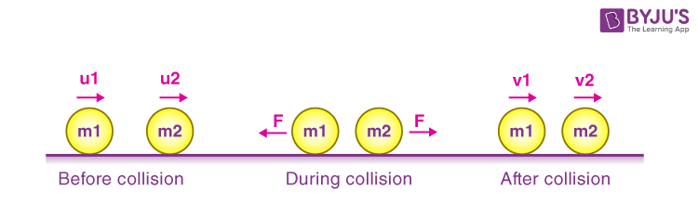

Slide 4
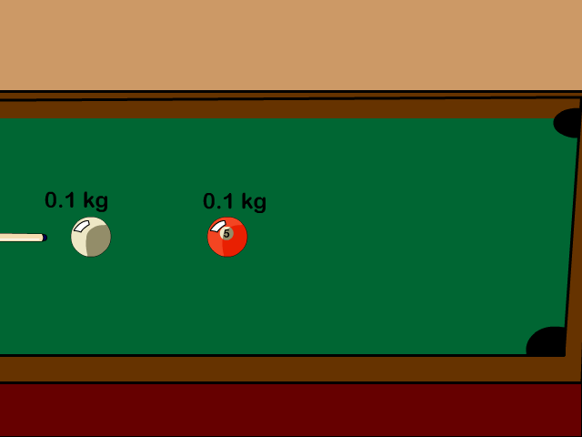

Slide 5
Colliding Billiard Balls
When one billiard ball strikes another, momentum is transferred from the moving ball to the stationary one.
Before collision: Only the first ball has momentum.
After collision: The momentum is shared between both balls, but the sum remains constant.

Slide 6
Car Collision
When two cars crash into each other:
The total momentum of both cars before impact equals the total momentum after (if we ignore external forces like friction).
This works even if one car stops and the other bounces away.

Slide 7
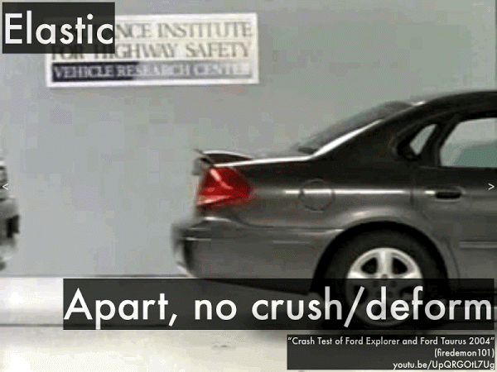
Car Collision

Slide 8
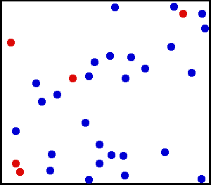
Gas molecules bouncing off of each other

Slide 9
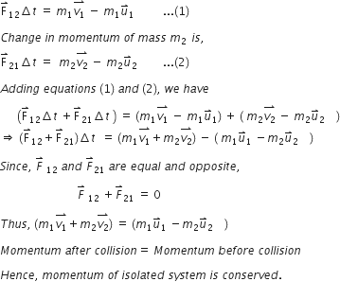

Slide 10
Elastic collisions
Objects collide:
(a) without being deformed
(b) no kinetic energy (energy of motion) is lost

Slide 11
Inelastic Collision
Definition: A collision in which momentum is conserved but kinetic energy is not (some is converted into sound, heat, deformation, etc.)
Behavior: Objects may stick together or deform after collision.
Example:
  A car crash where two vehicles crumple
  Clay balls hitting and sticking together
➡️ Key Point: Kinetic energy is lost to other forms, but total momentum remains constant.

Slide 12
