Slide 1

Humidity in OT
ADNAN RAMZAN
Fsc (OT)
Doctors Institute of Medical & Emerging Science

Slide 2
Humidity
Humidity in an operating room (OR) refers to the amount of water vapor in the air, which must be precisely controlled between 20% and 60% relative humidity (RH) to ensure patient and staff safety.
Proper humidity levels help prevent the growth of microorganisms, reduce the risk of static electricity, and maintain the integrity of sterile supplies, according to standards like those from ASHRAE.
Notes:
American
Society of
Heating,
Refrigerating and
Air-Conditioning
Engineers

Slide 3
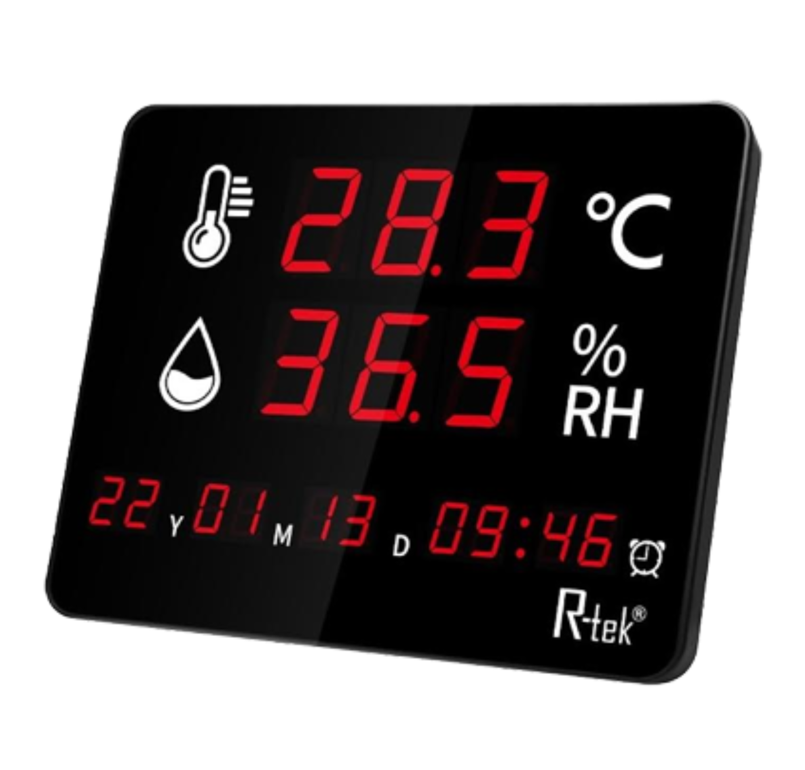
Hygrometer

Slide 4
Acceptable Operative Temperatures
Summer : 24.5–28°C (76–82°F) at 30% RH
Summer: 23–25.5°C (74–78°F) at 60% RH
Winter : 20.5–25.5°C (69–78°F) at 30% RH
Winter: 20–24°C (68–75°F) at 60% RH

Slide 5
Why Humidity Control Is Important
RH > 60% increases chances of mold/mildew and wound infections.
RH < 20% can cause static electricity and reduce shelf life of supplies.
OR standard RH: 20–60%.
Notes:
Mold and mildew are both types of fungi that grow in moist environments, but mildew is the early, flat, powdery stage of mold

Slide 6
Rationale for Lower Limit (20%)
In dry air (low humidity), the charge cannot escape easily, so it stays on the surface and builds up.
Things like rubber, plastic, paper, and adhesives need a little moisture to stay flexible.When humidity is low, they lose moisture and become hard, cracked, or weak.
Prevents sparks that may risk fire.
Maintains function of sterile indicators and electro-medical equipment.
Reduces static electricity harm to equipment.

Slide 7
Rationale for Upper Limit (60%)
High RH increases mold risk.
Can worsen patient wound infection chances.
Causes discomfort for OR personnel.

Slide 8
Temperature & Humidity Relationship
When temperature rises, relative humidity usually falls.
Cold ORs have higher RH at the same absolute humidity.
ORs may exceed approved limits depending on geography and season.

Slide 9
Office Environment Guidelines
Heating season: 20–23.5°C at ~50% RH.
Cooling season: 23–26°C at ~50% RH.
Maintain constant RH to avoid computer equipment issues.

Slide 10
Easy Student-Friendly Points
Think of humidity as 'water in the air'. Too much = mold, too little = dryness.
OR staff comfort matters—temperature affects concentration.
Equipment like computers and monitors work best at stable humidity.
Proper temp/RH reduces infection risk and keeps instruments safe.
OR climate varies due to seasonal changes—systems must adjust.

Slide 11


