Slide 1

Surgical Technology
ADNAN RAMZAN
BS(OT&RIT)
Doctors Institute of Medical & Emerging Science

Slide 2
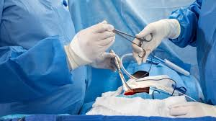
Surgical Technology

Slide 3
Surgical Technology
A specialized healthcare field focused on assisting surgeons.
Ensures safe surgery by preparing tools, equipment, and sterile environment.
Surgical technologists are key members of the operating room team.

Slide 4
Who is a Surgical Technologist?
A trained professional who supports surgeons, nurses, and anesthesia providers.
Works before, during, and after surgery.
Known as:
Scrub Tech
Operating Room Tech
Surgical Tech.

Slide 5
Why Surgical Technologists Are Important
Reduce surgical risks.
Maintain sterile conditions.
Ensure surgeries run smoothly and efficiently.
Improve patient safety and outcomes.

Slide 6
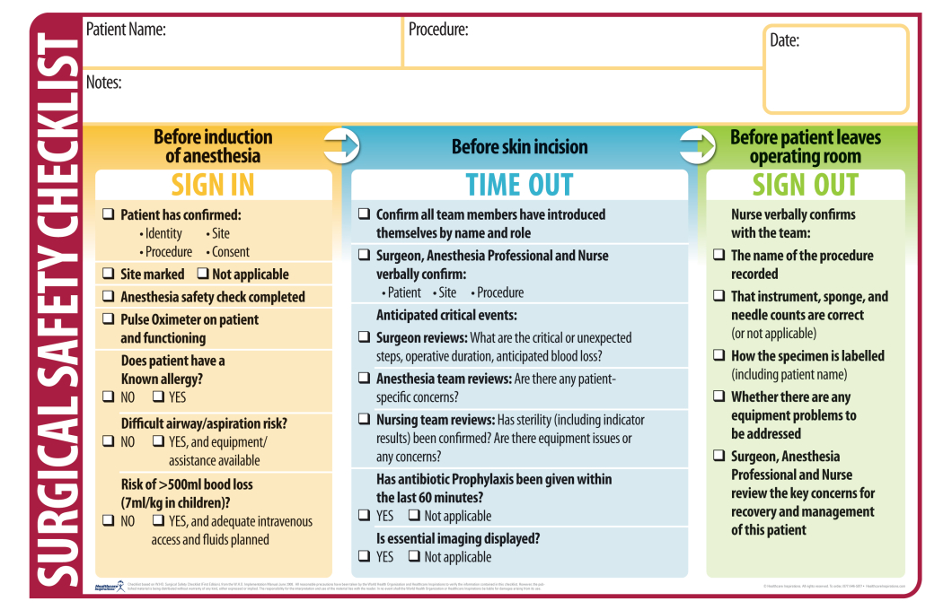

Slide 7
Primary Roles of a Surgical Technologist
Surgical tech roles fall into three phases:
1. Preoperative (Before Surgery)
2. Intraoperative (During Surgery)
3. Postoperative (After Surgery)

Slide 8
Preoperative Role 1
Preparing the Operating Room:
Set up surgical instruments and supplies.
Arrange operating table, lights, and equipment.
Ensure all tools are sterilized.

Slide 9
Preoperative Role 2
Preparing the Patient:
Help with gowning and gloving the surgical team.
Assist in positioning the patient.
Prepare sterile drapes.

Slide 10
Intraoperative Role 1
Assisting the Surgeon:
Pass instruments and supplies.
Hold retractors.
Assist with suction and irrigation when required.

Slide 11
Intraoperative Role 2
Maintaining Sterility:
Monitor sterile field.
Avoid contamination of tools and surfaces.
Replace contaminated items quickly.

Slide 12
Intraoperative Role 3
Handling Surgical Equipment:
Adjust lights and equipment.
Operate cameras or scopes.
Maintain readiness with backup instruments.

Slide 13
Intraoperative Role 4
Counting Instruments and Supplies:
•Count sponges, needles, and instruments.
Ensure nothing is left inside the patient.
Work with nurses to document counts accurately.

Slide 14
Postoperative Role 1
After-Surgery Responsibilities:
Clean and disinfect the surgical area.
Re-sterilize tools.
Restock supplies for next surgery.

Slide 15
Postoperative Role 2
Patient Transfer & Documentation:
Assist in moving patient to recovery.
Document tool use and sterilization records.
Check equipment condition.

Slide 16
Workplaces for Surgical Technologists
Hospitals
Trauma Centers
Outpatient Surgery Centers
Plastic Surgery Clinics
Endoscopy Units
Labor and Delivery Units

Slide 17
Essential Skills Required
Strong attention to detail
Knowledge of sterile techniques
Good communication
Physical stamina
Fast decision-making
Ability to work under pressure

Slide 18
Educational Requirements
High school diploma or equivalent.
Certificate or Associate Degree in Surgical Technology.
Training in anatomy, physiology, microbiology, and sterile procedures.

Slide 19
Clinical Training
Hands-on training includes:
Real operating room practice.
Handling instruments.
Participating in supervised surgeries.
Learning teamwork and communication.

Slide 20
Certification Options
CST – Certified Surgical Technologist (most common).
TS-C – Technologist in Surgery-Certified.
Benefits:
Better salary
More job opportunities
Professional credibility

Slide 21
Career Advancement Opportunities
Lead Surgical Technologist
Surgical First Assistant (SFA)
Operating Room Manager
Educator or Instructor
Sales Representative for surgical equipment companies

Slide 22
Salary Overview
Competitive salary depending on location.
Higher pay in trauma hospitals and specialty surgery.
Certification increases earning potential.

Slide 23
Future Job Outlook
High demand due to increasing surgeries.
Growth in outpatient surgery centers.
Technology advancements create more opportunities.

Slide 24
Why Choose Surgical Technology?
Fast entry into the medical field.
High job satisfaction.
A meaningful role in saving lives.
Opportunities for growth and specialization.

Slide 25
Conclusion
Surgical Technology is a rewarding and important healthcare career.
It offers challenging work, steady job growth, and meaningful patient impact.

Slide 26


