Slide 1

Self in Social Psychology
Social Psychology| BS
Hafsa Rasheed

Slide 2
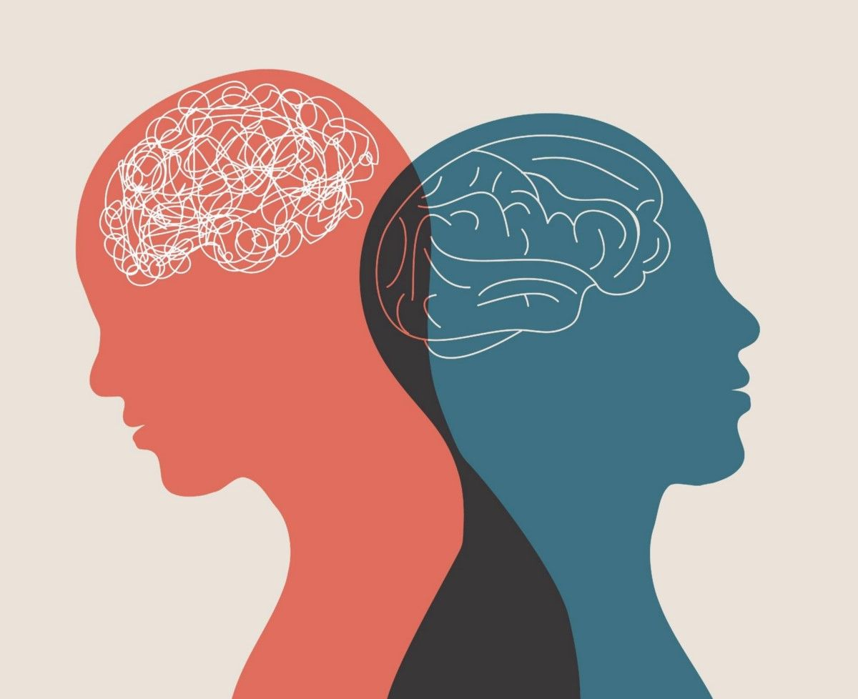
What is “The Self” in Social Psychology?
In Social Psychology, the self is not just personal identity — it is a social product.
It includes:
✅ Self-Concept → All the beliefs we hold about who we are.
✅ Self-Esteem → How we evaluate ourselves emotionally.
✅ Self-Presentation / Impression Management → How we show ourselves to others.
✅ Self-Knowledge → How well we understand our motives, feelings, and behavior.
Key point:
We understand ourselves through society, culture, interactions, and feedback, not in isolation.

Slide 3
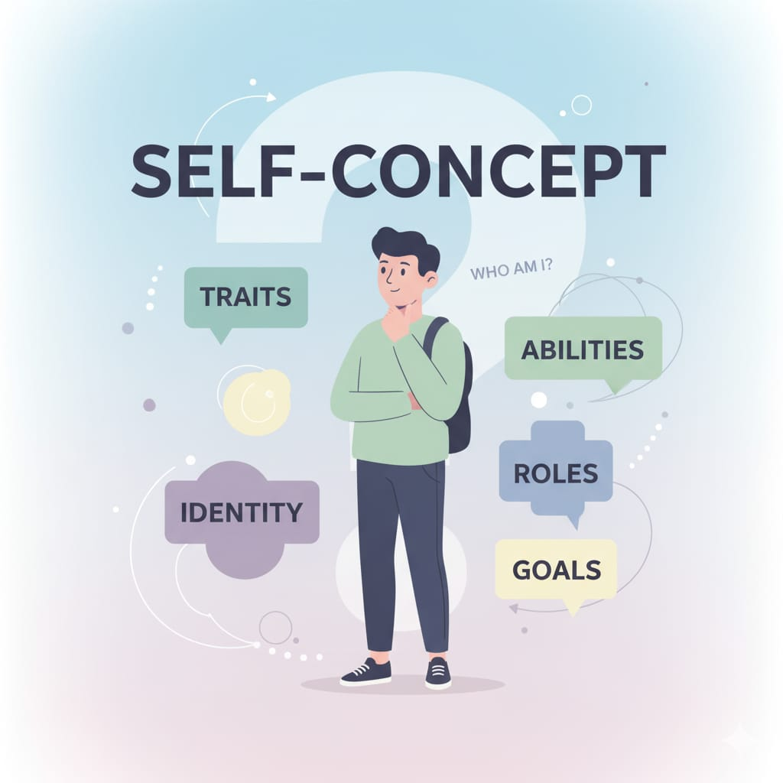
Self-Concept (Who Am I?)
Self-concept = your mental picture of yourself.
Includes:
• Abilities (e.g., “I am good at writing”)
• Traits (e.g., “I am introverted”)
• Social roles (e.g., student, daughter, teacher)
• Group identities (e.g., Pakistani, Muslim, Punjabi, etc.)
• Life goals (e.g., “I want to be a lecturer”)

Slide 4
Continued
The Self is Dynamic:
Your self-concept changes with experiences.
Example:
A shy student becomes confident after joining a debating society.
Now self-concept changes from “quiet” to “confident speaker.”

Slide 5
How Do We Develop Self-Concept?
1. Through Others — Looking-Glass Self
Charles Horton Cooley (American sociologist):
We see ourselves through others’ reactions.
• “If people think I am smart, I start believing it.”
• “If teachers call me irresponsible, I internalize it.”
✅ Pakistani example:
Family constantly praising siblings → child develops strong academic identity.

Slide 6
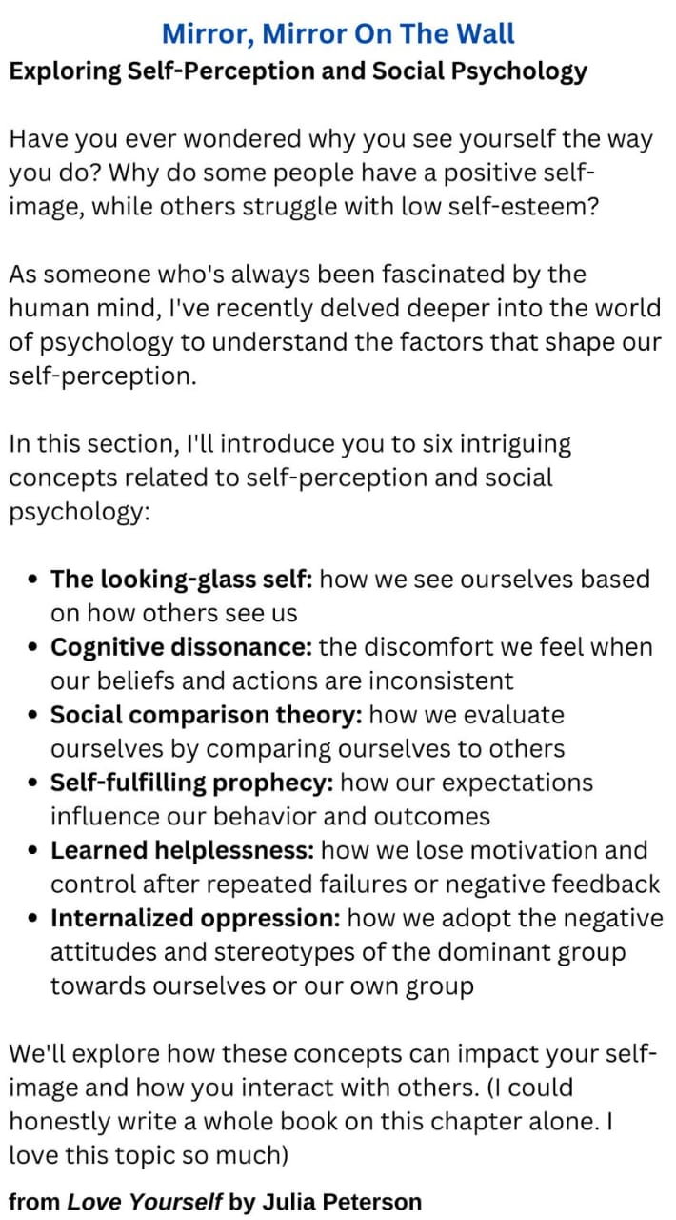

Slide 7
Continued
2. Through Social Comparison —
Theory by Leon Festinger (American)
We compare ourselves to others to evaluate our abilities.
Two types:
✅ Upward Comparison
→ Comparing with someone better
• can motivate
• can also reduce self-esteem
Example:
Comparing with a class topper.

Slide 8
Continued
✅ Downward Comparison
→ Comparing with someone worse
• boosts self-esteem
• helps us feel better when stressed
Example:
“I am doing better than my friend who failed the test.”

Slide 9
Continued
3. Through Culture
Different cultures shape different selves:
Individualistic cultures (USA, UK)
→ Emphasize uniqueness & independence.
“I am unique, creative, independent.”
Collectivistic cultures (Pakistan, India)
→ Emphasize family, honor, duty.
“I am a daughter, a sister, a part of my community.”
✅ Pakistani example:
Your identity includes how others see your family’s reputation (izzat).

Slide 10
Self-Esteem (How Do I Feel About Myself?)
Self-esteem = emotional evaluation of yourself
✅ High self-esteem
• confidence
• resilience
• initiative
✅ Low self-esteem
• fear of failure
• sensitivity to criticism
• self-doubt

Slide 11
Effects of Social Comparison on Self-Esteem
Upward comparison → lowers it
Downward comparison → raises it
✅ Pakistani example:
Comparing grades with cousins affects confidence strongly.

Slide 12
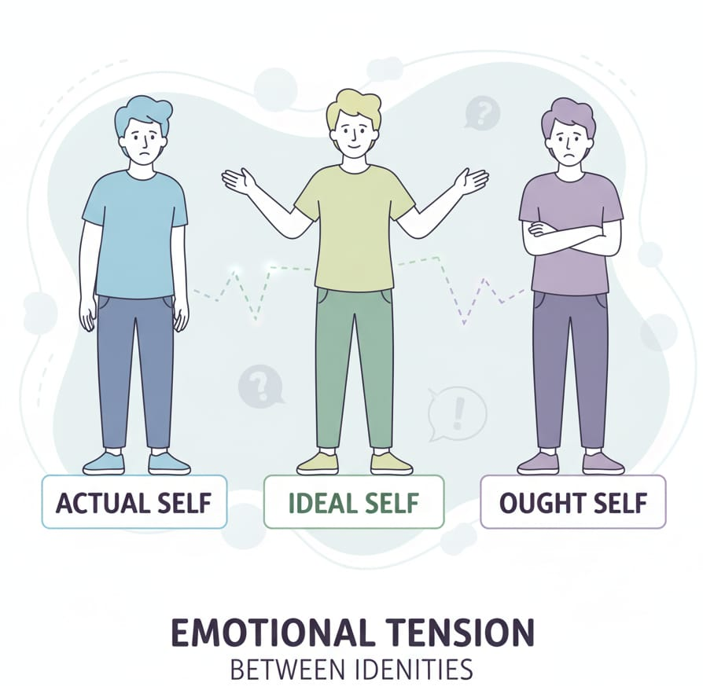
Self-Discrepancy Theory
Tory Higgins (Canadian-American social psychologist)
We have three selves:
(1) Actual Self
→ Who I am right now.
(2) Ideal Self
→ Who I want to be
(goals, dreams)
(3) Ought Self
→ Who I should be.
(family, society expectations)

Slide 13
When mismatches happen:
Actual ≠ Ideal → sadness, depression
Actual ≠ Ought → guilt, anxiety
✅ Pakistani example:
• Ideal: “I want to be an artist.”
• Ought: “My family wants me to be a doctor.”
→ Tension, stress, identity conflict.

Slide 14
Self-Knowledge: Do We Really Know Ourselves?
Research shows we are not always honest or accurate about ourselves.
✅ Reasons:
• We underestimate negative qualities (self-enhancement)
• We justify our behavior (self-serving bias)
• We don’t see hidden motives
• Others often know our blind spots better
✅ Example:
A student thinks she is “not talkative,” but classmates think she is loud.

Slide 15
Self-Presentation (Impression Management)
Erving Goffman (Canadian sociologist) — “life is a stage.”
We try to control how others see us.
✅ Common Strategies:
1. Ingratiation
→ Being nice to be liked
Example: Complimenting teachers or seniors.
2. Self-Promotion
→ Highlighting abilities
Example: “I have 3 years of experience” in an interview.

Slide 16
Continued
3. Supplication
→ Acting weak to get help
Example: “I can’t do this without your support.”
4. Self-Verification
→ Wanting others to confirm our identity
Example: If I see myself as hardworking, I want others to see that too.

Slide 17
The Self in Pakistani Society (Very Relevant)
• Strong influence of family expectations
• Social comparison is common (“cousins’ competition”)
• Identity includes religious and cultural roles
• Women experience more ought-self pressure
• Social media amplifies ideal-self expectations
• Students gain self-esteem from academic achievements and approval

Slide 18
Activity 1: Actual vs Ideal Self Cards
• Students write their Actual and Ideal selves
• Compare for mismatches
• Discuss how it affects emotions

Slide 19
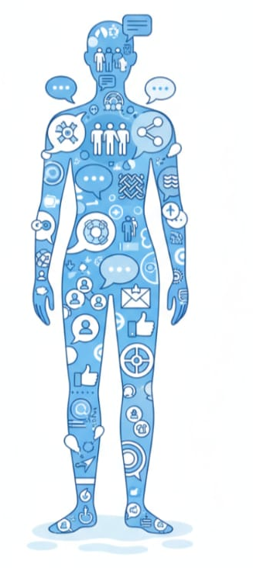
Activity 2: Social Comparison Line
• Students stand in a line based on how confident/successful they feel
• Identify what caused upward/downward comparisons

Slide 20
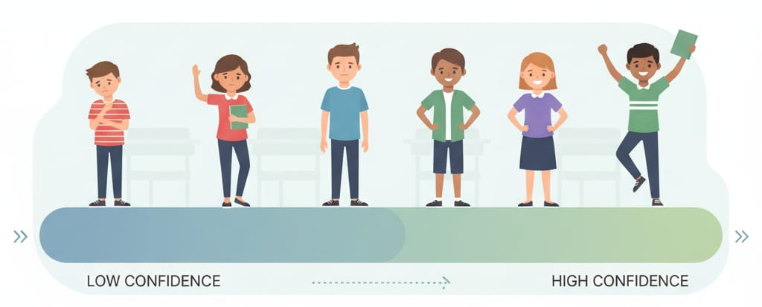
Activity 3: Identity Circle Map
Students draw a circle of:
family roles
achievements
personality traits
cultural roles
→ Shows how identity is socially shaped

