Slide 1

ANATOMY
BS RIT,OTT,MLT
1ST SEMESTER
DR DANISH

Slide 2
Bone Growth and Remodeling
1. Bone Formation After Birth
At birth, bone formation is not fully complete.
In intramembranous bones, some membrane remains to allow post-natal growth (e.g., skull).
Endochondral bones still contain cartilage when the baby is born.

Slide 3
2. Growth Plate (Epiphyseal Plate)
A plate of hyaline cartilage persists between the diaphysis and each epiphysis.
Also called growth plate, epiphyseal plate, or epiphyseal cartilage.
Long bones have two growth plates: proximal and distal.

Slide 4
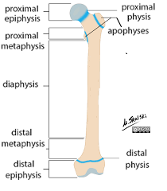

Slide 5
3. Metaphysis
Region where epiphyseal cartilage joins the diaphysis.
Epiphyseal cartilage continuously forms:
  Fresh cartilage cells
  New cartilage matrix
Cartilage formed in metaphysis is replaced by ossified bone.
Responsible for increase in length during childhood and early adolescence.

Slide 7
4. Increase in Diameter (Appositional Growth)
Osteoblasts under the periosteum add bone → bone diameter increases.
Osteoclasts remove bone from inner surface of medullary cavity.
Maintains proper proportion between:
  Medullary cavity diameter
  Overall shaft diameter

Slide 8
5. Epiphyseal Plate Closure
When a bone reaches its genetically determined length:
  Epiphyseal cartilage stops growing.
  Plates become narrow and disappear.
Fusion of diaphysis with epiphysis occurs → epiphyseal closure.
No further increase in length is possible.
In adults, the former plate appears as a dense epiphyseal line on X-ray.

Slide 9
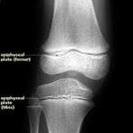

Slide 10
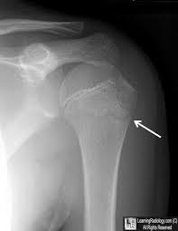

Slide 11

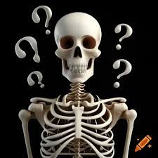

Slide 12


