Slide 1

Adjective
FSC English
Hafsa Rasheed

Slide 2
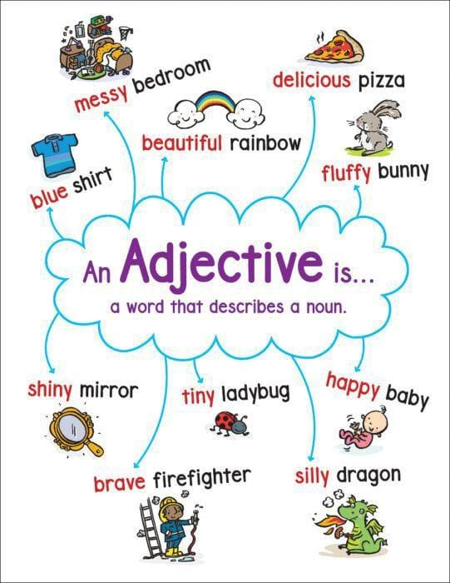
Objective
Identify adjectives and their uses
Learn types and degrees
Use “much” and “more” correctly
Practice with fun, real-life activities

Slide 3
What is an Adjective?
An adjective is a word that describes a noun or pronoun. It tells us about quality, quantity, number, or state.
A sweet mango
The tired student
Three kittens
Some water
“Can you describe your morning using 3 adjectives?”

Slide 4
Position of Adjectives
1. Before a noun → A long road
2. After a linking verb → The road is long.
Linking verbs: be, seem, look, become, feel, taste, sound
Rule: Adjectives come before nouns but after verbs like is, looks, feels.

Slide 5
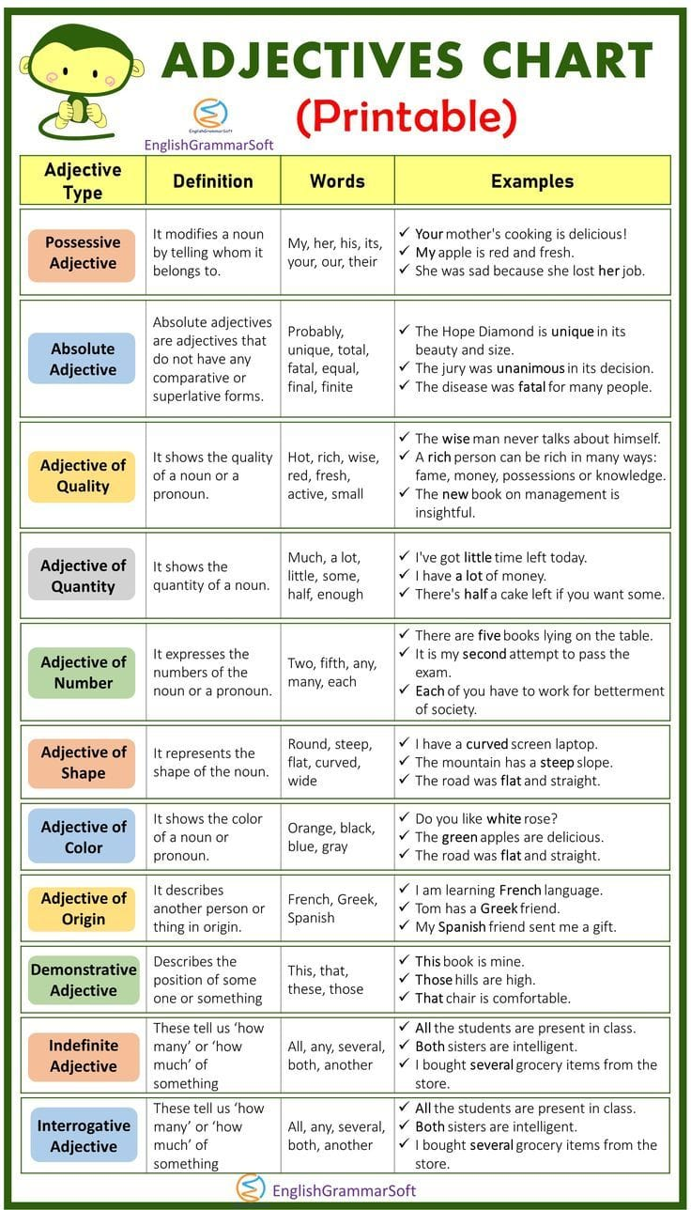
Types of Adjectives

Slide 8
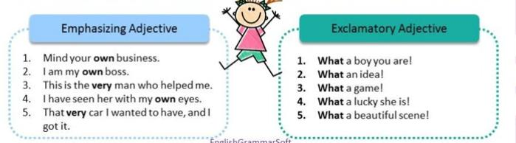

Slide 9
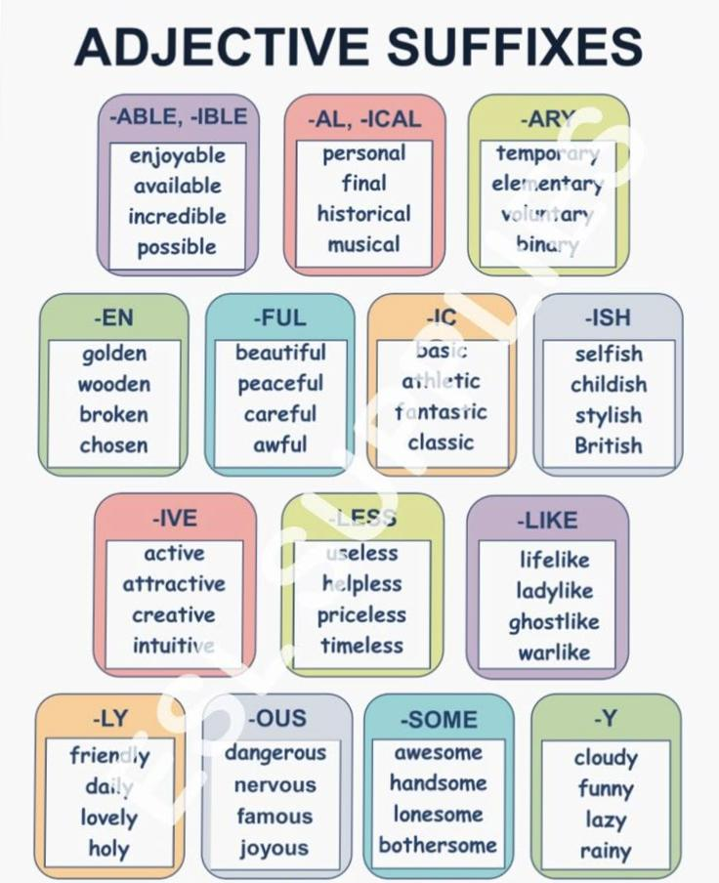

Slide 10
Forms / Degrees of Adjectives
Positive | No comparison | Ali is tall.
Comparative | Compare two | Ali is taller than Ahmad.
Superlative | Compare three or more | Ali is the tallest boy.
“Can someone give me a comparative sentence for ‘intelligent’?”

Slide 11
Rules for Comparison
One syllable: add -er, -est
→ small → smaller → smallest
Two syllables ending in “y”: y → i + -er, -est
→ happy → happier → happiest
Long adjectives: use more / most
→ beautiful → more beautiful → most beautiful

Slide 12
Irregular Adjectives
good → better → best
bad → worse → worst
far → farther/further → farthest/furthest

Slide 13
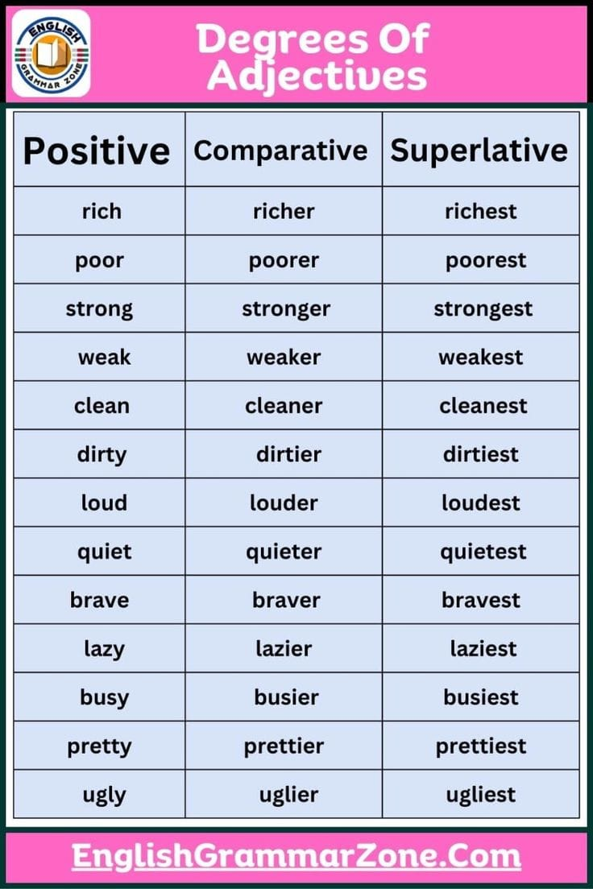
List of Common & Important Adjectives

Slide 14
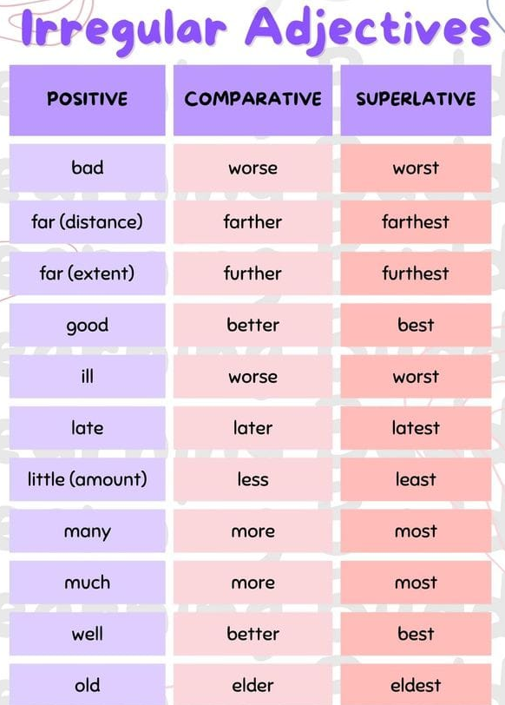

Slide 15
The Use of “Much” and “More”
Much
Used with uncountable nouns.
I don’t have much time.
She doesn’t drink much milk.
More
Used for comparison or with both countable & uncountable nouns.
She is more intelligent than Ali.
I need more water.
He has more friends than I do.
Rule to Remember:
Much = quantity (How much?)
More = comparison (More than...)
“Do we say much apples or more apples?”

Slide 16
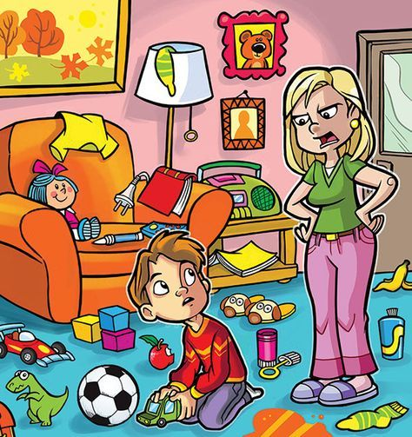
Activity 1: Describe Image

Slide 17
Activity 2 — Comparative Challenge
Make comparison sentences.
Some words are:
tall / short
fast / slow
sweet / sour

Slide 18
Homework / Writing Practice
Write a short paragraph (5–6 lines) describing:
1. Your favorite season ️
2. Your best friend ️
3. Your study place
Highlight all adjectives in your paragraph.

Slide 19


