Slide 1

BASIC MEDICAL SCIENCE
FSC MEDICAL TECHNOLOGIES I
DR DANISH

Slide 2
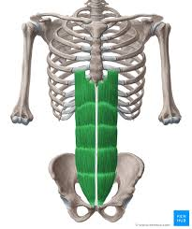
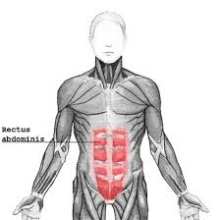
Core Muscles
Rectus Abdominis: Commonly known as the "abs," rectus abdominis flexes the lumbar spine and helps in trunk flexion.

Slide 3
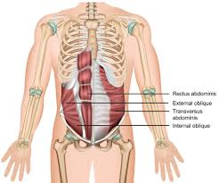
Obliques
External and internal obliques are located on the sides of the abdomen and aid in trunk rotation and lateral flexion.

Slide 4
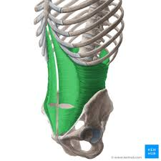
Transversus Abdominis
Situated deep within the abdomen, transversus abdominis provides stability to the spine and pelvis.

Slide 5
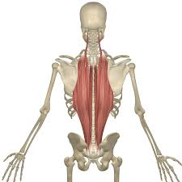
Erector Spinae
These muscles run along the spine and help in spinal extension.

Slide 6
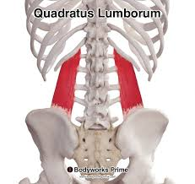
Quadratus Lumborum
Located in the lower back, quadratus lumborum aids in lateral flexion and extension of the lumbar spine.

Slide 7
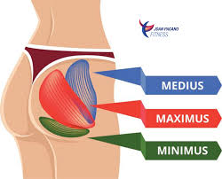
Lower body muscles
Gluteus maximus,medius,&minimus:
located in the buttocks,responsible for hip extension,abduction & rotation

Slide 8
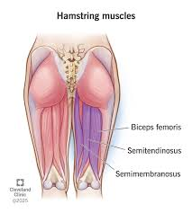
Hamstrings
Consists of:
Biceps femoris,semitendinosus,&semimembrenousus
Flexes the knee &extended the hip

Slide 9
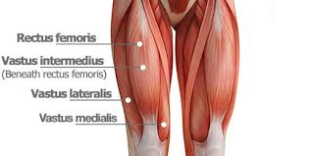
Quadriceps
Consists of rectus femoris,vastus lateralis,vastus medialus,&vastus intermedialus
Extends the knee and flex the hip

Slide 10
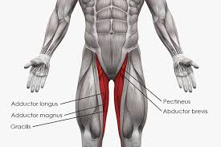
Adductors
Situated on inner thigh
Help in thigh adduction

Slide 11
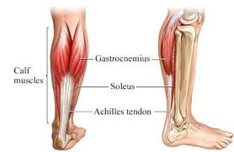
Calves
Gastrocanemius and soleus
Located in the lower leg
Responsible for plantar flexion of ankle

Slide 12
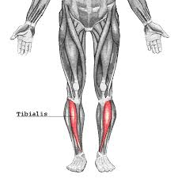
Tibialis anterior
Front of lower leg
Dorsiflexes the foot & inverts the foot

Slide 13
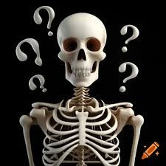

Slide 14
