Slide 1

ANATOMY
BS RIT,OTT,MLT
1ST SEMESTER
DR DANISH

Slide 2
Endochondral Ossification
Definition:
Process by which bone is formed from a pre-existing cartilage model.
Responsible for the formation of long bones, short bones, and the base of the skull.

Slide 3
Sites
Occurs mainly in:
  Long bones (e.g., femur, humerus)
  Short bones
  Vertebrae and base of skull

Slide 4
Stages
Formation of Cartilage Model
Growth of Cartilage Model
Development of Primary Ossification Center
Formation of Medullary (Marrow) Cavity
Development of Secondary Ossification Centers
Formation of Articular Cartilage and Epiphyseal Plate
Closure of Epiphyseal Plate

Slide 5
Formation of Cartilage Model
Mesenchymal cells → chondroblasts → hyaline cartilage model.
Covered by perichondrium(sheath covering the most cartilage except articular cartilage)

Slide 6
Growth of Cartilage Model
Cartilage enlarges by appositional growth(add new layers to surface of tissue) interstitial growth(add new material from within causing growth of cartilage)

Slide 7
Development of Primary Ossification Center
Perichondrium → periosteum.
Periosteal bone collar forms around the shaft (diaphysis).
Cartilage in center calcifies and degenerates.
Blood vessels invade → osteogenic cells → osteoblasts form bone.

Slide 8
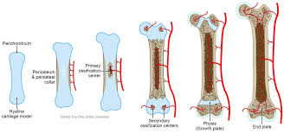

Slide 9
Formation of Medullary (Marrow) Cavity
Osteoclasts resorb bone in the center → marrow cavity formed.

Slide 10
Development of Secondary Ossification Centers
Appear in epiphyses after birth.
No periosteal collar here; cartilage is replaced by bone internally.

Slide 11
Formation of Articular Cartilage and Epiphyseal Plate
Articular cartilage remains at joint surfaces.
Epiphyseal plate (growth plate) persists between diaphysis and epiphysis → allows bone growth in length.

Slide 12
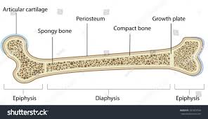

Slide 13
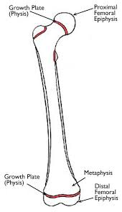

Slide 14
Closure of Epiphyseal Plate
Fusion of epiphysis with diaphysis → bone growth in length stops

Slide 15
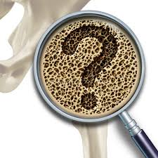

Slide 16


