Slide 1

ANATOMY
BS RIT,OTT,MLT
1ST SEMESTER
DR DANISH

Slide 2
Ossification(osteogenesis)
Process of bone formation is called ossification
Calcification: deposition of calcium salts is called calcification which is also the part of the ossification

Slide 3
Types of Ossification
1.Intramembranous ossification
2.Endochondral ossification

Slide 4
Intramembranous Ossification
Definition:
Process in which bone develops directly from mesenchymal tissue(the immature embryonic connective tissues forming membranes)
No cartilage stage involved.
Also called membranous ossification.

Slide 5
Sites / Examples
Flat bones of skull (frontal, parietal, occipital).
Facial bones, mandible, and part of clavicle.

Slide 6
Stages
Mesenchymal Condensation
Formation of Osteoid

Slide 7
Mesenchymal Condensation
Mesenchymal cells cluster in vascular connective tissue membrane.
Cells differentiate into osteoblasts forming ossification centers.

Slide 8
Formation of Osteoid
Osteoblasts secrete osteoid (organic bone matrix) around themselves.
Osteoid becomes calcified → osteoblasts trapped → become osteocytes.

Slide 9
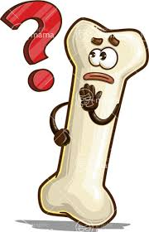

Slide 10


