Slide 1
Physiology
DPT
Awais Hamza

Slide 2
Rate of Rhythmic Discharge of Excitatory & Conductive System
Rate of Rhythmic Discharge
SA Node → 70–80 / min
AV Node → 40–60 / min
Purkinje Fibers → 15–40 / min
Additional Points
SA node has the highest intrinsic rate, hence acts as the normal pacemaker.
Lower centers fire only when SA node fails (escape rhythm).

Slide 3
Normal Heart Rate by Age & Sex
Adult Male HR = 72 (70–80) beats/min
Adult Female
Slightly higher than male→ Lower BP + more sympathetic tone.
Old Age
Slightly higher HR→ Compensatory adjustment for age-related circulatory changes.
Children HR = 95–100 beats/min

Slide 4
Factors Affecting Heart Rate
1) Higher Centers (Frontal Lobe & Hypothalamus)
Excitement → ↑HR
Sudden Shock → ↓HR
2) Respiration
Inspiration → ↑HR
Expiration → ↓HR

Slide 5
Factors Affecting Heart Rate
3) Reflexes
Baroreceptor (Marey’s reflex): ↑BP → ↓HR
Chemoreceptor reflex: ↓BP → ↑HR
Bainbridge reflex: ↑Venous return → ↑HR

Slide 6
Factors Affecting Heart Rate
4) Anoxia → ↑HR
5) Moderate ↑CO₂ → ↑HR; severe ↑CO₂ → ↓HR
6) ↑Body temperature (fever/hyperthyroidism) → ↑HR
7) ↑Intracranial pressure → ↓HR (vagal stimulation)
8) Sympathetic stimulation → ↑HR
9) Thyroxine → ↑BMR → ↑HR
10) Exercise → ↑HR

Slide 7
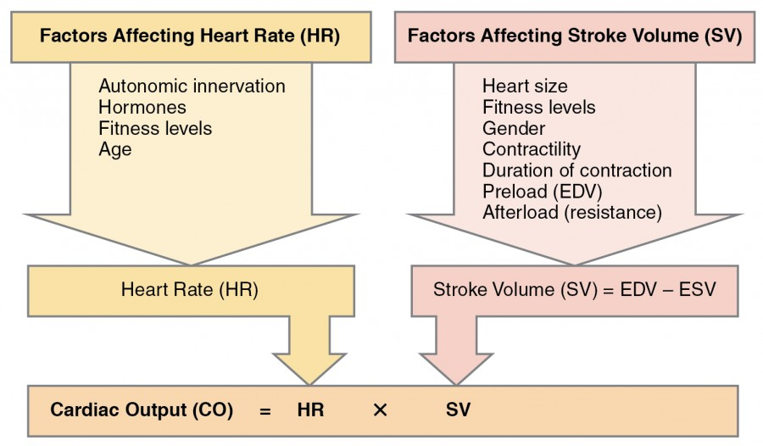

Slide 8
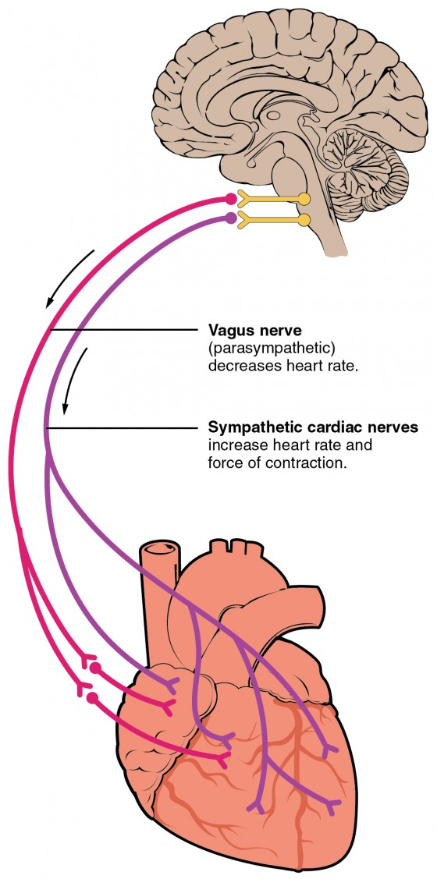

Slide 9
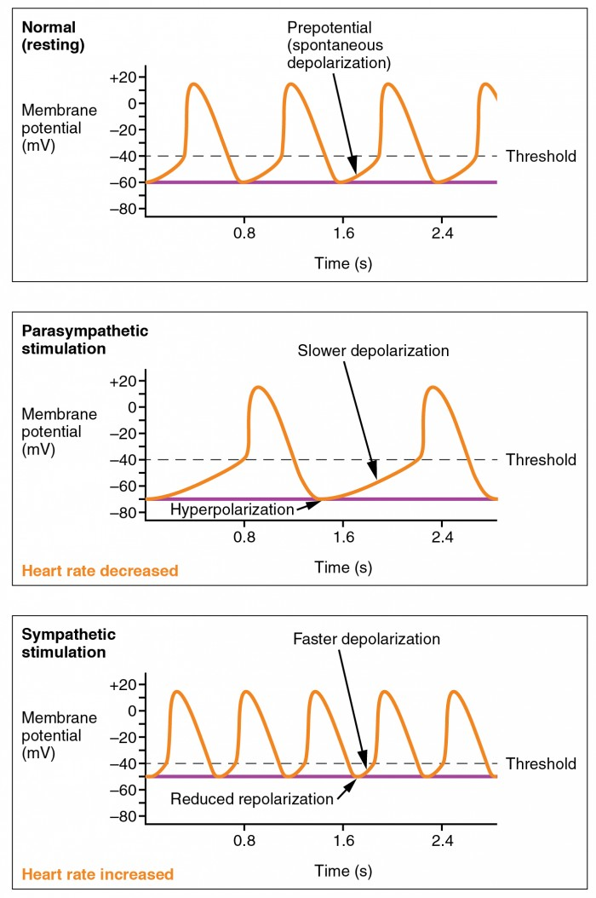

Slide 10
Sinus Arrhythmia
Definition
HR increases during inspiration and decreases during expiration.
Cause
Inspiration → ↑Venous return → ↑RA stretch → Bainbridge reflex → ↑HR.
Marey’s Law
HR is inversely proportional to BP (except during exercise).

Slide 11
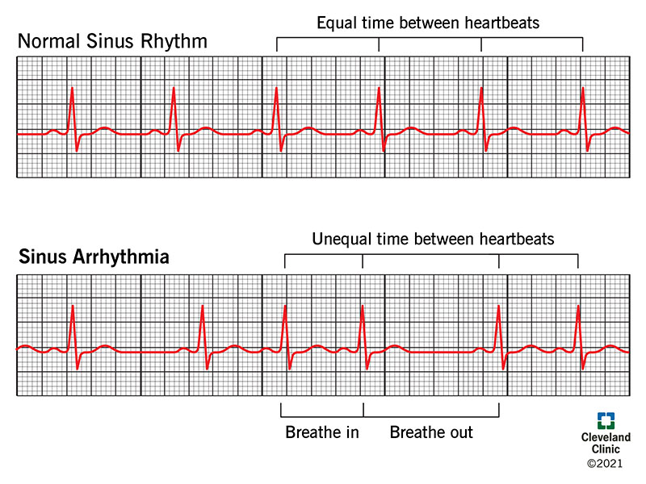
Sinus Arrhythmia

Slide 12
How is sinus arrhythmia treated?
Since respiratory sinus arrhythmia is normal, people without symptoms rarely need treatment.
With nonrespiratory sinus arrhythmia or ventriculophasic sinus arrhythmia, generally, you don’t need any further testing or intervention

Slide 13
Regulation of Heart Rate
HR is regulated by:
1) Local Mechanism
SA node generates rhythmic impulses (≈72 bpm).
Any factor influencing SA node rhythmicity changes HR.

Slide 14
Regulation of Heart Rate
2) Nervous Mechanism
Sympathetic system
  NE release → ↑Na⁺ & Ca²⁺ permeability
  ↑SA discharge rate → ↑HR
  ↑Impulse conduction
  ↑Force of contraction

Slide 15
Regulation of Heart Rate
Parasympathetic system
  ACh release → ↑K⁺ permeability → Hyperpolarization
  ↓SA discharge rate → ↓HR
  ↓Impulse conduction
  ↓Force of contraction

Slide 16
Pacemaker of Heart
Definition
Site that originates rhythmic cardiac impulses.
OR
Structure that determines HR.
Normal Pacemaker: SA Node
Reason: Highest discharge rate (70–80/min).

Slide 17
Ectopic Pacemaker & Overdrive Suppression
Ectopic Pacemaker
Any pacemaker outside SA node.
Causes
AV node or Purkinje fibers firing > SA node rate
Block of SA node impulse transmission
Overdrive Suppression
SA node (70–80/min) suppresses Purkinje system (15–40/min).
Fast rhythm → Temporary suppression of lower centers.

Slide 18
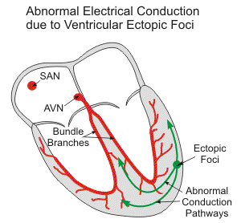

Slide 19
Electrocardiogram (ECG)
Definition
Graphic recording of electrical potentials during depolarization & repolarization.
Father of ECG: Einthoven (1903)
Significance
Identify pacemaker site, Calculate HR, Recognize rhythm
Detect voltage changes
Diagnose heart diseases

Slide 20
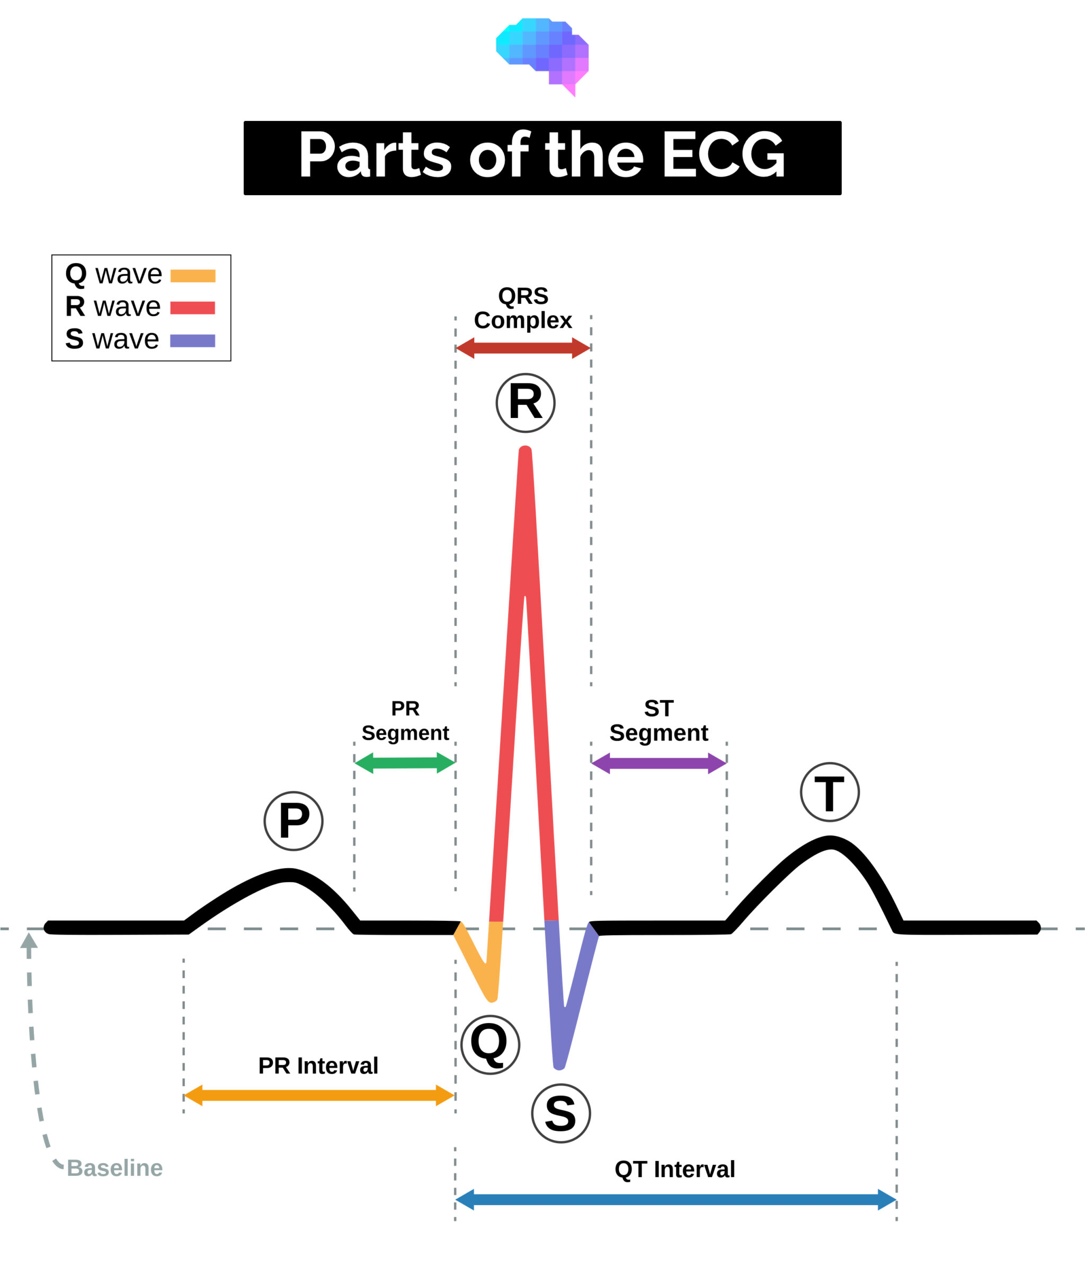

Slide 21
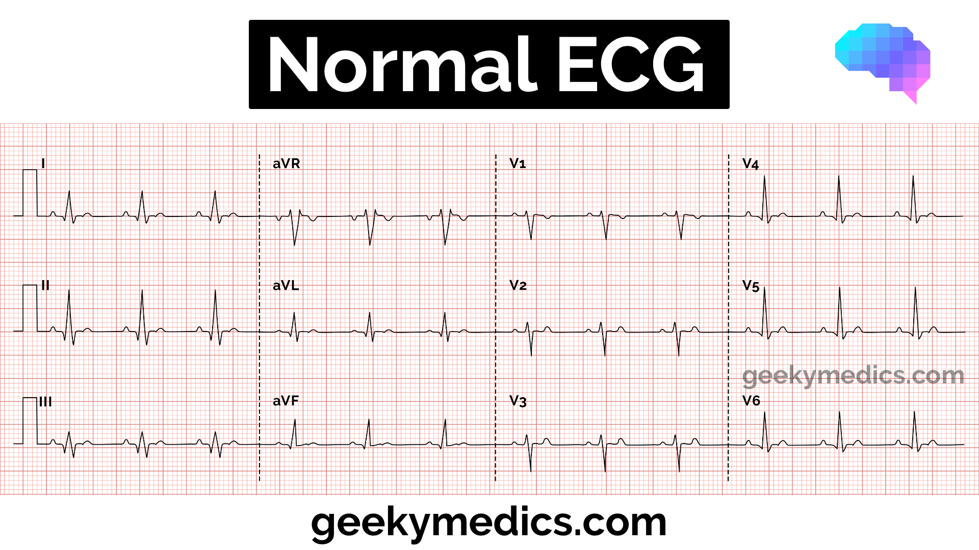

Slide 22
ECG Waves
P Wave
Atrial depolarization
QRS Complex
Ventricular depolarization
T Wave & ST Segment
Ventricular repolarization

Slide 23
ECG Waves
Atrial T Wave
Atrial repolarization (hidden in QRS)
U Wave
Papillary muscle repolarization
Prominent in hypokalemia

Slide 24
ECG Intervals & Durations
PR Interval
Onset of atrial → onset of ventricular contraction 0.16 sec (120–210 ms)
QT Interval
Ventricular contraction duration 0.35 sec
Total ECG Time (one heartbeat) 0.83 sec
HR Calculation
HR = 60 / 0.83 = 72 bpm

Slide 25
ECG Calculation Methods
Small squares between R–R / 1500
Large squares between R–R / 300
For irregular rhythm:
Count QRS in 15 large squares × 20

Slide 26
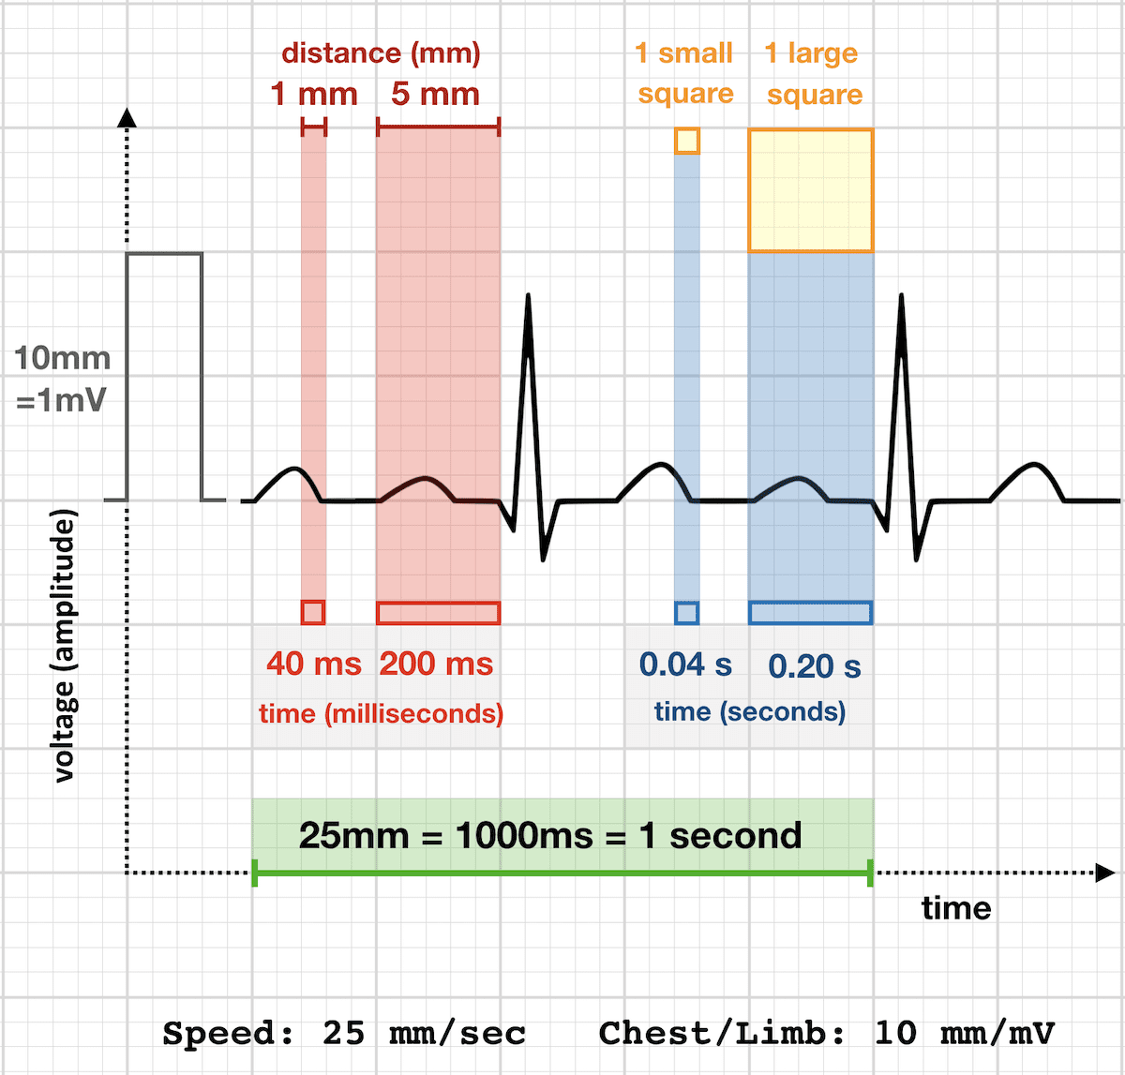

Slide 27
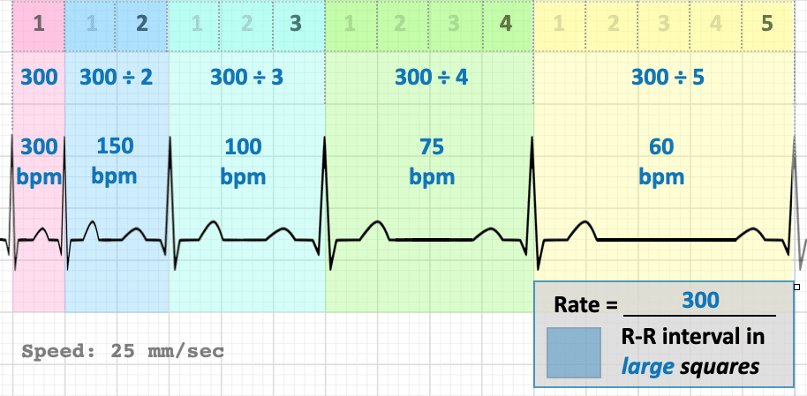
Large square method

Slide 28
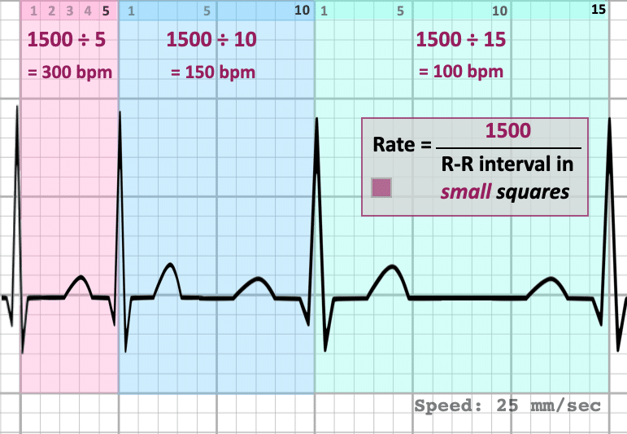
Small square method

Slide 29
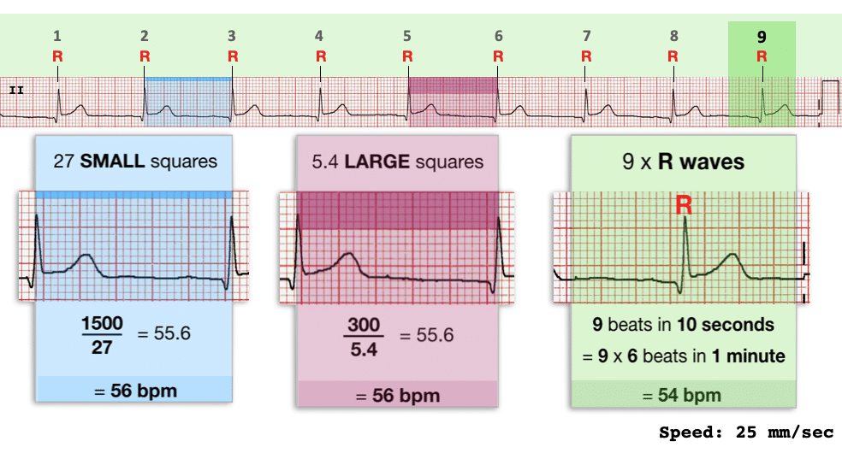
R wave method

Slide 30
Electrocardiographic Leads
Bipolar Limb Leads
Lead I: RA (–) → LA (+)
Lead II: RA (–) → LL (+)
Lead III: LA (–) → LL (+)
Precordial (Chest) Leads
V1 → 4th ICS right
V2 → 4th ICS left

Slide 31
Electrocardiographic Leads
V3 → Midway V2 & V4
V4 → 5th ICS MCL
V5 → Anterior axillary line
V6 → Mid-axillary line
Augmented Unipolar Limb Leads
aVR → Right arm
aVL → Left arm
aVF → Left leg

Slide 32
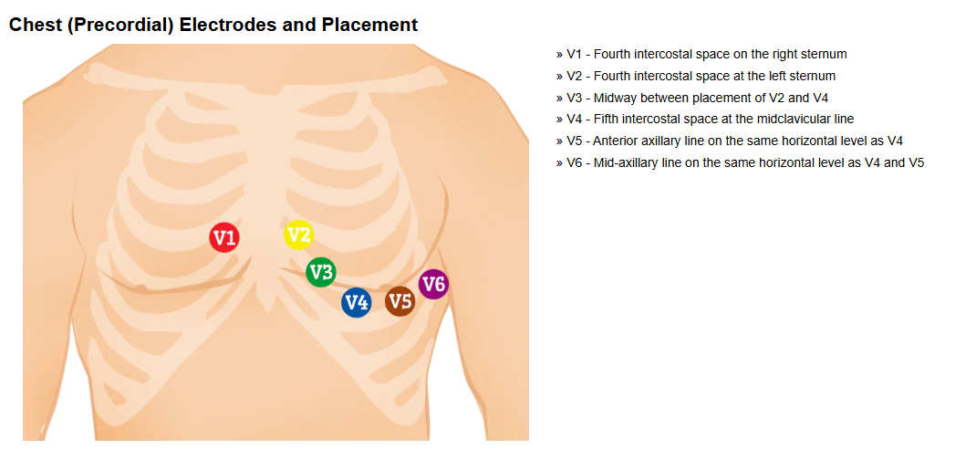

Slide 33
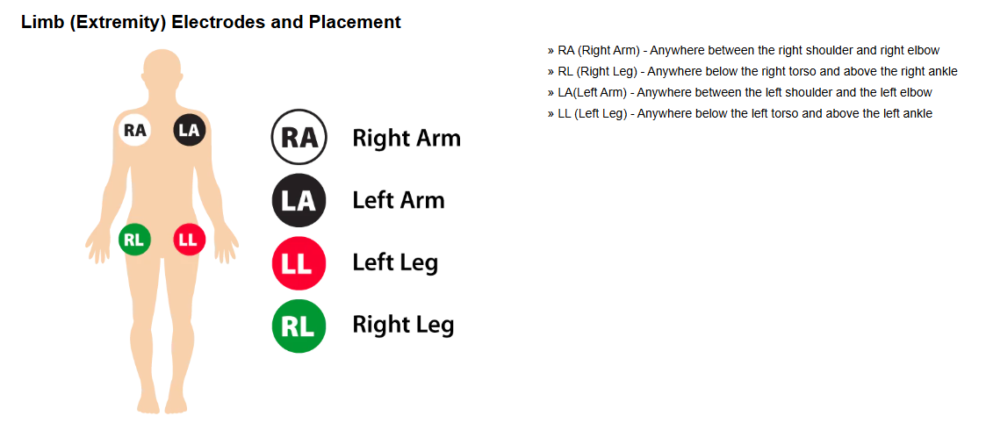

Slide 34
Einthoven’s Triangle & Law
Einthoven’s Triangle
Equilateral triangle around heart (RA, LA, LL)
Einthoven’s Law
Lead II = Lead I + Lead III

Slide 35
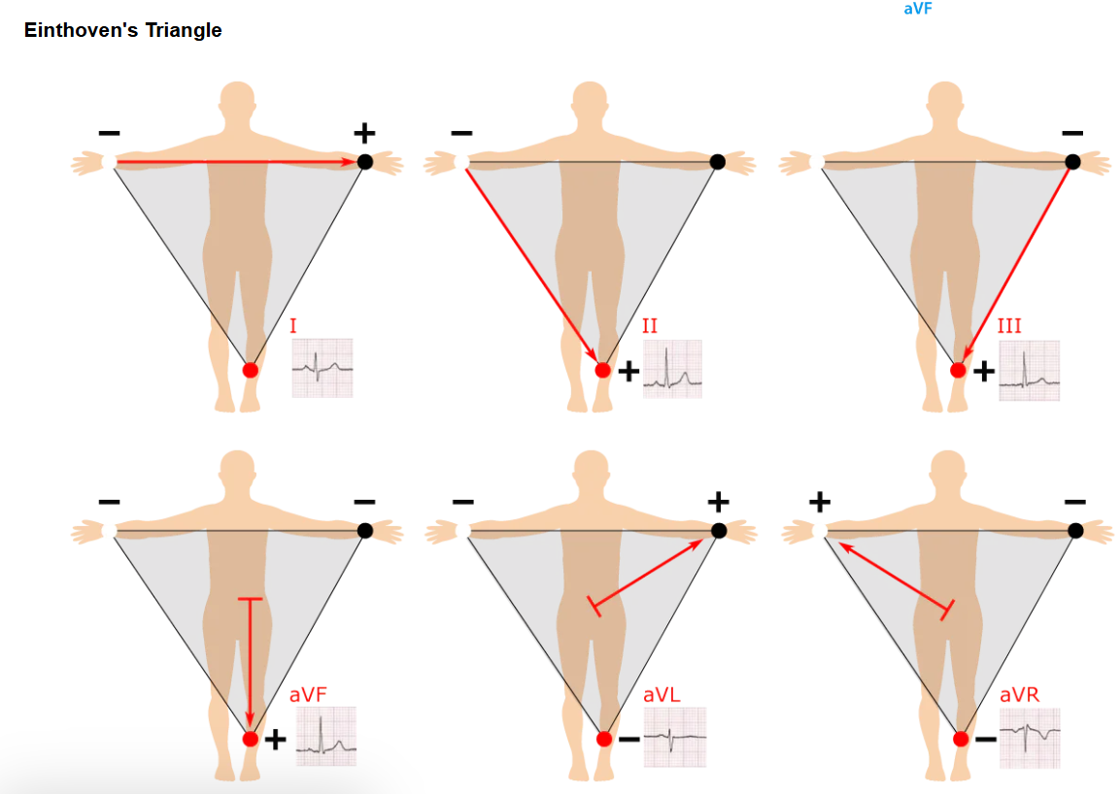

Slide 36
Abnormalities of P Wave
Inverted P: Pacemaker shifted to AV node
Absent P: Atrial fibrillation
P-mitrale: Left atrial hypertrophy (notched P)
P-pulmonale: Right atrial hypertrophy (tall P)
Nodal rhythm: Reversed P direction

Slide 37
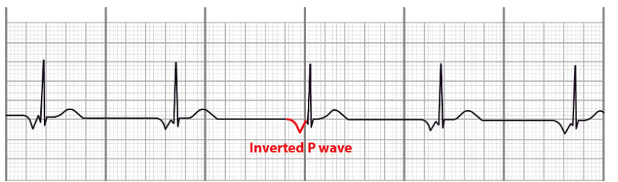
Inverted P

Slide 38
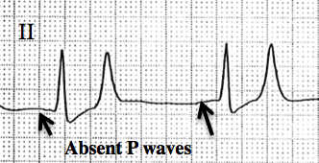
Absent P

Slide 39
Abnormalities of QRS Complex
High Voltage: RVH / LVH
Low Voltage: Pericardial effusion, old MI
Prolonged QRS: Ventricular hypertrophy, bundle block
Bizarre QRS: Scar tissue, conduction block

Slide 40
Current of Injury, J Point & ST Shift
Current of Injury
Flow from injured (–) to normal (+) tissue.
Causes
Trauma, infection, ischemia
J Point
End of QRS where potential = zero
ST Segment Shift
ST ≠ TP level → Present in ischemia/injury

Slide 41
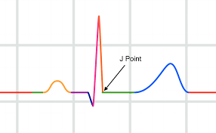
J Point

Slide 42
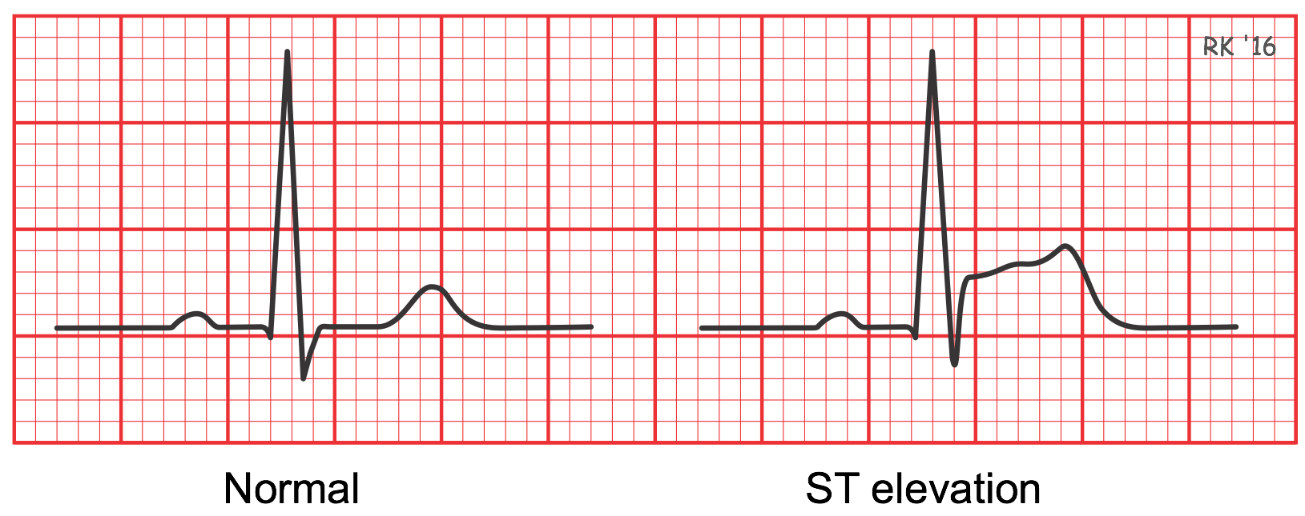
ST Segment Shift

Slide 43
T Wave Abnormalities
Opposite T wave polarity: Bundle branch block
Inverted T wave: Ischemia
Biphasic T: Digitalis toxicity

Slide 44
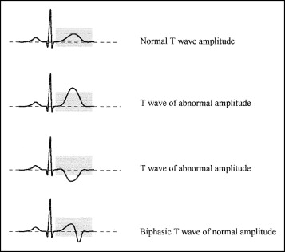

Slide 45
ECG in Myocardial Infarction
T wave inversion
ST elevation
Deep Q wave

Slide 46
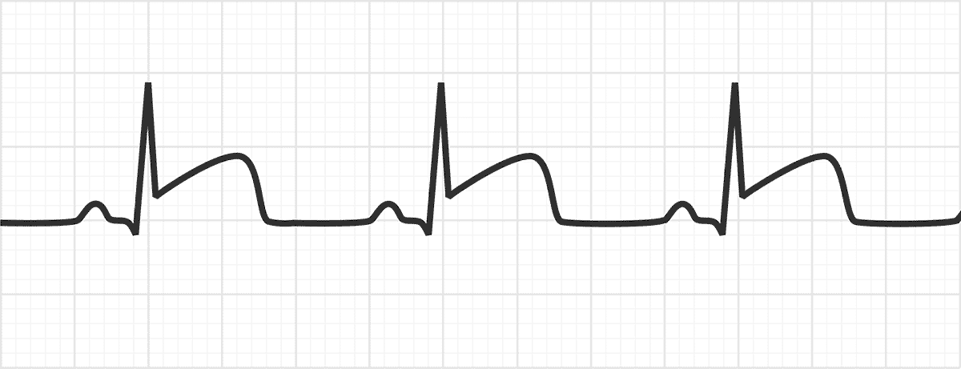
ECG MI

Slide 47
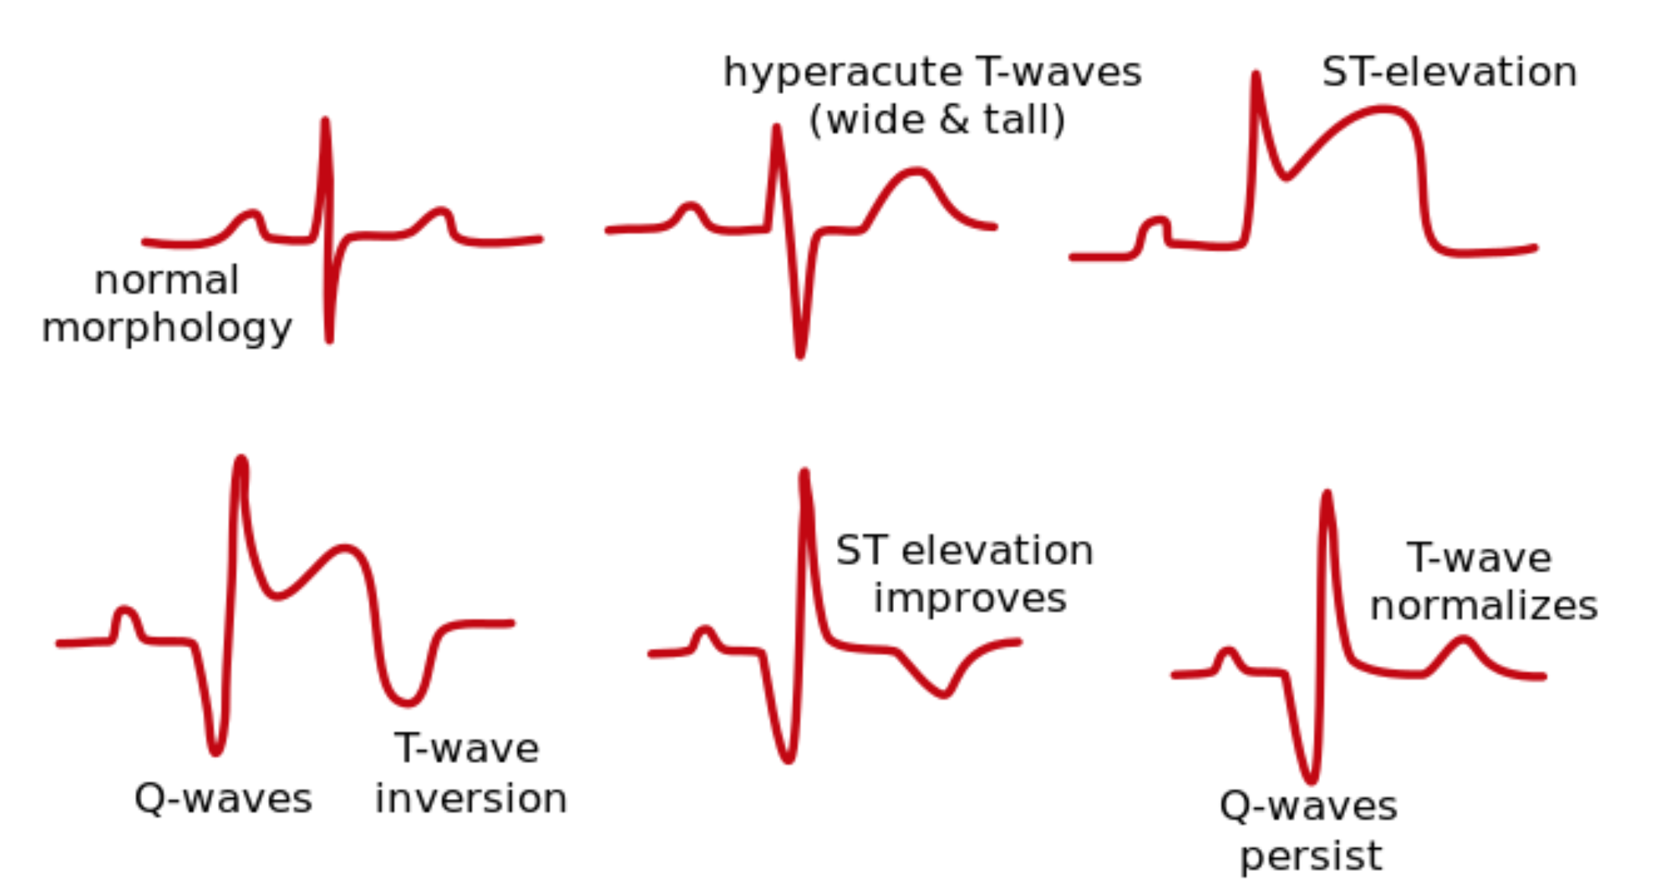
Post MI Changes

Slide 48
His Bundle Electrogram (HBE)
A deflection
H spike
V deflection
Used to locate AV conduction blocks.

Slide 49
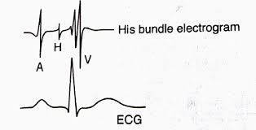
His Bundle Electrogram

Slide 50
Vector & Vectorcardiogram
Vector
Arrow indicating direction & magnitude of electrical current
Resultant Vector
From depolarized base (–) → polarized apex (+)
Vectorcardiogram
Loop showing changes during cardiac cycle

Slide 51
Mean Electrical Axis
Definition
Preponderant direction of ventricular depolarization
Normal value
+59°
Axis Deviations
Left Axis Deviation
Expiration, Lying down,Obesity

Slide 52
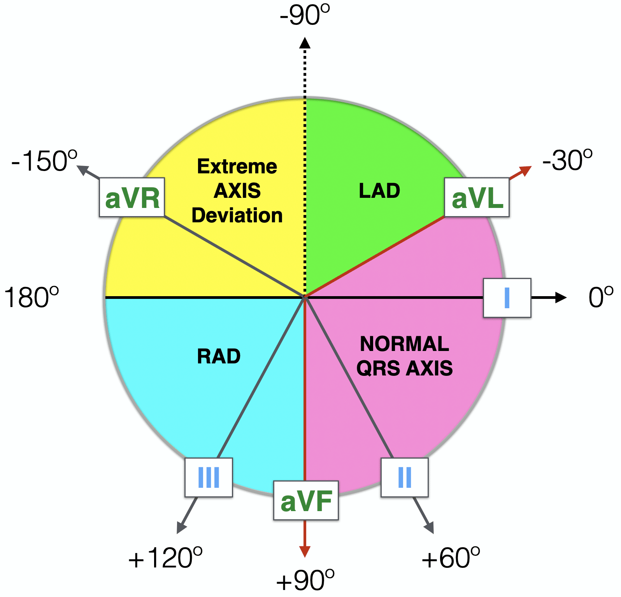
ECG Axis Interpretation

Slide 53
Mean Electrical Axis
Obesity
LV hypertrophy
LBBB
Right Axis Deviation
Inspiration
Standing
Tall person
RV hypertrophy
RBBB

Slide 54
Cardiac Arrhythmias
Normal Sinus Rhythm
SA node origin
Bradycardia
HR < 60/min

Slide 55
Bradycardia
Found In
Sleep, Athletes (increased vagal tone)
Vagal stimulation, Carotid sinus syndrome
Additional High-Yield
Seen in hypothyroidism, Drugs: β-blockers, Ca⁺⁺ channel blockers, digitalis
May indicate conduction disease (SA/AV node dysfunction)

Slide 56
Tachycardia - HR > 100 beats/min
Found In
Fever, Emotion, Exercise
Sympathetic stimulation
Additional High-Yield
Hyperthyroidism, hypovolemia, anemia
Pain, anxiety
Early heart failure

Slide 57
Sick Sinus Syndrome
Definition
Dysfunction of SA node → Bradycardia, dizziness, syncope.
Additional Points
May alternate with tachycardia (“tachy-brady syndrome”)
Seen in elderly due to fibrosis of SA node
Often requires pacemaker

Slide 58
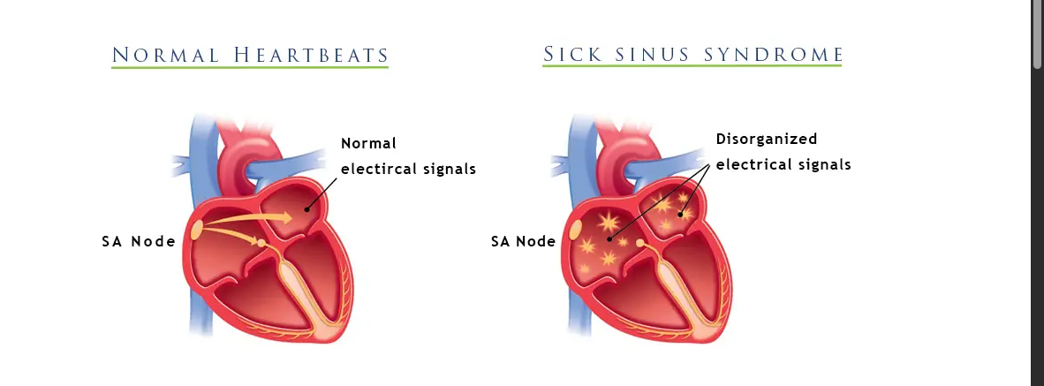
Sick Sinus Syndrome

Slide 59
Cardiac Arrhythmia Overview
Definition
Variation in normal rhythm OR abnormal rhythm.
Causes
Abnormal rhythmicity of pacemaker
Shift from SA node to another pacemaker
Conduction blocks
Abnormal pathways
Spontaneous ectopic impulses

Slide 60
Re-Entry / Circus Movement
Definition
Cardiac impulse travels continuously around a loop of tissue → arrhythmia.
Characteristics
HR 200–300 beats/min
Contraction still coordinated (in flutter)

Slide 61
Re-Entry / Circus Movement
Causes
Long pathway (dilated heart)
Slow conduction (Purkinje block)
Short refractory period (epinephrine)
Example
Atrial flutter
→ Synchronous circular movement in dilated atria (valvular disease)

Slide 62
Flutter vs Fibrillation
Flutter
200–300/min
Coordinated but too fast
Often progresses to fibrillation
Fibrillation
Rapid, incoordinated
No effective pumping
Types: Atrial & Ventricular

Slide 63
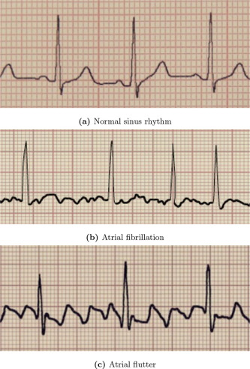
Flutter vs Fibrillation

Slide 64
Causes
Causes of Atrial Fibrillation
Atrial over-dilation (flutter → fibrillation)
Hypertension, valvular disease
Hyperthyroidism
Causes of Ventricular Fibrillation
Ventricular dilation
Purkinje block
Myocardial ischemia/infarction

Slide 65
Ectopic Focus
Definition
An over-excitable spot producing premature impulses.
Causes
Re-entry signals, Local ischemia, Toxic irritation (caffeine, nicotine)
Lack of sleep, anxiety,Calcified plaques
Produces
Premature contractions (extrasystole)

Slide 66
Premature Contractions + Compensatory Pause
Premature Contraction
Contraction before normal systole → extra beat
Most commonly due to ectopic focus
Compensatory Pause
Interval between premature & next normal contraction is prolonged.
Additional Note
Common in stress, stimulants, ischemia

Slide 67
Paroxysmal Tachycardia
Definition
Sudden onset of very rapid HR occurring in paroxysms.
Mechanism
Irritable focus acts as temporary pacemaker due to re-entry
Emits rapid impulses
Then reverts back to SA node

Slide 68
Paroxysmal Tachycardia
Types
Atrial
AV nodal (SVT)
Ventricular
HR
150–220 bpm (atrial/AVN)
180–250 bpm (ventricular)

Slide 69
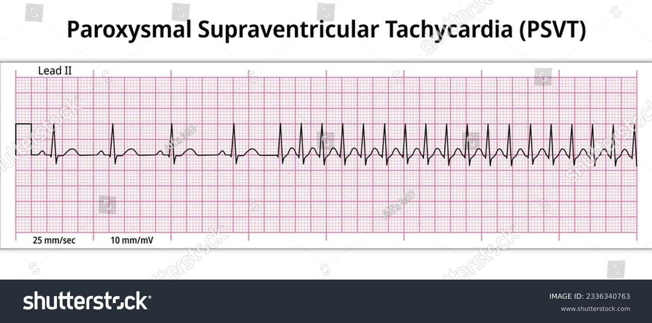
Ecg Paroxysmal Supraventricular Tachycardia

Slide 70
Heart Block (Overview)
Definition
Block of impulse transmission from SA node to ventricles.
Types
Sinoatrial block
AV block
Bundle branch block
Arborization block

Slide 71
Sino-Atrial Block
Mechanism
SA node impulse blocked before entering atria.
Characteristics
Sudden disappearance of P wave
Missing one full heartbeat
AV node may take over rhythm (escape rhythm)

Slide 72
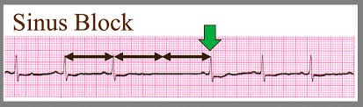
Sino-Atrial Block

Slide 73
Atrioventricular (AV) Block — Causes
Ischemia of AV node (CAD)
Compression by scar/calcification
Myocarditis (diphtheria, rheumatic fever)
Excess vagal stimulation (carotid sinus)

Slide 74
AV Block Types
1) First-Degree Block
All impulses are transmitted, PR interval prolonged > 220 ms
2) Second-Degree Block
Some impulses blocked (dropped beats)
Mobitz I (Wenckebach): Progressive PR lengthening → dropped QRS
Mobitz II:Sudden dropped QRS, No PR prolongation
More dangerous (often needs pacemaker)

Slide 75
Third-Degree Block (Complete Block)
No impulses reach ventricles
Atria & ventricles beat independently
P waves > QRS waves
Requires pacemaker

Slide 76
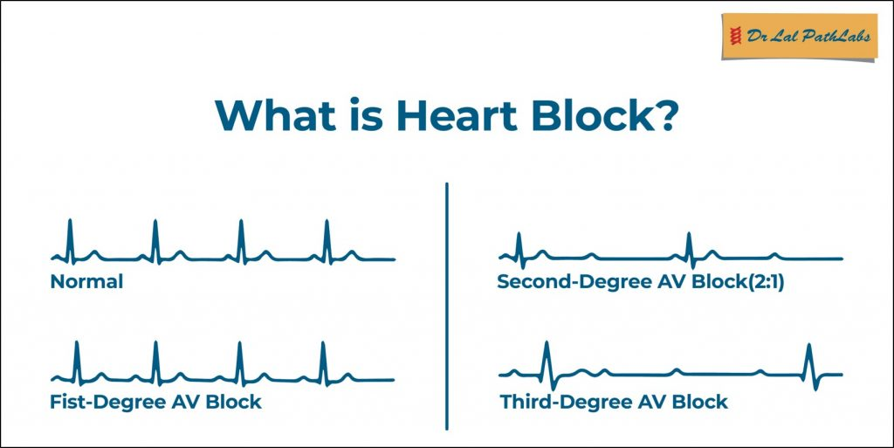

Slide 77
Arborization Block
Definition
Impulse blocked in Purkinje fiber arborization.
Found In
Chronic myocardial damage (scarring)
Cardiomyopathies

Slide 78
Bundle Branch Block (Right/Left)
Definition
Impulse blocked in either bundle branch.
Features
Normal ventricle contracts first
Blocked ventricle contracts later
Produces splitting of S1
QRS complex prolonged (>120 ms)

Slide 79
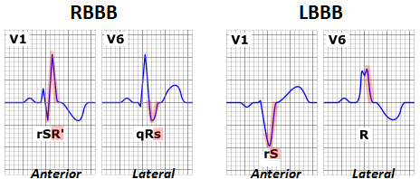
RBB vs LBB

Slide 80
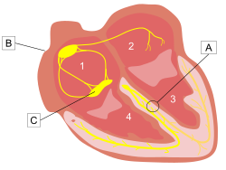
This image shows bundle branch block where the beating rhythm is hindered, but not stopped

Slide 81
Ventricular Escape
Occurs When
Ventricles stop when AV block occurs
After 4–10 sec → Purkinje fibers become pacemaker
Rate
15–40 bpm

Slide 82
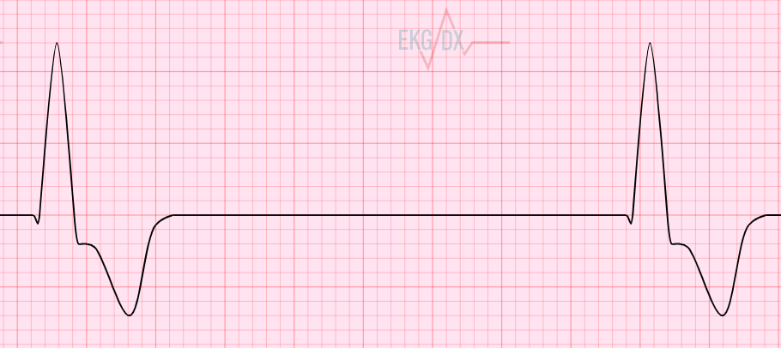
Ventricular Escape

Slide 83
Stokes–Adams Syndrome
Mechanism
In complete AV block → ventricles stop
Cerebral ischemia for 5–30 sec
Patient faints (syncope)
May Cause
Seizure-like movements
Sudden death if prolonged

Slide 84
Cardiac Arrest
Definition
Sudden cessation of rhythmic contractions.
Causes
Severe hypoxia
Deep anesthesia
SA node ischemia
Severe myocardial disease

Slide 85
Dextrocardia
Definition
Heart located on right side
Apex pointing right
Additional
May be part of situs inversus
ECG leads must be reversed for interpretation

Slide 86
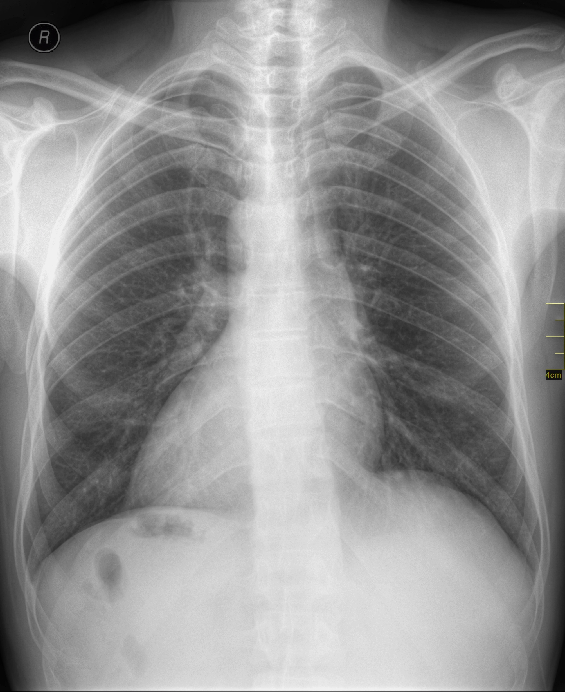
Chest X-ray

Slide 87


Slide 88


