Slide 1

GENERAL ANATOMY
BS RIT,MLT,OTT
1ST SEMESTER
DR DANISH

Slide 2
Gross Anatomy of a (Adult)Typical Long Bone
Main Parts
a. Shaft (Diaphysis)
  Cylindrical, forms the main body.
  Made mainly of compact (cortical) bone.
  Encloses medullary (marrow) cavity containing yellow marrow in adults.

Slide 3
CONTINUED
b. Ends (Epiphyses)
Expanded extremities of the bone.
Composed mainly of cancellous (spongy) bone with a thin outer shell of compact bone.
Contains red bone marrow (hematopoietic).
Articular surfaces covered by hyaline (articular) cartilage.

Slide 4
Coverings
Periosteum
Tough, fibrous membrane covering external surface (except articular areas).
Outer fibrous layer: dense connective tissue.
Inner osteogenic layer: contains osteoblasts for bone growth and repair.
Rich in blood vessels and nerves.
Site of attachment for tendons and ligaments.

Slide 5
CONTINUED
Endosteum
Thin vascular membrane lining medullary cavity.
Contains osteogenic cells.

Slide 6
Medullary Cavity
Central cavity in diaphysis.
Contains yellow (fatty) marrow in adults; red marrow in children.

Slide 7
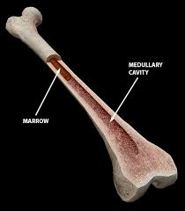

Slide 8
Articular Cartilage
Smooth, hyaline cartilage on epiphyseal surfaces at joints.
Reduces friction and absorbs shock.

Slide 9
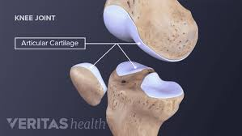

Slide 10
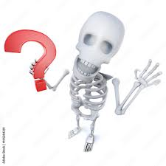

Slide 11


