Slide 1
Operating Theatre Ventilation
FSC(OT)
ADNAN RAMZAN

Slide 2
Operation theater ventilation is a specialized HVAC (heating, ventilation, and air conditioning) system designed to control airborne contamination in a surgical suite, thereby reducing the risk of surgical site infections (SSIs).
It works by
filtering
pressurizing air,
providing a flow of clean, sterile air towards the surgical field
efficiently removing contaminated air from the room.

Slide 3
Why is Ventilation So Crucial?
Goals:
Patient Safety: To reduce the risk of post-operative wound infections by controlling airborne bacteria and contaminants.
Comfort & Efficiency: To provide a comfortable environment (temperature, humidity) for the surgical team.
Cost-Effectiveness: A well-designed system lowers both infection rates and long-term operating costs.
Key Fact: A poor ventilation system can lead to unnecessary patient suffering and higher healthcare costs.

Slide 4
What Does Operating Room Ventilation Do?
The air supply has four main functions:
Dilute Contamination: Fresh air dilutes airborne germs and particles.
Control Airflow: Prevents dirty air from less clean areas flowing into the sterile operating zone.
Provide Comfort: Controls temperature and humidity for the surgical team.
Remove Hazards: Helps remove and dilute waste anesthetic gases

Slide 5
Types of Ventilation Systems
There are two main categories of ventilation systems used in operating theatres:
Mixing Ventilation
Parallel Flow Ventilation (often called Laminar Flow)
Notes:
Laminar mean in the form of layers with out turbulance

Slide 6
Mixing Ventilation
  The standard, older system.
  Supply air mixes rapidly with the room's existing air.
Parallel Flow Ventilation (often called Laminar Flow)
  The modern, ultra-clean system.
  Air flows in a steady, parallel stream without mixing.
Notes:
Steady mean constant

Slide 7
Mixing Ventilation
Air is supplied from diffusers in the ceiling.
The new air mixes with the old room air to dilute contaminants.
Disadvantages
Unstable Airflow: Air moves in an uncontrolled manner.
High Contamination: The area around the operating table can have twice the concentration of contaminants (like bacteria or anesthetic gases) compared to the rest of the room.
Inefficient: Not ideal for removing hazardous gases effectively

Slide 8
Parallel Flow (Laminar) Ventilation
clean air flowing straight down over an operating table
How it Works
A large bank of HEPA filters in the ceiling supplies ultra-clean air.
Air moves in a steady, parallel stream directly over the operating table, like a "curtain of clean air."
It pushes contaminants away from the sterile site and toward the floor for exhaust.

Slide 9
Advantages:
Creates an Ultra-Clean Zone directly over the patient.
Dramatically reduces the risk of airborne infection.
Highly effective for critical surgeries like joint replacements.

Slide 10
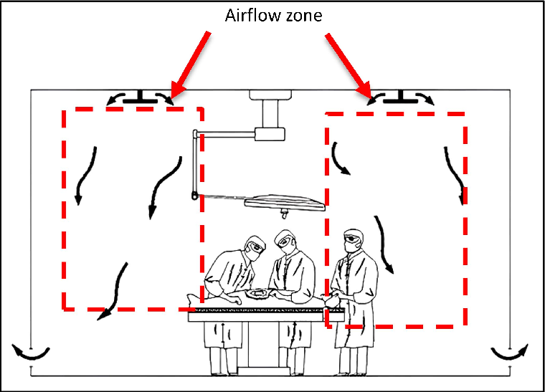
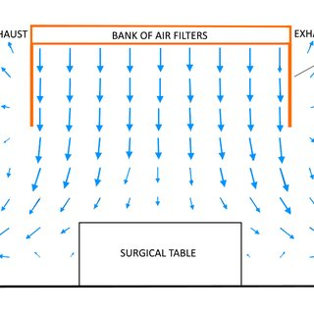

Slide 11
Challenge with Standards
Existing standards often focus only on:
  Number of air changes per hour.
  Particle concentration levels.
The Gap: These standards provide good baseline safety but don't directly guarantee a system that minimizes post-operative infections. The design must go beyond just meeting the standard.

Slide 12
Summary
Ventilation is Key: It is the most important system for preventing surgical site infections.
Choose the Right System: Parallel (Laminar) Flow is superior to Mixing Ventilation for creating an ultra-clean environment.
Design Matters: Every piece of equipment, from lights to surfaces, must be designed for easy cleaning and sterilization.

Slide 13
Maintenance is Safety: Regular, scheduled maintenance of ventilation and equipment is essential for patient and staff safety.
Think Beyond Standards: Good theatre design must aim for the lowest possible infection risk, not just compliance with minimum standards

Slide 14
Infection Control: Operating Theatre Lights
The design and maintenance of lights are critical for infection control.
Design Must-Haves:
Smooth Surfaces: Minimal cracks, crevices, or visible screws where dust and germs can hide.
Easy to Clean: Surfaces must be easy to wipe down without needing harsh chemicals.
Sterilizable Handles: Handles must be designed for easy sterilization.
Why? Dust and debris on lights can fall into the open surgical wound.

Slide 15
Maintenance of Equipment
6-Monthly Safety Checks: All parts of the light should be inspected every six months.
Battery Backup: A minimum 3-hour battery backup is standard.
Full Discharge Test: This test must be performed to ensure the lights can actually run for 3 hours during a power outage.
Proactive maintenance prevents equipment failure in the middle of a surgery.

Slide 16


