Slide 1
RIT-Magnetism & Its Applications
Fsc RIT
AWAIS HAMZA

Slide 2
Electromagnetic Induction
Electromagnetic induction is the production of an induced EMF when magnetic flux through a circuit changes.
Basis of generators, transformers, induction motors, inductors.
Magnetic flux (Φ) changes due to:
Change in magnetic field
Change in area
Change in orientation

Slide 3

Faraday’s Law of Electromagnetic Induction
The induced EMF is directly proportional to the rate of change of magnetic flux.
Faraday’s Law:
“N” = number of turns
Negative sign shows opposing nature of induced EMF (Lenz’s law).
Faster change = larger EMF.

Slide 4
Lenz’s Law
The direction of induced EMF is such that it opposes the change that produced it.
Demonstrated by the negative sign in Faraday’s law.
Explains:
Opposing currents in coils
Magnetic braking
Induced currents resisting motion

Slide 5

Self-Induction
When current in a coil changes, the coil induces an EMF in itself.
This induced EMF opposes change in current.
The property of a coil to induce EMF in itself is called self-inductance (L).
Formula:

Slide 6
Mutual Induction
When current changes in one coil, it induces an EMF in another nearby coil.
Basis of transformers, wireless charging, induction cookers.
Mutual inductance depends on:
Number of turns
Distance between coils
Core material (iron increases induction)

Slide 7
Eddy Currents
When a solid conductor is placed in a changing magnetic field, circular currents are produced.
These circulating currents are called eddy currents.
Effects:
  Heating of metals
  Power loss in transformers
  Magnetic braking in trains
Reduced by:
  Laminated iron cores
  Slotted cores

Slide 8

Transformers
A transformer changes AC voltage from one level to another.
Works on mutual induction.
Two coils:
  Primary coil (input AC)
  Secondary coil (output AC)
Types
Step-up: increases voltage
Step-down: decreases voltage
Transformer Equation

Slide 9
Transformer Components
Iron core: increases magnetic flux
Primary coil
Secondary coil
Insulation
Tank with cooling oil
Laminated core (reduces eddy currents)

Slide 10

Ideal Transformer
No energy losses
100% efficiency
No eddy currents, heat losses, flux leakage
Power conservation:

Slide 11
Introduction to AC (Alternating Current)
AC changes direction and magnitude continuously.
Represented by a sine wave.
AC quantities:
Amplitude
Frequency
Time period
RMS values

Slide 12
Tesla’s Polyphase System
Introduced by Nikola Tesla.
Uses three-phase AC.
Advantages:
  Smooth rotation in motors
  Higher efficiency
  Less power loss
  Self-starting motors
Used in:
Power plants
Industry
Transmission systems

Slide 13

Power Grid Distribution
Steps:
Generation (power stations)
Step-up transformers (very high voltage transmission)
Transmission lines
Step-down transformers at grid stations
Distribution to homes and industries
Reason for using high voltage
Reduces current
Reduces power loss

Slide 14
Transformer Theory
Based on mutual induction.
Changing AC current in primary produces changing magnetic flux in the core.
This flux links with secondary coil → induces EMF.
Efficiency affected by:
  Copper losses
  Eddy current losses
  Hysteresis losses
  Flux leakage

Slide 15
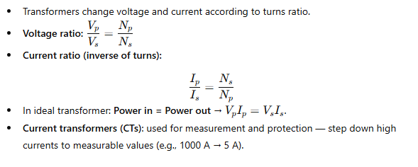
Current Transformation (Current Ratio)

Slide 16
Working Principle of a Transformer (Recap)
AC in primary coil → produces alternating magnetic flux in core.
Flux links the secondary coil → by mutual induction an EMF is induced.
Secondary EMF magnitude depends on turns ratio and rate of flux change.
Requires AC supply (no steady DC operation).

Slide 17
Transformer Core & Core Medium
Purpose: Provide low reluctance path for magnetic flux and improve coupling.
Core materials:
Laminated silicon steel (power transformers) — reduces eddy currents.
Amorphous metal (low core losses) — used for energy-efficient transformers.
Ferrite cores (high frequency devices, e.g., SMPS) — low eddy & hysteresis at high freq.
Core shapes / types: core-type, shell-type, toroidal (circular).

Slide 18
Core-Type vs Shell-Type vs Toroidal
Core-type: windings on two limbs of rectangular core — common for power transformers.
Shell-type: core surrounds windings — better short-circuit strength and flux containment.
Toroidal: doughnut-shaped core — compact, low leakage flux, low noise, used in audio & precision equipment.

Slide 19
Transformer Core Saturation
Saturation: when increasing magnetizing force (H) no longer increases flux density (B) linearly.
Causes: excessive flux (over-voltage), DC offset in supply, magnetizing current transients.
Effects: distorted output waveform, high magnetizing current, overheating, buzzing, increased losses.
Prevention: design margin (operate below knee of B–H curve), use proper core material, avoid DC on AC circuits, use air gap in some inductors.

Slide 20
Transformer Losses & Efficiency
Loss types:
Copper losses (I2^22R): in windings, proportional to load2^22.
Core (iron) losses: frequency dependent
  Hysteresis loss — due to magnetisation cycles, ∝ frequency.
  Eddy current loss — induced currents in core, reduced by lamination.
Stray losses: leakage flux heating tank and supports.
Dielectric & mechanical losses (minor).
Typical efficiency: large power transformers ≈ 98–99% at rated load; small transformers lower.
Max efficiency occurs near rated load where copper loss ≈ core loss.

Slide 21
Cooling Methods (Transformer Cooling)
Air-cooled (Dry type): natural air convection, used indoors/smaller units.
Oil-immersed (Liquid cooled):
ONAN — Oil Natural, Air Natural (natural convection of oil and air).
ONAF — Oil Natural, Air Forced (fans accelerate cooling).
OFAF / OFWF — Oil Forced, Air/Water Forced (pumps and heat exchangers).
Water-cooled: for very large units or special installations.
Cooling increases rating and life; oil also provides insulation.

Slide 22
Transformer Types (Classification)
By Phase: Single-phase, Three-phase.
By Core Construction: Core-type, Shell-type, Toroidal.
By Cooling: Dry-type, Oil-immersed (ONAN, ONAF etc.), Water-cooled.
By Mounting / Location: Pole-mounted, Pad-mounted (ground), Substation (indoor/outdoor).
By Purpose: Power transformer, Distribution transformer, Instrument transformer (CT, PT), Isolation transformer, Autotransformer, Pulse transformer.

Slide 23
By Installation / Location
Pole-mounted: outdoors on poles for rural distribution.
Pad-mounted: ground-mounted, fenced, used in residential/commercial areas.
Substation transformers: large, installed in substations (indoor/outdoor).
Indoor dry-type: in buildings, limited fire/safety hazards.

Slide 24
Autotransformer (Special Type)
Single winding acts as both primary & secondary with taps.
Advantages: smaller, cheaper, lighter for same VA.
Disadvantages: not galvanically isolated (primary & secondary connected), limited voltage change range.

Slide 25
Instrument Transformers: CT & PT
Current Transformer (CT):
Steps down high current to standard secondary (e.g., 5 A).
Used for metering and protection.
Accuracy depends on burden and class (e.g., 0.5, 1.0).
Potential/Voltage Transformer (PT/VT):
Steps down high voltage for meters/relays (e.g., 11 kV → 110 V).
Provides isolation and accurate voltage measurement.

Slide 26
Applications of Transformers
Power distribution: step-up at generating stations, step-down near consumers.
Isolation: separate circuits for safety.
Impedance matching: audio systems and radio.
Measurement & protection: CTs and PTs for meters and relays.
Voltage stabilization: via tap changers.
Special: welding transformers, furnace transformers, SMPS transformers (high freq).

Slide 27
Eddy Currents — Recap (with Prevention)
Induced in conducting parts where flux changes.
Problems: heating, energy loss, core noise.
Prevention: use laminated cores, insulated windings, slots, or ferrite cores at high frequencies.

Slide 28
Parts of a Single-Phase Transformer
Core: Provides magnetic path for flux
Primary winding: Connected to input AC supply
Secondary winding: Connected to load; delivers transformed voltage
Insulation: Separates windings and prevents short circuits
Tank: Contains oil (in oil-filled types) and provides protection
Cooling system: Air-cooled or oil-cooled

Slide 29
Parts of a Single-Phase Transformer
Conservator: Maintains oil level (oil transformers)
Breather: Removes moisture from air entering conservator
Bushings: Insulated terminals for HV and LV connections
Tap changer: Adjusts voltage ratio

Slide 30
Transformer Core
Made of laminated silicon steel to reduce eddy current losses
Provides low reluctance path for alternating magnetic flux
Two main types:
Core type: Windings around two limbs
Shell type: Windings surrounded by core on three sides
Functions:
Carry alternating flux, Minimize losses, Improve coupling between windings

Slide 31
Windings in a Transformer
Primary Winding
Connected to AC supply
Produces alternating magnetic flux in core
Current depends on input voltage and load on secondary
Secondary Winding
Receives magnetic flux and produces induced EMF
Supplies electrical load
Voltage depends on turns ratio

Slide 32
Insulation in Transformer
Used to prevent electrical contact between windings and core
Materials:
  Paper insulation (kraft paper)
  Varnish
  Pressboard
  Transformer oil (insulating + cooling medium in oil-filled transformers)
Insulation must withstand:
  High voltage, Heat, Moisture, Mechanical stress

Slide 33
Insulating Agents
Solid insulation: paper, cardboard, epoxy resin
Liquid insulation: transformer oil (mineral oil), synthetic oils
Gaseous insulation: air, SF₆ (for special transformers)
Functions:
  Provide dielectric strength
  Prevent short circuits
  Aid cooling (liquid insulation)

Slide 34
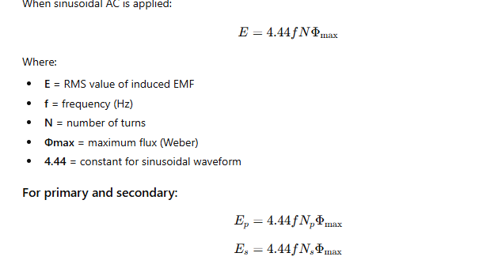
EMF Equation of a Transformer

Slide 35
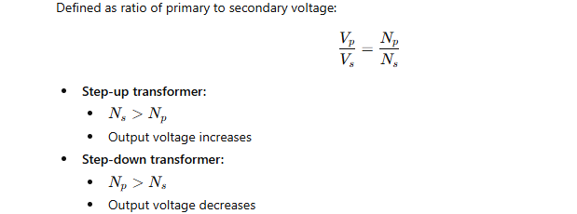
Voltage Transformation Ratio (Turns Ratio)

Slide 36
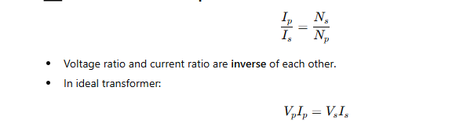
Current Ratio

Slide 37
Magnetic Flux Path in a Single-Phase Transformer
AC current in primary → produces alternating flux in core
Flux links both windings
Induces EMF in secondary by mutual induction

Slide 38
Practical Aspects of Transformer Models
Require high compute (GPUs/TPUs) for training
Scales extremely well with model size
Training dominated by matrix multiplications
Sensitive to batch size, learning rate, and tokenization quality
Memory usage grows with sequence length² (self-attention cost)
Used in: NLP, vision, speech, genomics, multimodal tasks

Slide 39
Transformer Architecture (High-Level)
Encoder: Processes input sequence
Decoder: Generates output sequence (e.g., translation)
Each block contains:
Multi-Head Self Attention (MHSA)
Layer Normalization
Feed Forward Network (FFN)
Residual / skip connections
Fully parallelized — no recurrence, no convolution

Slide 40
Model Size (Parameters & Scaling)
Controlled by:
Number of layers (depth)
Hidden dimension (width)
Attention heads
Feed-forward size (usually 4× hidden dim) Small: <100M parameters (BERT-base: 110M)Medium: ~1–10B parameters
Large-scale: 10B–1T+ parameters
Performance improves predictably with scale (scaling laws)

Slide 41
Attention Masks
Padding mask:
Prevents model from attending to padded tokens
Causal/Decoder mask:
Prevents looking ahead into future tokens
Used for autoregressive (GPT-style) models
Encoder–decoder mask:
Controls cross-attention in seq2seq models

Slide 42
Positional Encoding
Transformers have no recurrence, so need positional info.
Two types:
1. Sinusoidal Positional Encoding (Original)
Deterministic,Can extrapolate to longer sequences,Uses sine/cosine functions of different wavelengths
2. Learned Positional Embeddings
Trainable parameters, Adapt better to dataset structure, Limited to max sequence used during training

Slide 43
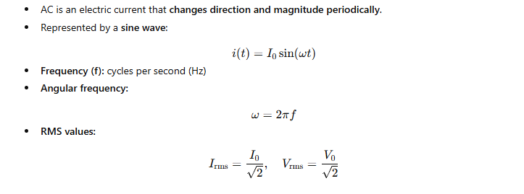
AC (Alternating Current) — Introduction

Slide 44
Types of AC Circuits
Resistive (R) – only resistors
Inductive (L) – only coils
Capacitive (C) – only capacitors
RC – resistor + capacitor
RL – resistor + inductor
RLC – resistor + inductor + capacitor

Slide 45
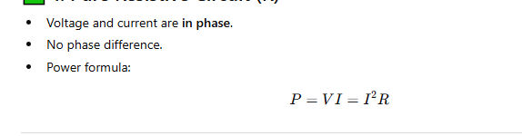
Pure Resistive Circuit (R)

Slide 46
Pure Inductive Circuit (L)
Current lags behind voltage by 90°
Voltage rises first, current comes later.
Inductor opposes change in current.

Slide 47
Pure Capacitive Circuit (C)
Current leads voltage by 90°
Voltage rises after current.
Capacitor stores energy in electric field.

Slide 48
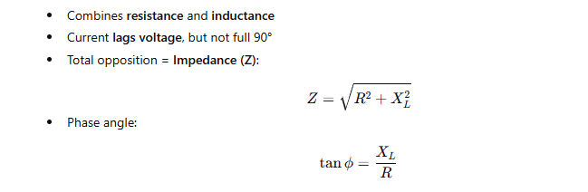
RL Circuit (Resistor + Inductor)

Slide 49
RC Circuit (Resistor + Capacitor)
Combines resistance and capacitance
Current leads voltage, but not full 90°

Slide 50
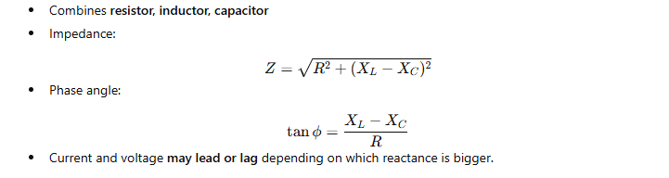
RLC Series Circuit

Slide 51
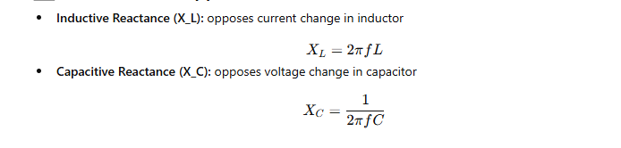
Reactance (Opposition to AC)

Slide 52
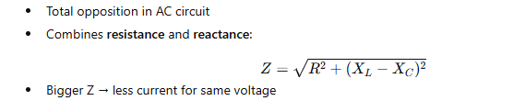
Impedance (Z)

