Slide 1
The cardiovascular system
BS Hons
AWAIS HAMZA

Slide 2
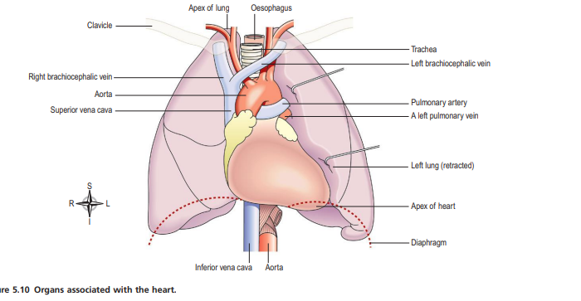

Slide 3
Cardiovascular System: Introduction
Cardiovascular (Cardio = heart, Vascular = blood vessels)
The system is divided into two main parts:
The heart
→ pumping action ensures constant blood circulation.
The blood vessels
→ long, branching network through which blood flows.

Slide 4
Dual Circulatory System
The heart pumps blood into two anatomically separate circulations:
Pulmonary circulation
Systemic circulation

Slide 5
Functional Anatomy of the Cardiac System
The cardiac system consists of:
Heart → muscular pump
Blood vessels → arteries, arterioles, capillaries, venules, veins
Pulmonary circulation → heart ↔ lungs
Systemic circulation → heart ↔ tissues

Slide 6
Pulmonary Circulation (Right Heart)
Right side of the heart → Lungs
Functions:
Gas exchange
Blood collects oxygen from air sacs (alveoli)
Excess CO₂ diffuses into alveoli → exhaled

Slide 7
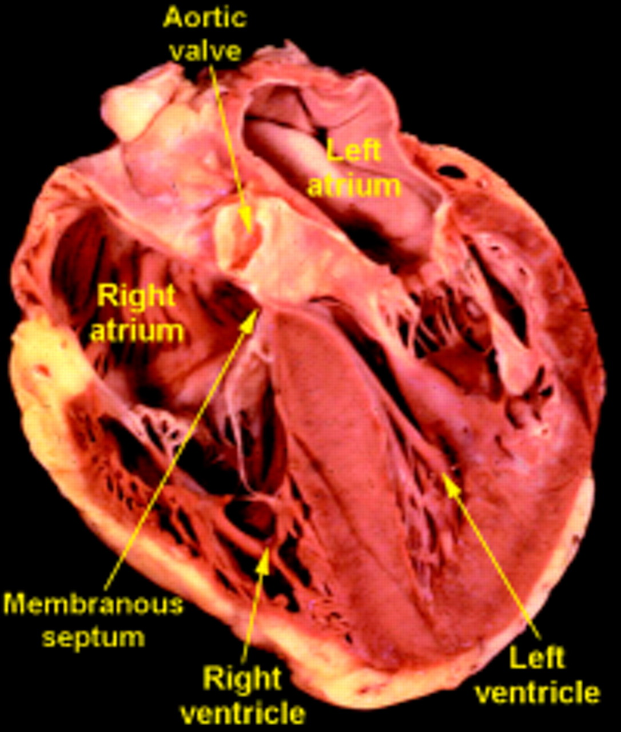
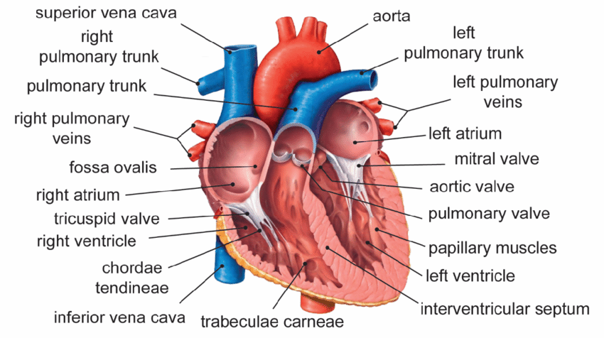

Slide 8
The Heart: Location & Orientation
Located in mediastinum, between lungs
2/3 lies left of midline
Apex → left 5th intercostal space, mid-clavicular line
Base → superior, toward right shoulder

Slide 9
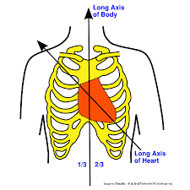
Position

Slide 10
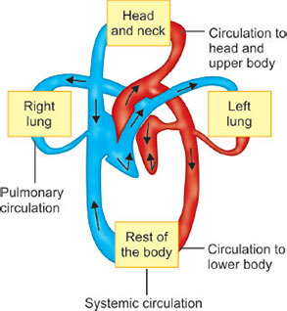

Slide 11
Systemic Circulation (Left Heart)
Left side of the heart → Whole body
Functions:
Supplies all tissues with oxygen & nutrients
Collects tissue wastes for excretion
Cells extract glucose, amino acids, ions, oxygen from blood

Slide 12
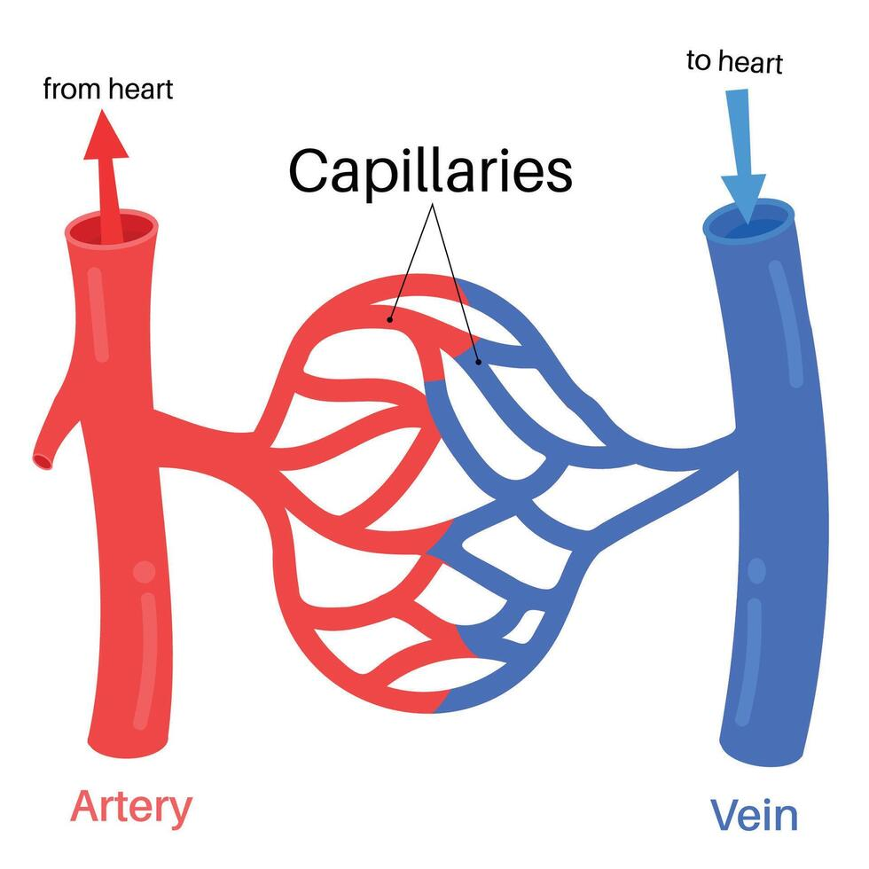

Slide 13
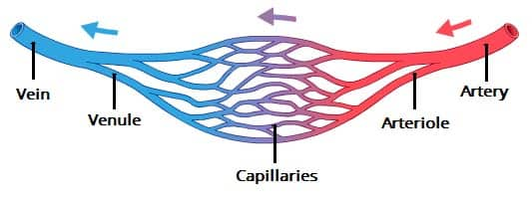

Slide 14
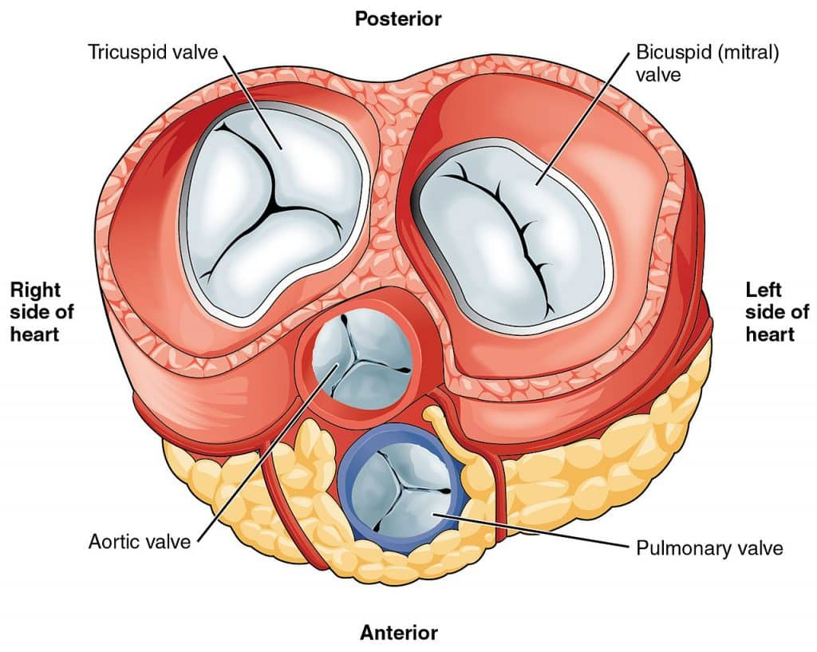

Slide 15
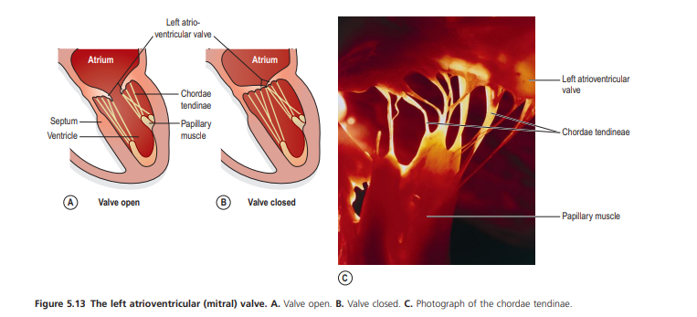

Slide 16
Cardiovascular Adaptation
Cardiovascular function undergoes constant physiological adjustments to meet body demands.
Examples:
Exercise → ↑ cardiac output
Stress → ↑ HR & BP
Rest → ↓ HR
Posture change → baroreceptor reflex maintains BP

Slide 17
Age-Related Changes
Cardiovascular function declines with age
Effects include:
Reduced elasticity of blood vessels
Increased BP
Slower heart responses
Higher risk of arrhythmias & valve defects

Slide 18
Layers of the Heart Wall
Pericardium
Fibrous pericardium,Serous pericardium: parietal + visceral (epicardium)
Pericardial cavity with fluid → reduces friction
Myocardium
Thick cardiac muscle layer, Contains contractile fibers + conduction system
Endocardium
Smooth endothelial layer, Lines chambers & valves

Slide 19
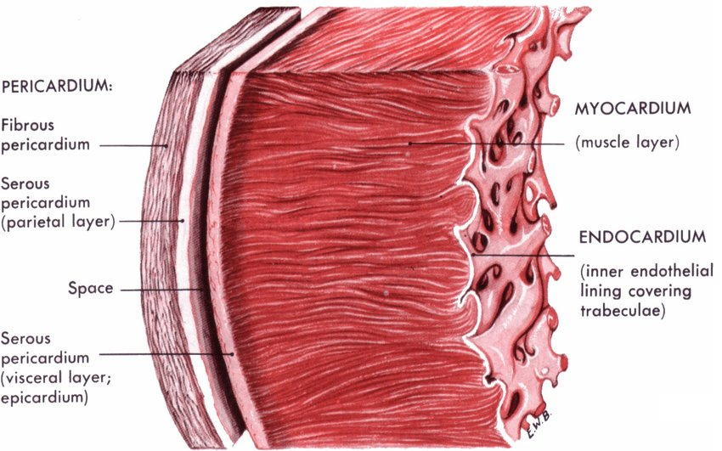
Layers of the Heart Wall

Slide 20
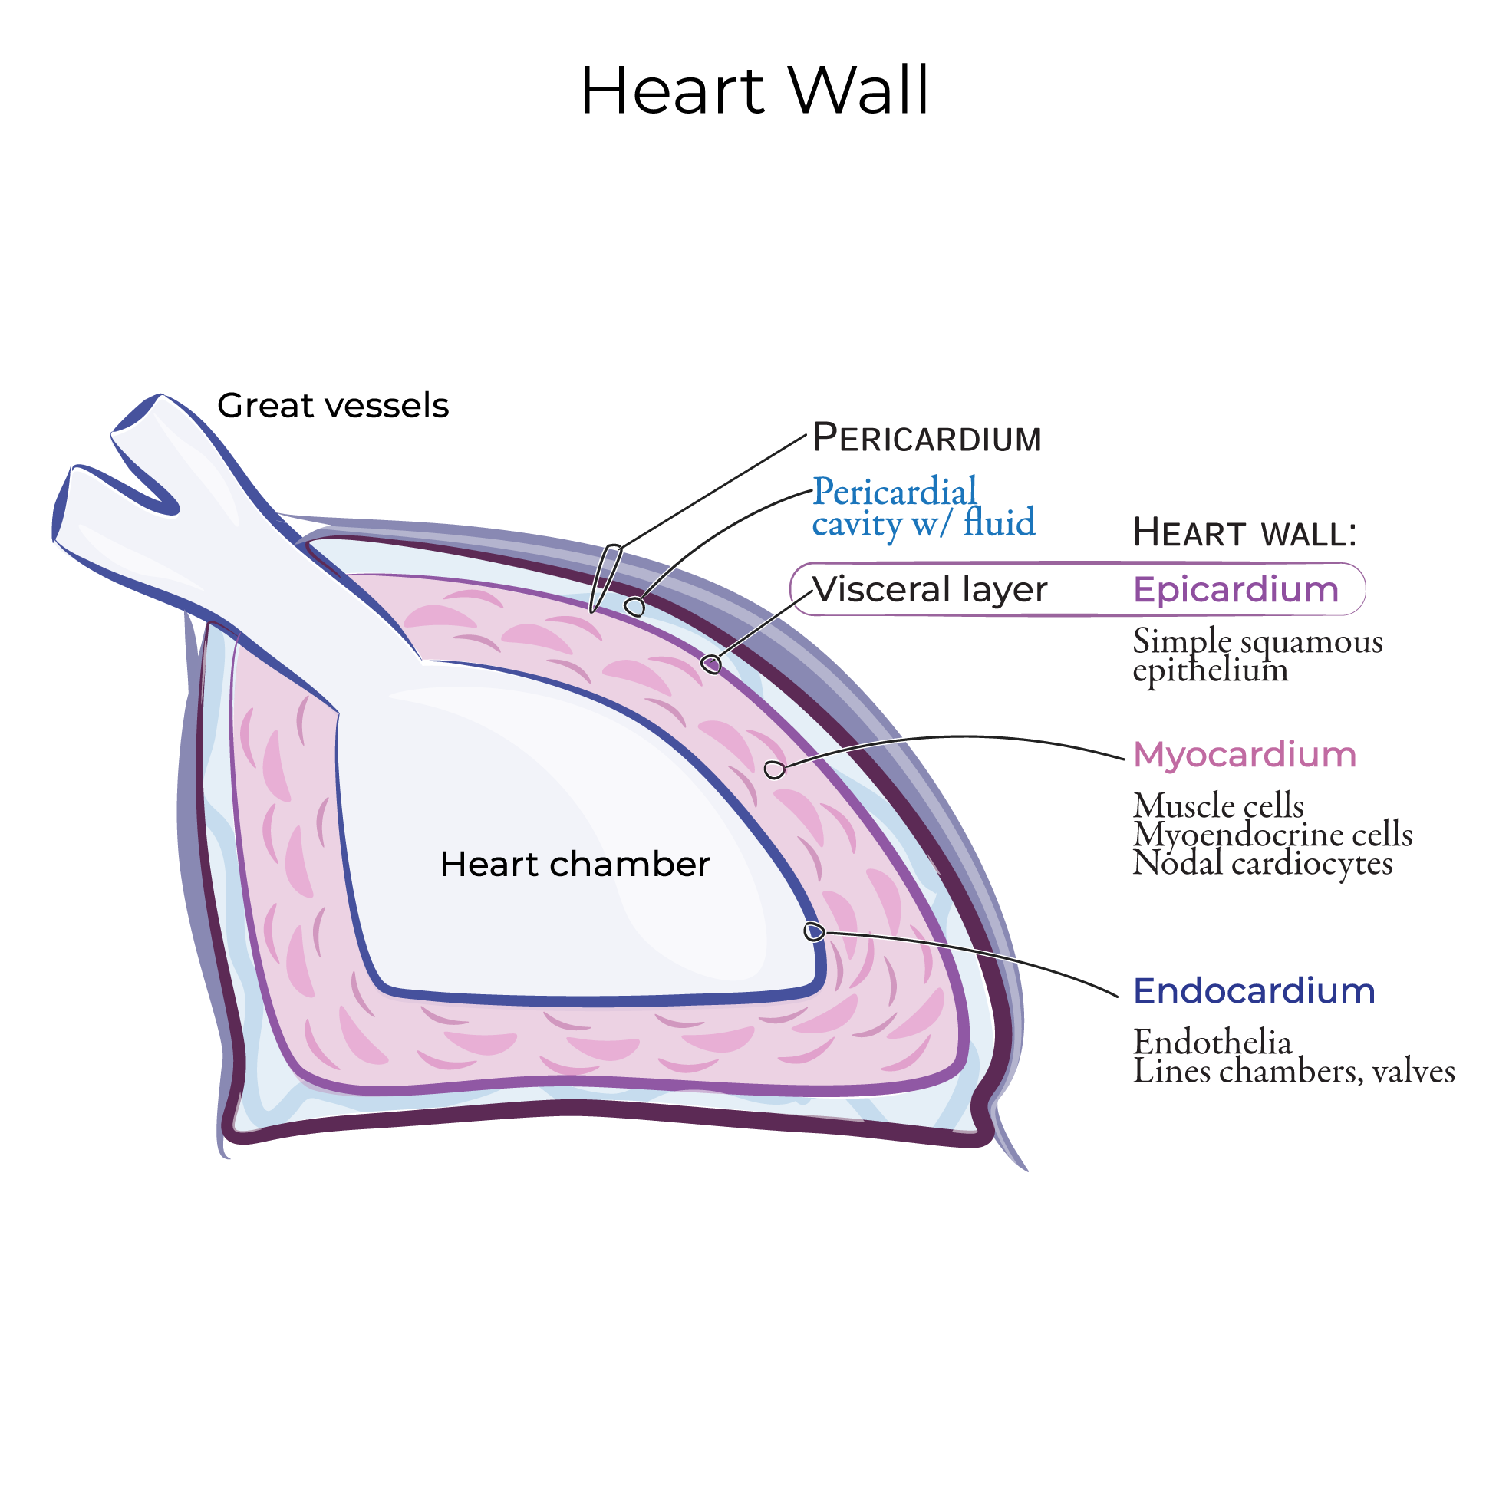

Slide 21
Chambers of the Heart
Right Atrium
Receives ** deoxygenated blood**: SVC, IVC, coronary sinus
Contains SA node
Right Ventricle
Pumps blood → pulmonary trunk
Thin-walled (low pressure)

Slide 22
Chambers of the Heart
Left Atrium
Receives oxygenated blood from 4 pulmonary veins
Left Ventricle
Thickest wall
Pumps blood to whole body via aorta
Highest pressure chamber

Slide 23
Heart Valves (Functional Anatomy)
Atrioventricular (AV) valves
Tricuspid (right)
Mitral/Bicuspid (left Function: Prevent backflow from ventricles → atria
Chordae tendineae + papillary muscles: Prevent valve prolapse during ventricular systole
Semilunar valves
Pulmonary valve
Aortic valve

Slide 24
Coronary Circulation
Heart muscle receives blood via:
Right & left coronary arteries (from aortic root)
Branch into: LAD, circumflex, marginal, PDA, etc.
Coronary veins → coronary sinus → right atrium
High-yield physiology
Maximal coronary perfusion during diastole
LV hypertrophy ↓ coronary flow (increased wall thickness)

Slide 25
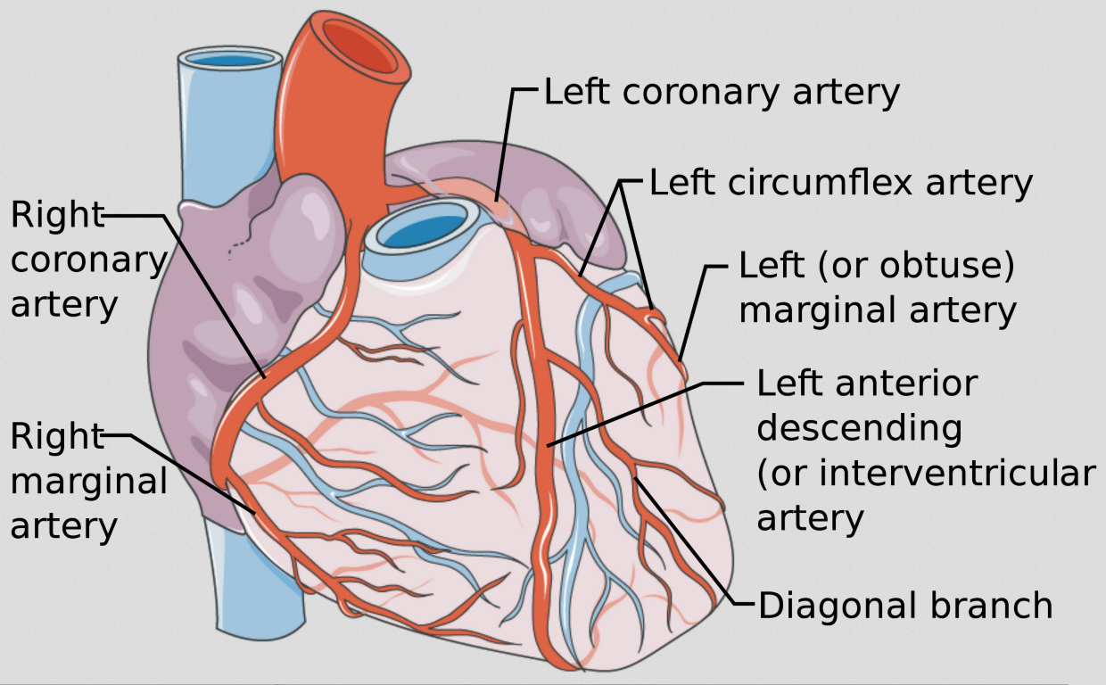
Coronary Circulation

Slide 26
Cardiac Conduction System Components
SA Node → primary pacemaker
AV Node → slows conduction (AV delay)
Bundle of His → only bridge atria–ventricles
Right & left bundle branches
Purkinje fibers → rapid conduction → coordinated contraction

Slide 27
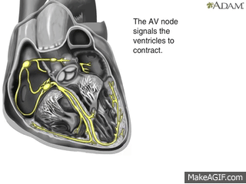
Cardiac Conduction System

Slide 28
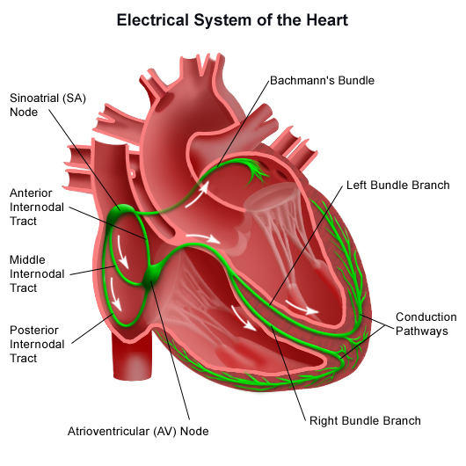
Cardiac Conduction System

Slide 29
Blood Supply to Conduction System
SA node → RCA (60%) or LCA (40%)
AV node → RCA (85–90%)
Bundle branches → LAD
Purkinje network → LAD + RCA branches
Damage → arrhythmias or heart block

Slide 30
Cardiac Muscle Functional Anatomy
Characteristics:
Striated, branched cells
Intercalated discs
Gap junctions → electrical syncytium
Desmosomes → mechanical strength
High mitochondrial density → fatigue resistant

Slide 31
Functional Anatomy of the Pulmonary Circulation
Right ventricle → pulmonary trunk → pulmonary arteries → lungs → pulmonary veins → left atrium
Features:
Low pressure (15–25 mmHg)
Thin-walled RV
Gas exchange in alveoli

Slide 32
Functional Anatomy of the Systemic Circulation
Left ventricle → aorta → arteries → arterioles → capillaries → venules → veins → right atrium
Features:
High pressure system
Arterioles are primary resistance vessels
Capillaries → exchange of nutrients/gases
Veins → act as blood reservoirs (70%)

Slide 33
Lymphatic System
Drains excess interstitial fluid
Returns proteins & lymph to bloodstream
Filters pathogens
Works closely with CV system to maintain fluid balance

Slide 34
Arteries & Arterioles
Function:
These vessels transport blood away from the heart.
Structure:
All arteries and arterioles have three wall layers
Tunica adventitia Outer fibrous tissue layer
Tunica media Middle layer of smooth muscle + elastic tissue
Tunica intima Inner lining of squamous epithelium (endothelium)

Slide 35
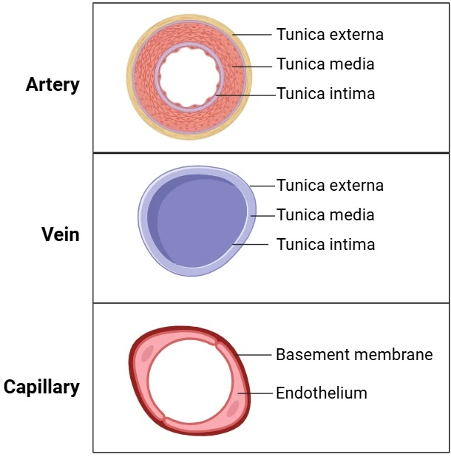

Slide 36
Differences in Arterial Structure
Elastic Arteries (Aorta & Major Arteries)
Tunica media → more elastic fibers, fewer smooth muscle cells
  Stretch during systole, Absorb high-pressure wave from the heart
  Recoil in diastole (Windkessel effect)
Muscular Arteries → Arterioles
As arteries branch and become smaller:
  Tunica media becomes mostly smooth muscle, Elastic fibers decrease

Slide 37
Arterioles: Resistance Vessels
Arterioles = smallest arteries
Tunica media almost entirely smooth muscle
Their diameter is precisely regulated
Systemic blood pressure is mainly determined by:
  The resistance they offer to blood flow
  → Hence called resistance vessels

Slide 38
Structural Difference: Arteries vs Veins
Arteries have thicker walls than veins
Reason:
Must withstand higher pressure of arterial blood
Have more smooth muscle & elastic tissue

Slide 39
Anastomoses
Definition:
Arteries that connect to form a link between main arteries supplying the same area.
Examples:
Palms of hands
Soles of feet
Brain
Joints
Limited presence in heart muscle

Slide 40
End-Arteries
Definition:
Artery that is the sole supply of blood to a tissue.
Examples:
Branches of the Circle of Willis
Central artery of the retina
Clinical Significance:
→ Occlusion → complete tissue death
→ No collateral supply

Slide 41
Capillaries
Capillary Wall Structure:
Single layer of endothelial cells
Thin basement membrane
Allows passage of:
  Water, Electrolytes, Small molecules
Does not allow:
  Large molecules (proteins),Blood cells

Slide 42
Capillary Network & Function
Capillaries link smallest arterioles to smallest venules
Diameter ≈ 7 μm (same as RBC)
Site of exchange:
O₂
CO₂
Nutrients
Wastes

Slide 43
Precapillary Sphincters
Entry to capillary beds is controlled by rings of smooth muscle
Called precapillary sphincters
Regulated by:
Hypoxia → sphincters dilate
Accumulation of tissue waste
High metabolic activity

Slide 44
Sinusoids (Special Capillaries)
Locations:
Liver
Bone marrow
Spleen (not mentioned but relevant)
Characteristics:
Wider, irregular lumen
Leaky walls (incomplete endothelial lining)
Blood flows slowly and at low pressure

Slide 45
Capillary Refill Time
Test:
Press skin → turns pale
Time to become pink again = capillary refill time
Normal:
→ < 2 seconds
Prolonged refill suggests:
Poor perfusion, Shock, Dehydration
Low cardiac output

Slide 46
Veins & Venules
Function:
Veins return blood at low pressure to the heart.
Wall Structure:
Same three layers as arteries
Tunica adventitia
Tunica media
Tunica intima

Slide 47
Structural & Functional Comparison
When cut:
Veins collapse (thin walls, low pressure)
Arteries remain open (thicker walls)
Blood flow:
Artery cut → spurting, high-pressure jets
Vein cut → slow, steady flow

Slide 48
Venous Valves
Structure:
Formed by folds of tunica intima
Reinforced with connective tissue
Semilunar cusps with concavity toward the heart
Location:
Abundant in limb veins, especially lower limbs
Absent in:
  Very small veins, Very large veins, Thorax & abdominal veins

Slide 49
Venules
Definition:
The smallest veins, formed by the union of capillaries.
Functions:
Begin venous return pathway
Participate in exchange (especially post-capillary venules)
Important in:
  Inflammation
  White cell migration

