Slide 1

GENERAL ANATOMY
DPT
1ST SEMESTER
DR DANISH

Slide 2
Grooves and holes
Introduction:
Holes and grooves fall under the category of openings/depressions
These allow passage of nerves, blood vessels, tendons, etc.

Slide 3
Foramen
A hole through bone.
Example: Foramen magnum large hole at base of skull through which the spinal cord passes.
Nutrient foramen of humerus

Slide 4
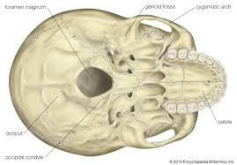

Slide 5
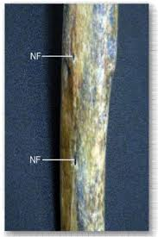

Slide 6
Meatus
An opening into a canal (a type of “hole”).
Example:external auditory meatus in temporal bone of skull

Slide 7
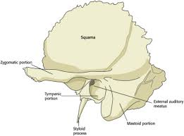
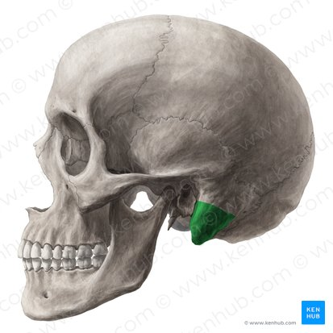

Slide 8
Fissure
A slit or narrow opening/groove.
Superior and inferior orbital fissures in orbital cavity of skull

Slide 9
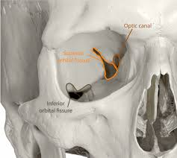

Slide 10
Sulcus / Groove:
a furrow or trench in the bone surface, often for vessels, nerves, or tendons.
Intertubercular sulcus of humerus

Slide 11
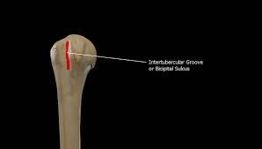

Slide 12
Heatus
A gap or opening in the bone for passage of nerves and blood vessels etc
Example: sacral hiatus on dorsal surface of sacrum

Slide 13
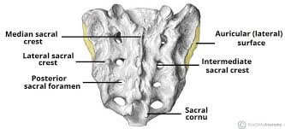

Slide 14


Slide 15


